Slide 1
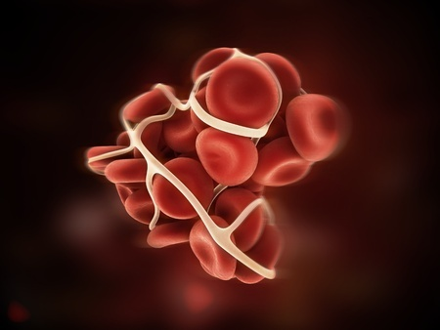
Venous thromboembolism

Slide 2
Learning objectives
Gain organised knowledge in the subject area VTE
Be able to correctly interpret diagnostic information in suspected VTE
Know and apply the relevant evidence and/or guidelines to different clinical presentations of VTE
Notes:
Learning objectives always the same for each topic …

Slide 3
Cases

Slide 4
Case 1
A 45 year old man presented to Ambulatory Care with right leg swelling and pain, which had occurred spontaneously over the last 3 days
On examination, his right calf was 5cm wider than the left
His only past medical history was hypertension

Slide 5
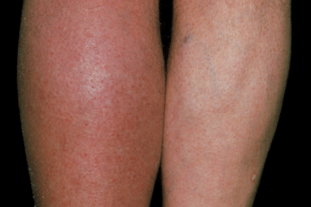
Doppler USS of the right leg showed a femoral vein thrombosis
Notes:
What should be done at this point?
Would you do a d dimer? – no. High Wells Score – straight to imaging.
Bloods for FBC, U&E, LFT, baseline clotting (all related to proposed treatment with LMWH/warfarin)

Slide 6
Exercise
In small groups answer the following Qs:
What is the management in this case? (pharmacological and non-pharmacological)
What is the duration of anti-coagulation?
What further investigations should be performed?
What follow-up is required?
Notes:
Treatment options –
Anticoagulation (LMWH plus warfarin – stop LMWH after a min of 5 days treatment or two therapeutic INRs - whichever is sooner)
Do not offer elastic graduated compression stockings to prevent post-thrombotic syndrome or VTE recurrence after a proximal DVT. This recommendation does not cover the use of elastic stockings for the management of leg symptoms after DVT. [new 2015]
Elevate leg when resting, walk plenty and no long haul travel for 2 weeks
Counselling re anticoagulant therapy and written information /card (v important)
Decision re duration of anti-coagulation:
In ALL cases of unprovoked DVT they need screening for cancer: history and examination, CXR, bloods (incl FBC, calcium/LFTs), urinalysis.
In patients aged over 40 who do not have signs/symptoms of cancer based on this initial screen, consider abdo/pelvis CT and mammogram for women.
How many of your departments do this in every case?
Studies have suggested that among patients with VTE, a large number of the cancers most commonly found are those in the abdomen and pelvic areas (ovary, pancreas, liver, kidney colon). Adopting an intensive testing strategy which involves ultrasound scans, antigen tests, tumour markers, FOB, PSA or colonoscopy increases false positives without significant increases in sensitivity.
9.4% of patients with first episode unprovoked VTE who underwent the baseline routine tests had cancer detected. Over the course of 2 years, an additional 24/201(11.9%) developed cancer. These overall rates of an underlying cancer in patients with an unproved VTE are consistent with data from multiple large published registry studies. There were no cancers detected in the above study in pts under the age of 40.
The recommendation is limited to patients with an apparently unprovoked VTE (as in the study), which represents only 20% of patients with a VTE, and further restricting it to patients over the age of 40years, in whom a cancer has not been detected by routine investigations, will significantly limit the workload and capacity impact on the NHS, of this recommendation while potentially maximising benefit.
Test for thrombophilia in patients with unprovoked DVT in whom it is planned to stop treatment. Don’t test people on treatment.

Slide 7
Duration of treatment?
Question:
What is the risk of a recurrent DVT in a 30 year old man who presents with a single unprovoked DVT?
Cancer patients
6 months then review risks/benefits
LMWH only
Provoked DVT/PE
3 months then review risks/benefits
Unprovoked DVT/PE
6 months then review risks/benefits
Notes:
What’s the risk of a recurrent DVT in a 30 year old man who presents with a single unprovoked DVT??
Answer:
When a major reversible risk factor such as surgery can be identified as the sole explanation for VTE, then the risk of recurrence is relatively low (i.e. ≈3% in the first year).
In contrast, the risk is high (≈10% in the first year) in patients with unprovoked (“idiopathic”) VTE and in those with persistent, irreversible, or other risk factors.
Recurrence of thrombosis is 31.6% in the first 6 months of IVDU pts
Patients should be counselled re this.
What about IVDUs?? – 6 months LMWH +DOACs then review risks/benefits. Look out for other complications at presentation: infected DVT, bacteraemia, groin abscess etc. Some reports of Vit K deficiency, chaotic lifestyle and interaction with methadone/HIV meds means warfarin inappropriate.
Who is following DVT patients up in your hospital??

Slide 8
Lower limb DVT: summary (NICE)
?DVT → history, exam and Wells Score
If DVT suspected plus Wells = likely then do a proximal Doppler USS (whole leg not recommended)
NICE recommends doing a d dimer in likely cases so that if the proximal scan is negative they can be offered a repeat scan in one week if their d dimer is high …
This is because proximal scans may miss calf DVTs that could extend – you don’t need a repeat scan if a whole leg USS was performed first
If DVT suspected plus Wells = unlikely then get a d dimer, if positive get a scan, if negative DVT is virtually excluded
For all cases, if you can’t get a Doppler within 4 hours then treat and get a scan within 24 hours
Consider and communicate alternative explanations for symptoms in patients with negative scans
Don’t forget to arrange further investigations/FU for new DVT cases
Notes:
History and examination is KEY! If the history is clearly not a DVT at all, don’t even go here – for example trauma/ ruptured head of gastrocnemius while running for the bus, calf tears etc.
How many of your depts follow this guideline?
D-dimer tests have relatively high sensitivity but low specificity (false positive results common). When the sensitivity of a d-dimer test increase, its specificity decreases. To be useful in the diagnosis of DVT, a D-dimer test has high sensitivity and high negative value - fewer people with DVT will be missed. Therefore, a negative D-dimer may be useful in excluding DVT but a positive D-dimer is of no diagnostic value, it merely mandates further testing. Whilst a negative D-dimer test is good enough to exclude the diagnosis of DVT in a patient with an “unlikely” pre-test clinical probability it is not good enough in those with a “likely” pre-test probability.
The Guideline Development Group had recommended proximal leg vein ultrasound scans as the clinical importance of picking up extra calf vein blood clots by scanning the whole leg is uncertain. Moreover, the evidence review suggested that ultrasound scan of calf veins are not very sensitive in picking up calf vein DVT. A repeat proximal leg vein scan is recommended to ensure that any clots propagating to the proximal veins are not missed. Therefore: STOP anticoagulation for 1 week.
The GDG also modelled that an above-knee ultrasound with a repeat if negative is more cost-effective than a single above-knee or full-leg ultrasound scan.

Slide 9
DVT follow up
Investigations for cancer if unprovoked DVT
History and physical examination
CXR
FBC, calcium, LFT, urinalysis
Consider abdo-pelvis CT (and mammogram in women) if aged over 40 years
Treatment should be reviewed – not stopped – at 3 or 6 months
?DASH score
Thrombophilia screen in some patients
Risk of recurrence, counselling of patient
Management of post-thrombotic limb if applicable
Notes:
1.6 Thrombophilia testing
Do not offer thrombophilia testing to patients who are continuing anticoagulation treatment. [2012]
Consider testing for antiphospholipid antibodies in patients who have had unprovoked DVT or PE if it is planned to stop anticoagulation treatment. [2012]
Consider testing for hereditary thrombophilia in patients who have had unprovoked DVT or PE and who have a first‑degree relative who has had DVT or PE if it is planned to stop anticoagulation treatment. [2012]
Do not offer thrombophilia testing to patients who have had provoked DVT or PE. [2012]
Do not routinely offer thrombophilia testing to first‑degree relatives of people with a history of DVT or PE and thrombophilia. [2012]

Slide 10
DASH Score
DASH: D dimer, Age, Sex, Hormones (hormone use at the time of VTE)
D dimer measured 3 weeks after stopping treatment for VTE
20-25% of those with unprovoked DVT experience a recurrence within 5 years
Risk of recurrence declines and risk of bleeding increases over time, so if we could predict those most at risk of recurrence that would be better
A study based on 1800 patients found half were low risk of recurrence (DASH score <1)

Slide 11
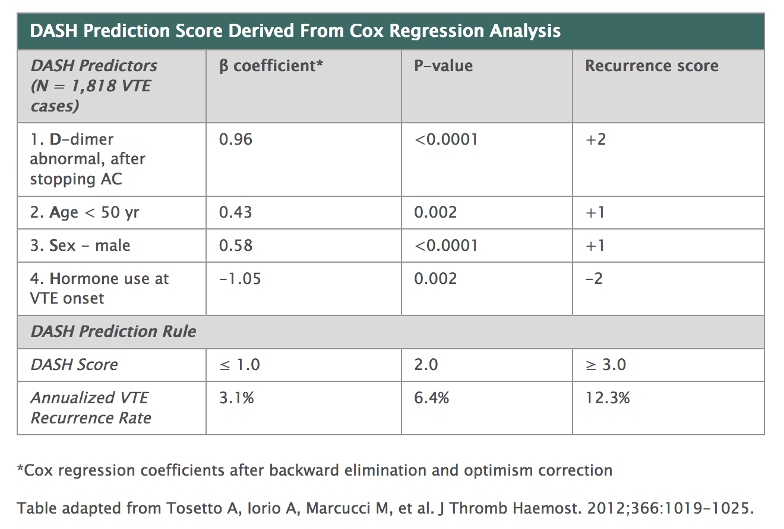

Slide 12
Any questions at this point?

Slide 13
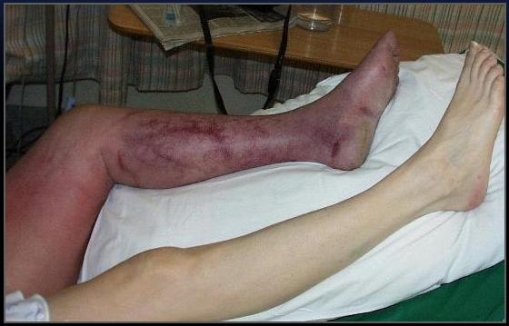
What’s this called?
Notes:
Phlegmasia cerulea dolens
(Phlegmasia alba dolens = white leg, more severe)
Massive DVT causing obstruction and severe pain. Call vascular surgery.
NICE: Consider catheter-directed thrombolytic therapy /embolectomy for patients with symptomatic iliofemoral DVT who have:
• symptoms of less than 14 days’ duration and
• good functional status and
• a life expectancy of 1 year or more and
• a low risk of bleeding.
Phlegmasia stems from a Greek term (phlegma) meaning inflammation. It has been used in the medical literature in reference to extreme cases of lower-extremity deep venous thrombosis (DVT) that cause critical limb ischemia and possible limb loss. Phlegmasia alba dolens (PAD) describes the patient with swollen and white leg because of early compromise of arterial flow secondary to extensive DVT. This condition is also known as “milk leg,” especially as it affects women in the third trimester of pregnancy or post partum.
Phlegmasia cerulea dolens (PCD) is more advanced and considered a precursor of frank venous gangrene. It is characterised by severe swelling and cyanosis and blue discoloration of the extremity. It was first described by Hildanus in the 16th century. Later, the term PCD was first used by Gregoire in 1938. Its rarity notwithstanding, phlegmasia is a life-threatening condition. It is crucial for nonvascular specialists to be able to recognise this condition promptly and accurately; treatment is time-sensitive.

Slide 14
Case 2
A 50-year-old woman was admitted with pain, redness and swelling of her thigh that had developed over the preceding 48 hours ?cellulitis.
Her only past medical history was gastro-oesophageal reflux disease and varicose veins.

Slide 15
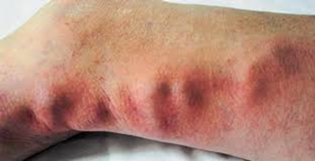
She was started on IV flucloxacillin by the FY1 doctor (house officer)

Slide 16
Exercise
In small groups answer the following Qs:
What is the diagnosis?
What further investigations should be performed?
What are the treatment options in this case?
Notes:
Superficial thrombophlebitis of the proximal thigh (near sapheno-femoral junction)
Doppler USS of the affected leg to exclude occult DVT + to assess risk of propagation to DVT
Anti-embolism stockings
In this case, probably LMWH prophylactic dose 30 days (depends on USS Doppler)
General advice – elevation, hot towel, do not restrict mobility, watch for signs of DVT

Slide 17
Notes:
Revision of anatomy: deep vs superficial veins of the leg and the sapheno-femoral junction

Slide 18
Superficial thrombophlebitis: summary
Inflammation of the superficial veins
Swelling, pain, redness
Scanty evidence base re: management
SIGN guidelines and NICE ‘clinical knowledge summary’ broadly agree
New more clearer guidelines from BJH on superficial vein thrombosis and thrombophlebitis
Anticoagulate base on risk of developing DVT
Notes:
“Superficial thrombophlebtis” and “superficial vein thrombosis” are not the same thing (see flow chart later) but often used interchangeably …

Slide 19
Superficial thrombophlebitis: summary
SIGN Guideline 122
10-21% of pts have a DVT, more likely if >5cm inflammation or within 10cm of sapheno-femoral junction
Topical treatments only alleviate symptoms
Oral NSAIDs prevent extension, recurrence and progression to DVT, so does LMWH
Not clear if LMWH (prophylactic or therapeutic doses) is better than NSAIDs – but in high risk cases LMWH recommended*
NICE CKS
The risk of DVT should be considered
Treat with oral NSAIDs and paracetamol, class 1 AES and advice. Topical NSAIDs can be used for symptomatic relief
LMWH not routinely recommended, but experts advise it should be used in high risk cases (no dose recommendation)
Treat super-added infection with antibiotics
Notes:
So what does SIGN say? More clear and I recommend this:
Patients with clinical signs of superficial thrombophlebitis affecting the proximal long saphenous vein should have an ultrasound scan to exclude concurrent DVT.
Patients with superficial thrombophlebitis should have anti-embolism stockings and can be considered for treatment with prophylactic doses of LMWH for up to 30 days or fondaparinux for 45 days. If LMWH is contraindicated, 8-12 days of oral NSAIDs should be offered.
Patients with superficial thrombophlebitis at, or extending towards, the sapheno-femoral junction can be considered for therapeutic anticoagulation for 6-12 weeks.

Slide 20
SIGN (2010) guideline recommendations
Patients with clinical signs of superficial thrombophlebitis affecting the proximal long saphenous vein should have an ultrasound scan to exclude concurrent DVT
They should have anti-embolism stockings and considered for treatment with prophylactic doses of LMWH for up to 30 days or fondaparinux for 45 days. If LMWH is contraindicated, 8-12 days of oral NSAIDs should be offered
Patients with superficial thrombophlebitis at, or extending towards, the sapheno-femoral junction can be considered for therapeutic anticoagulation for 6-12 weeks

Slide 21
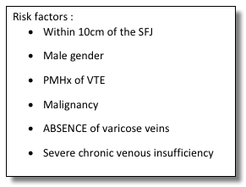
Superficial vein thrombosis (SVT):
a current approach to management
British Journal of Haematology 2015; 168: 639-645
Based on distance from sapheno-femoral junction
High risk:
SVT within 3 cm of the SFJ should be considered for therapeutic anticoagulation (2B) (treat as if DVT)
Moderate risk:
SVT and risk factors for extension, recurrence or progression should be offered treatment with prophylactic doses of LMWH or fondaparinux for 30–45 d (1B)
Low risk:
Other patients with SVT should be offered 8–12 d oral NSAIDs unless contraindicated (1A)

Slide 22
Case 3
British Journal of Haematology 2015; 168: 639-645

Slide 23
Any questions at this point?

Slide 24
Case 3
A 34-year-old man was admitted with acute onset of heaviness, pain and functional impairment of his right arm. The arm was cyanotic and swollen. For the past few weeks, he reported transient paraesthesia of his right arm during weightlifting.
He had a fracture of the right clavicle after a ski accident 5 years previously which was managed conservatively. There was no personal or family history of thrombosis.

Slide 25
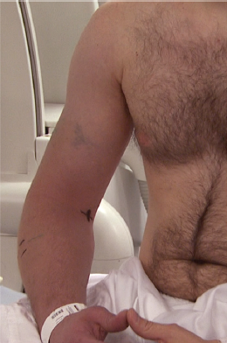
A Doppler USS right arm showed axillary and subclavian vein thrombosis

Slide 26
Exercise
In small groups answer the following Qs:
What are the treatment options in this case?
What further investigations should be performed?
What follow-up is required?
Notes:
Treatment options –
Anticoagulation (LMWH plus warfarin – stop LMWH when after min 5 days or two therapeutic INRs whichever is sooner)
NOACs not licensed for this condition - but may be worth discussing with Haem/Vasc.
If severe symptoms/signs and low bleeding risk/good functional status, refer to vascular for catheter directed thrombolysis or pharmaco-mechanical thrombectomy
Further investigations –
Imaging of the thorax a) CT or MRI of the thoracic inlet to look for cause of the compression; imaging of the thorax to look for cancer (lung/lymphoma) – discuss protocol with radiologist.
Follow-up –
Referral to vascular surgery
Any cancer referrals
Lymphoedema clinic (compression not recommended acutely but may be needed for PTS)
Wells Score for DVT not validated for upper limb cases. D-dimer not validated/not recommended. No validated diagnostic or treatment strategy or national guideline. Management based on consensus statements e.g. American College Chest Physicians 2012 and British Journal of Haematology guidelines.

Slide 27
Upper limb DVT: summary
Increasing incidence up to 10% all DVTs
Primary
Effort-related thrombosis (Paget-Schroetter Syndrome). Weights, tennis, repeated overhead activities (swimming, decorating). Most have underlying VTOS
Idiopathic*
Secondary most common
Indwelling central venous catheters/ports/PPM
Cancers, mainly lung and lymphoma
Surgery/trauma/immobilisation of arm
Pregnancy and ovarian hyperstimulation syndrome
Notes:
Effort-related usually good history and most common cause of primary upper limb DVT
VTOS = venous thoracic outlet syndrome; either due to first rib, clavicle, muscle bulk
Idiopathic require thrombophilia screen and further Ix – up to one quarter thought to be idiopathic have a cancer*
Idiopathic = no obvious underlying risk factor or VTOS can be identified. More likely to have abnormal thrombophilia screen.
Secondary most common cause of upper limb DVT overall
- higher number of leads and larger diameter catheters = higher risk
Surgery = 13x risk, plaster cast = 7x risk

Slide 28
Upper limb DVT: summary
Initial management
Anticoagulation: 3-6 months, though optimal duration not known
Catheter directed thrombolysis / pharmaco-mechanical thrombectomy in selected patients
Investigations/follow-up
Doppler USS initial investigation of choice
If primary upper limb DVT: imaging of the thorax +/- thrombophilia screen
If secondary: address underlying cause (e.g. catheter)
OP vascular surgery referral
Complications
Lower risk of PE cf lower limb DVT
Post-thrombotic syndrome (in one study, 13% pts with upper limb VTE)
Notes:
VTOS = venous thoracic outlet syndrome
Patients can be started on initial treatment and have urgent OP Ix and FU – imaging of the thorax should be discussed with a radiologist on a case by case basis so studies are protocolled correctly. OP ref to vascular surgery is for treatment of VTOS in selected cases.
There are some cancer cases when stenting may be considered acutely (e.g. SVC syndrome) – usually by a vascular radiologist.
Stenting in cases of VTOS is not advised without decompression surgery first, as the stent just fractures/re-occludes.
ACCP (2016) now recommend NOT to remove catheter if working well – continue anticoag until 3 months after removal

Slide 29
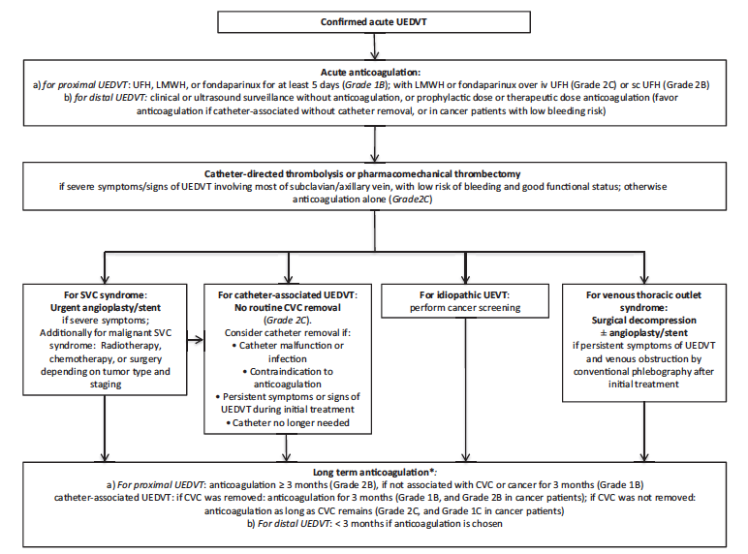
Notes:
From the 2012 consensus guidelines of the American College of Chest Physicians
See further reading – summary of ACCP recommendations.
No major change since 2016

Slide 30
Summary of BHS guideline: VTE in unusual sites
Cerebral venous and sinus thrombosis
Headache + stoke symptoms think CVT
LMWH for 7 days, warfarin for 3/12 once stable
SVC thrombosis
Treat as DVT (often long term anticoagulation)
Consider stenting in non-malignant, severe cases
IVC thrombosis
Consider IVC thrombosis in patients with bilateral DVT
Treat as proximal DVT but lower threshold to consider catheter-directed thrombolysis
Notes:
CVT: bleed a/w clot is not a contra-indication
Death can occur within hours of presentation due to cerebral herniation
SVC: malignancy most likely cause
Presents like SVCO

Slide 31
Any questions at this point?

Slide 32
Case 4
A 54 year old female smoker was admitted with gradually worsening breathlessness over the last 10 days. She reported a cough but no obvious fever or discoloured sputum.
Her past medical history included a DVT 5 years previously.
On examination, her vital signs were normal.
Her chest X-ray was normal.

Slide 33
Exercise
In small groups answer the following Qs:
What is your approach to deciding whether a patient has a PE?
Sketch it out on a piece of paper
What follow-up is required for patients who have had a PE?

Slide 34
An approach to ?PE in stable non-pregnant adults
Wells Score
0-1.5
Low clinical probability
2-4
4.5+
High clinical probability
Apply PERC rule*
d dimer
Start treatment and scan
Positive
PERC neg
Negative
No PE
No PE
sPESI score
*https://lifeinthefastlane.com/pulmonary-puzzle-016/
Notes:
In the Wells score there is one tricky Q: PE is the most likely diagnosis …

Slide 35
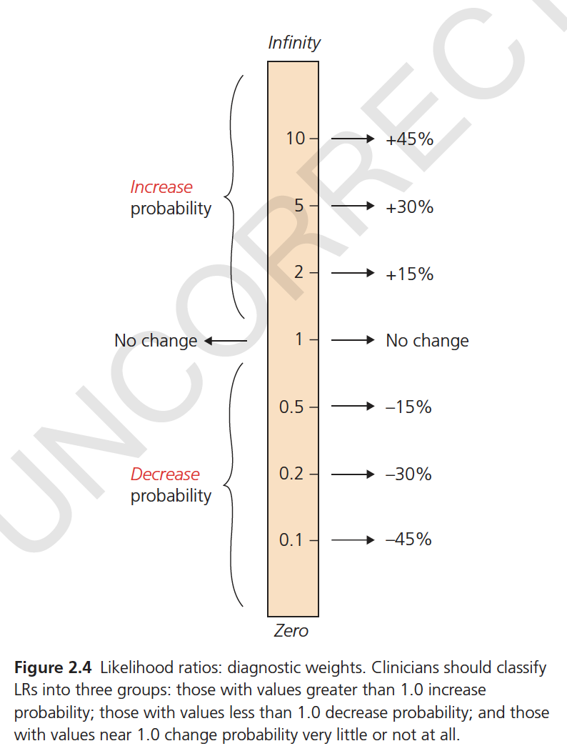

Slide 36
Likelihood ratios in ?PE
The only individual symptoms increasing the prior probability of pulmonary embolism are:
Sudden dyspnea (LR = 2.4)
Syncope (LR = 2)
Haemoptysis (LR = 2)

Slide 37
Likelihood ratios in ?PE
Individual physical findings increasing the prior probability of pulmonary embolism are:
Unilateral calf pain or swelling (LR = 2.5)
Left parasternal heave (LR = 2.4)
RR > 30 breaths/min (LR = 2)

Slide 38
Likelihood ratios in ?PE
The presence of wheeze (LR = 0.5) and fever >38ºC (LR = 0.5) modestly reduces the prior probability of PE
The presence or absence of a HR <100 or >100 as an isolated finding is unhelpful (LR = 1.3)
Chest wall tenderness is found in 11-17% patients with PE and also has an LR that is not helpful

Slide 39
Likelihood ratios in ?PE
In contrast to the modest accuracy of various individual findings …
… a high Wells Score (i.e. 4.5+) markedly increases the probability of PE (LR = 7.5), whereas a low Wells Score (i.e. <2) decreases it (LR = 0.3)

Slide 40
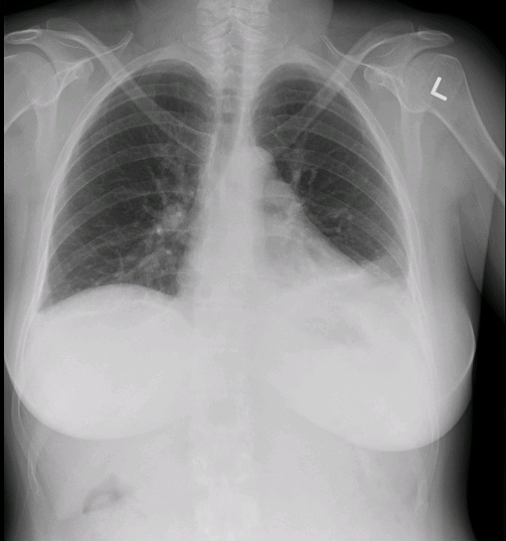
Chest X-ray findings in PE
Notes:
XR changes in PE
In the 1992 PIOPED study (prospective Ix in PE diagnosis), findings that were most common in PE were atelectasis and/or increased opacity in lower lung parenchyma, and pleural effusions.
Easy to confuse with “pneumonia”.
PEs also cause inflammation: CRP/wbc/fever so there can be a “grey area” between obvious pneumonias and obvious PEs.
Would you do a d dimer in this case??
Now, in this case a d dimer was already done (routine at the front door of ED without history/Wells) and was 19,000.
Comments please …
We talk about a raised d dimer being non-diagnostic. Hmm … maybe not as simple as that. In a study comparing the quantitative D-dimer levels to the presence of PE in symptomatic patients, PE prevalence was strongly related to the D-dimer level and increased 4 times with D-dimer levels >4000 ng FEU/ml compared with levels between 500 and 1000 ng FEU/ml. In a study performed in an out-patient setting in 671 patients with clinically suspected PE, the specificity of a D-dimer test was 93% when D-dimer levels exceeded 4000 μg FEU/l. However, in the
presence of intermediate and high clinical probability, this resulted in a limited positive predictive value because of the relatively low PE incidence (20%).[29 ] Thus, high D-dimer levels upon presentation may potentially prompt a more intense diagnostic approach, irrespective of pre-test probability…

Slide 41
An approach to ?PE in stable non-pregnant adults
Wells Score
0-1.5
Low clinical probability
2-4
4.5+
High clinical probability
Apply PERC rule*
d dimer
Start treatment and scan
Positive
PERC neg
Negative
No PE
No PE
sPESI score
*https://lifeinthefastlane.com/pulmonary-puzzle-016/

Slide 42
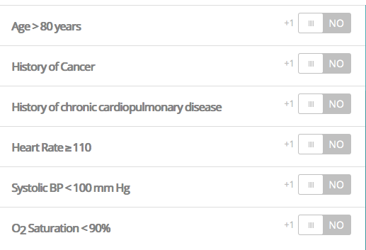
Ambulatory Care? Simplified PE Severity Index (sPESI) Score
Patients with a score of 0 are determined to be low risk, while those with a score of 1 or more are considered high risk and not suitable for Ambulatory Care
Notes:
How do you know if the patient can be treated in Ambulatory Care??
Google simplified PESI score and work out using MedCalc
The sPESI is only meant for risk stratification of pulmonary embolism after the diagnosis has been made (probable diagnosis awaiting scan counts).
The sPESI can not be used to risk stratify patients who are not being treated for PE.
Additional pathology which could lead to morbidity or mortality should not be overlooked in the setting of low risk sPESI scores.

Slide 43
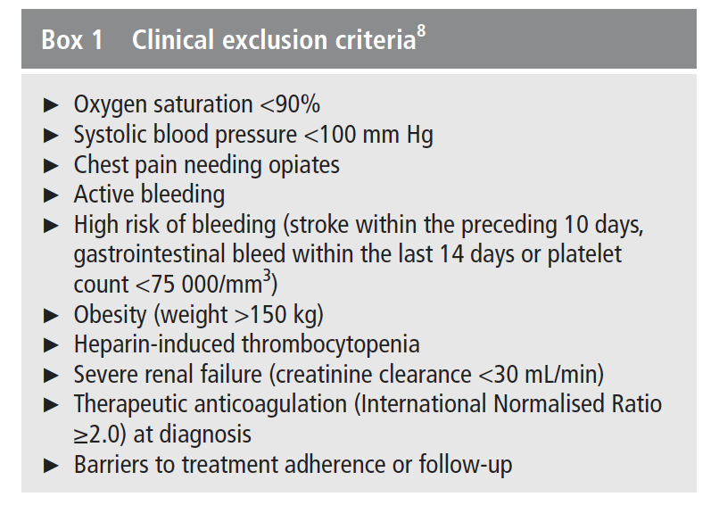
Clinical exclusion criteria for Ambulatory Care
BTS Guidelines for initial OP management of PE. Thorax 2018: 73: suppl 2

Slide 44
BTS Guidelines for initial OP management of PE. Thorax 2018: 73: suppl 2

Slide 45
Troponin to risk stratify PE patients
Where RV dilatation has been identified on CT scanning or echocardiography in patients who are suitable for OP management, consider measuring laboratory cardiac biomarkers (BNP, NT-proBNP, hsTnI or hsTnT). Normal values may be used to identify low-risk patients; elevated biomarkers in this context should prompt IP admission for observation. Grade C
Good practice points
✓ In the context of low-risk PE and an incidental finding of elevated troponin, senior review is required and alternative causes for troponin release should be considered
BTS Guidelines 2018

Slide 46
Evidence for Ambulatory Care in a not-yet-confirmed PE
Evidence statement
There are a limited number of studies in which patients with suspected PE who were identified as at low risk of adverse outcome were treated with anticoagulation prior to imaging, either same day or as an OP. Outcomes did not appear to be worse in those patients with suspected PE investigated as OP. Evidence level 2−
Recommendation
Patients with suspected PE should, where reasonably practical, undergo investigation on the same day of presentation to exclude a diagnosis of PE. An alternative strategy of anticoagulation followed by OP imaging within 24 hours may be considered in patients with suspected PE, who have been deemed low risk and eligible for OP care as per confirmed PE. Robust systems should be in place to facilitate next day investigation and review. Grade D
BTS Guidelines 2018

Slide 47
CT or V/Q scan?
CTPA
Preferred – simple positive/negative result, can visualise other lung pathology, RV dysfunction and proximal leg veins
90% sensitivity, 95% specificity - a negative CTPA essentially rules out PE
However, high sensitivity –> increased incidence of PE and probably diagnosing unimportant PEs
V/Q
Recommended in young/pregnant patients with normal CXRs and no history of lung disease (e.g. asthma) to reduce radiation
Role in patients who cannot have contrast
Different sensitivity and specificity figures in literature - non-diagnostic scans with high clinical suspicion still need CTPA – but see next
Much more sensitive than CTPA in diagnosing chronic PEs (e.g. Ix of pulmonary hypertension)
Notes:
Would you treat a small peripheral PE in a 90 year old lady with dementia living in a nursing home??
(No? Might want to know if the prox leg veins showed DVTs on imaging first).
A recent study examined the radiation dose of CTPA for women undergoing a single 64-slice multidetector CTPA procedure. The estimated exposure was 12.4-31.8 mSV. This was estimated to increase the risk of breast cancer by 1.004 to 1.042 and lung cancer from 1.005 to 1.076. The excess risk of cancer for individuals over 55 would be less than 1%; however, for a young
20-year-old woman this would be estimated to increase the relative lifetime risk of breast or lung cancer by 1.7 to 5.5%.
Although investigators have acknowledged the greater accuracy of CTPA, a number of recent studies have attempted to better define a potential role for V/Q scanning for the diagnosis of pulmonary embolism. The PIOPED II investigators reanalysed V/Q scan results using only the perfusion images and two distinct sets of diagnostic criteria.[18] Using a modification of the PIOPED II criteria, the sensitivity of lung scanning improved to 85%, the specificity declined to 93% and the nondiagnostic scan rate result was reduced to 21%.
NICE: Although CTPA has the advantage of being more sensitive and specific than planar V/Q scans which also have a higher non-diagnostic rate, planar V/Q scans may be the preferred option for some patients. The radiation exposure from V/Q scans is approximately equivalent to 8 months of natural background radiation (UK average 2.2 mSv per year), and significantly lower than CTPA scan208. Unlike CTPA, V/Q scans do not require the use of contrast media and should be offered to patients with a history of allergy to contrast media. This is also an option for patients at risk of further renal injury from contrast media e.g. patients with severe renal impairment.

Slide 48
Sensitivity and specificity of planar V/Q scan (after removing non-diagnostic scans from the analysis)
PE absent | Non-diagnostic scan | PE present
Normal/very low probability | Low/intermediate probability | High probability
Modified PIOPED ll Scintigraphic Criteria (V/Q result compared with DSA or CTPA + Wells)
Sensitivity 77.4%
Specificity 97.7%
The % of patients with a PE absent or PE present scan was 73.5%
Notes:
Around 25% pts have non-diagnostic scans with planar V/Q compared with only 6% CTPA – and CTPA is mostly non-diagnostic due to “technically inadequate scans”.
Low clinical prob and PE absent scan → no PE
2003 BTS guidelines therefore said that CTPA is preferred, and ‘Isotope lung scanning may be considered as the initial imaging investigation providing (a) facilities are available on site, and (b) chest radiograph is normal, and (c) there is no significant symptomatic concurrent cardiopulmonary disease, and (d) standardised reporting criteria are used, and (e) a non-diagnostic result is always followed by further imaging.’

Slide 49
V/Q SPECT
V/Q SPECT (single photon emission tomography) is the latest gold standard type of V/Q scan
3D images, greater diagnostic accuracy compared with planar V/Q scans … possibly comparable to CTPA
Reported as ‘no PE’ or a description of PE(s) present rather than probability (PIOPED ll)
Notes:
Single photon emission tomography (SPECT) provides three-dimensional volumetric images and has the potential to improve the diagnostic accuracy of the nuclear medicine imaging for pulmonary embolism. A direct comparison has been performed between SPECT V/Q, V/Q planar scanning and four-slice CTPA in 83 patients. In this study the sensitivity and specificity of SPECT were superior to planar V/Q and comparable to CTPA (sensitivity of SPECT was 97% versus 86% for CTPA, specificity of SPECT was 91% compared with 98% for CTPA, with a diagnostic accuracy of 94 versus 93%, respectively).
A prospective cohort study followed 405 patients classified as negative for pulmonary embolism by SPECT V/Q who did not receive anticoagulant therapy. Six patients (1.5%) subsequently developed venous thromboembolic complications in follow-up. Only 3% of patients had indeterminate SPECT V/Q scan findings. A larger retrospective evaluation of SPECT V/Q reported similar findings. SPECT V/Q is a promising modality, but large prospective multicentre accuracy and outcome studies are required to determine the utility of this test.

Slide 50
Thrombolysis in PE: NICE
Consider pharmacological systemic thrombolytic therapy for patients with PE and ‘haemodynamic instability’ on pharmacological interventions for VTE
Do not offer pharmacological systemic thrombolytic therapy to patients with PE and haemodynamic stability with or without right ventricular dysfunction on pharmacological interventions for VTE

Slide 51
Thrombolysis in PE: BTS (2003)
CTPA or echocardiography will reliably diagnose clinically massive PE [B]
Thrombolysis is the first line treatment for massive PE [B] and may be instituted on clinical grounds alone if cardiac arrest is imminent [B]; a 50 mg bolus of Alteplase is recommended [C]
Thrombolysis should not be used as first line treatment in non-massive PE [B]
Unfractionated heparin (UFH) should be considered (a) as a first dose bolus, (b) in massive PE, or (c) where rapid reversal of effect may be needed [C]
Otherwise, low molecular weight heparin (LMWH) should be considered as preferable to UFH, having equal efficacy and safety and being easier to use [A]
Notes:
5000 unit bolus of IV heparin
Onset of action of max anticoagulant effect is 2-3 hrs in LMWH (clexane)
Dr Berg: worry if hypotensive, cool peripheries/other signs of hypoperfusion eg metabolic acidosis and “looks peri-arrest”
Use larger doses 1mg/kg BD clexane for submassive PE

Slide 52
PE: treatment and follow-up
Non-pregnant patients require respiratory OP follow up (not small peripheral PEs)
Over 40’s with idiopathic PEs require cancer screening same as DVTs
Duration of anti-coagulation same as DVTs – risk/benefits assessment (not automatic stop) after this
Investigation is different in pregnant patients … (more of that in a minute!)
Notes:
Treatment is different in pregnant patients too for both DVT and PE – 1mg/kg BD clexane, factor Xa level monitoring and urgent referral to joint haem/obstetric clinic. No warfarin.

Slide 53
Any questions at this point?

Slide 54
Case 5
A 30-year-old woman, who was 30 weeks pregnant, was admitted with pleuritic chest pain and breathlessness.
She had no past medical history and was a non-smoker.
Her chest X-ray was normal.
How should investigations for ?PE proceed

Slide 56
PE in pregnancy Ix: Green-top guideline 2015
No evidence to support pre-test probability assessment
No evidence to support use of d-dimer
Always do a chest X-ray
USS if symptoms or signs of DVT
If no symptoms or signs of DVT then proceed to V/Q or CTPA
Women with suspected PE should be advised that, compared with CTPA, V/Q scanning may carry a slightly increased risk of childhood cancer but is associated with a lower risk of maternal breast cancer; in both situations, the absolute risk is very small

Slide 57
PE in pregnancy Rx: Green-top guideline 2015
Give LMWH based on booking/early pregnancy weight of patient
Insufficient evidence to recommend whether clexane 1.5mg/kg od or 1mg/kg bd …
Monitor anti-Xa activity only in patients who are <50kg or >90kg, or ‘other complicating factors’ such as renal impairment or recurrent VTE
Treatment should continue for at least 6 weeks postnatally
Warfarin is contraindicated, platelet count should be monitored
IV heparin is preferred as first line in massive PE, but thrombolysis can be used – involve senior team including senior physicians and obstetricians

Slide 58
PE in pregnancy follow-up: Green-top guideline 2015
Patients should be followed up in a joint Obstetric-Haematology clinic

Slide 59
Case 7
A 75-year-old woman was sent to Ambulatory Care for investigation of a raised d dimer (900 μg FEU/L). She had been admitted two weeks previously with pleurisy and had a negative CTPA. On discharge the Practice Nurse repeated the d dimer test to see if it was still raised and referred the patient back to Acute Medicine to ‘find the clot’.
The patient’s past medical history consisted of: COPD, heart failure, hypertension.
On examination the patient was well with no new symptoms and had mild bilateral lower leg oedema.
What would you do next?
Notes:
Other d dimer stories …

Slide 60
Correct interpretation of d dimer
Ginsberg and colleagues found that the combination of a low pre-test probability and a normal d dimer had a negative predictive value of 99%, whereas the negative predictive value was only 78% in patients with a high pre-test probability and a normal d dimer
A rule of thumb is that a ‘positive’ d dimer is non-diagnostic
However … should a d dimer of 900 be interpreted the same as a d dimer of 9,000?
Notes:
The starting point for interpretation of any d dimer result has to be: does this patient have symptoms and signs of DVT/PE??
An analysis reported no clear advantage of measuring D-dimer after the age of 80, except when the risk of performing CT was too high due to impaired renal function. In a study by Legnani et al, the authors highlighted the different age-specific, quantitative D-dimer cutoff values in patients aged 70 years or less and older than 70 years, respectively: VIDAS ELISA = 600 ng FEU/ml and 1200 ng FEU/ml, Innovance = 500 ng/ml and 900 ng/ml NP, Hemosil HS D-dimer (Instrumentation Laboratories) = 250 ng DDU/ml and 450 ng DDU/ml, and STA Liatest (Stago) = 700 ng FEU/ml and 1000 ng FEU/ml. In a pooled analysis involving three prospective studies, normal D-dimer levels along with LCP effectively excluded DVT in elderly patients.
In a study comparing the quantitative D-dimer levels to the presence of PE in symptomatic patients, PE prevalence was strongly related to the D-dimer level and increased 4 times with D-dimer levels >4000 ng FEU/ml compared with levels between 500 and 1000 ng FEU/ml. In a study performed in an out-patient setting in 671 patients with clinically suspected PE, the
specificity of a D-dimer test was 93% when D-dimer levels exceeded 4000 μg FEU/l. However, in the presence of ICP and HCP, this resulted in a limited positive predictive value because of the relatively low PE incidence (20%).[29 ] Thus, high D-dimer levels upon presentation may potentially prompt a more intense diagnostic approach, irrespective of PTP.
In a study of 1818 patients, the risk of recurrent VTE was higher among patients with positive D-dimer levels than those with negative results during a follow-up period of 26.9 months after an unprovoked VTE. This was independent of patient age or timing of the post-anticoagulation D-dimer testing.

Slide 61
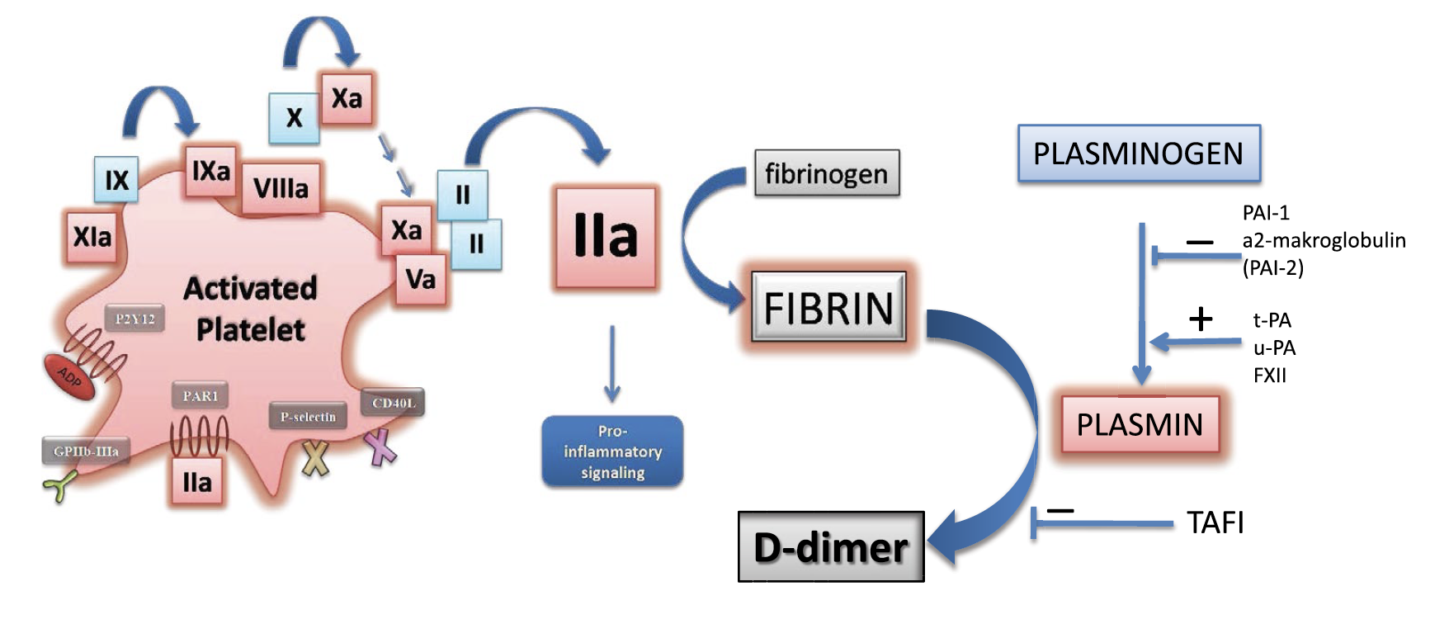

Slide 62
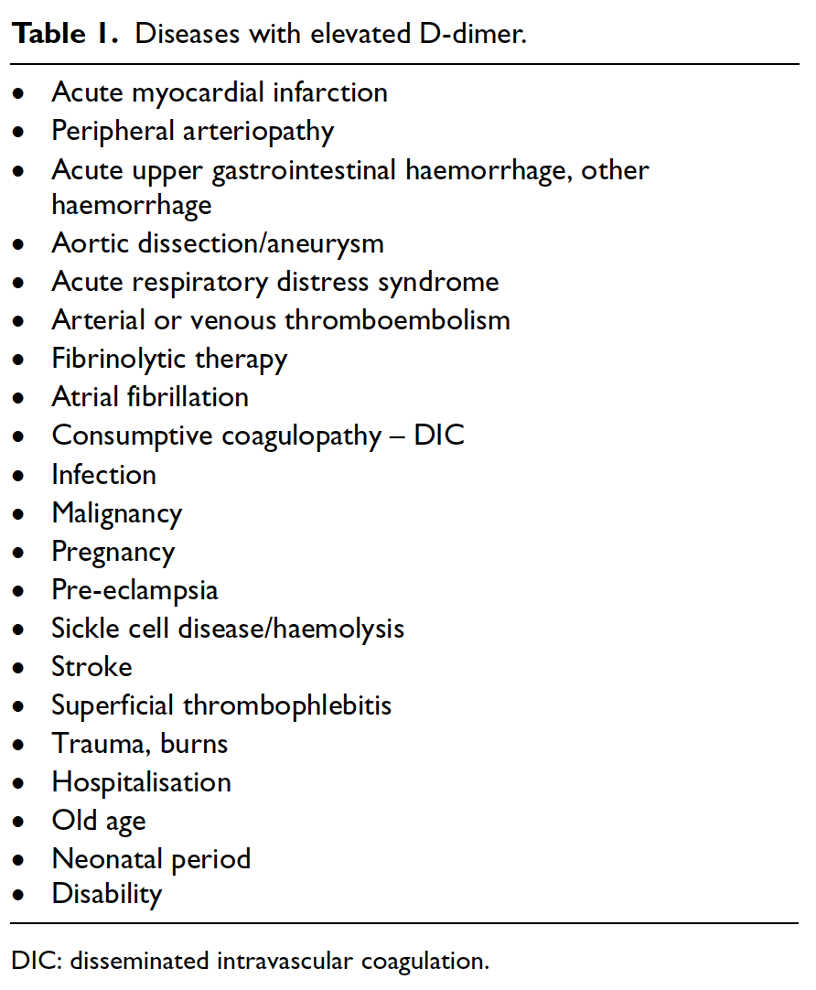

Slide 63
There are several different d dimer assays out there
All have different sensitivities and specificities … you need to know which your hospital uses!
For example:
In patients with suspected PE, assays with a moderate sensitivity should only be used when there is low PE pre-test probability whereas highly sensitive assays can also be used in patients with an intermediate pre-test probability

Slide 64
Correct use of d dimer
Not a stand-alone test
Should only be incorporated in to a diagnostic algorithm
Low clinical probability + negative d dimer effectively rules out VTE in studies
If the clinical probability is high, a negative d dimer should be ignored
But what if the clinical probability is low and the d dimer is high ..??

Slide 65
Low clinical probability and ‘very high’ d dimer levels
’With a low pretest probability and very high d-dimer level, recommendations are less clear. However, there is some evidence that very high d-dimer levels increase the likelihood of PE even in patients with low pretest probability.
The Christopher Study on 1515 patients showed that patients with d-dimer levels higher than 2000 ng/ml and an unlikely clinical decision rule had a pulmonary embolism prevalence of 36%.
Whether this finding should translate into more intensive diagnostic and therapeutic measures in patients with very high d-dimer levels irrespective of clinical decision rule remains to be studied in prospective trials.’
How to use d dimer in acute cardiovascular care. Eur Heart J 2017: 6(1): 69-80

Slide 66
Age-adjusted d dimer
Age-adjusted cut-off = age x 10 (μg/l)
A recent meta-analysis evaluating 13 cohorts including 12,497 patients with a non-high clinical probability for suspected VTE demonstrated that the use of an age-adjusted d-dimer cut-off value in patients over 50 years increased the specificity of d-dimer in all age categories with only a small insignificant decrease in sensitivity, which remained above 97% in all patients
How to use d dimer in acute cardiovascular care. Eur Heart J 2017: 6(1): 69-80

Slide 67
D dimer in pregnancy?
‘A normal d-dimer value has the same exclusion value for PE in pregnant women as in other patients with suspected PE. Given the paucity of studies, measurement of d-dimers is an option, especially in early pregnancy in order to avoid unnecessary exposure of the foetus to diagnostic radiation, even though the probability of a negative result is lower than in other patients with suspected PE.’
(This is not recommended in any UK guideline though)
How to use d dimer in acute cardiovascular care. Eur Heart J 2017: 6(1): 69-80

Slide 68
What about cancer patients?
None of the diagnostic algorithms for VTE has been studied in cancer patients
In a meta-analysis of 13 studies in 10,002 patients the prevalence of the combination of a low score on the Wells rule and a negative d-dimer test among cancer patients result was only 9%

Slide 69
Using d dimer in other conditions
In a recently published meta-analysis it was suggested that plasma d-dimer <500 μg/l is a useful screening tool to identify patients who do not have aortic dissection. Two other meta-analyses conferred supporting evidence that d-dimer represents a highly sensitive biomarker for the exclusion of AAD, with 100 % sensitivity at a cut-off of 100 μg/l and 99% at a cut-off level of 500 μg/l.
Higher d dimer levels in AF are associated with increased risk of stroke and death … further studies required
How to use d dimer in acute cardiovascular care. Eur Heart J 2017: 6(1): 69-80

Slide 70
MCQ answers

