Slide 1
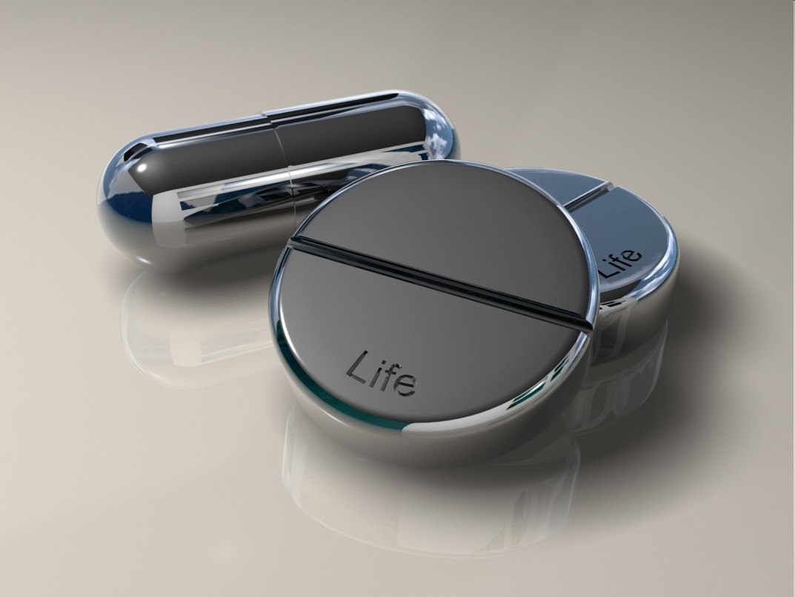
Medical Toxicology
Acknowledgment to Dr Tom Heaps

Slide 2
Learning objectives
Gain organised knowledge in the subject area of medical toxicology (overdoses)
Be able to correctly interpret/act on clinical findings and blood results
Know and apply the relevant evidence and/or guidelines
Be aware of common errors in the management of common overdoses
Notes:
Learning objectives always the same for each topic …

Slide 3
What we will cover
Paracetamol (acetaminophen)
Tricyclic anti-depressants
Other psychiatric medication: serotonin syndrome and neuroleptic malignant syndrome
Opioids
Salicylates
Amphetamine-like drugs
Iron overdose

Slide 4
Scenario 1: paracetamol
A 29-year-old woman presented in ED at 1100hrs having taken 24 x 500mg paracetamol 12 hours before. She also drank a large quantity of alcohol just prior to the overdose and vomited several times afterwards.
She had a history of depression, recurrent deliberate self-harm and alcoholism.
Her regular medications comprised citalopram and olanzepine.
On examination her vital signs were normal and her weight was 60kg.

Slide 5
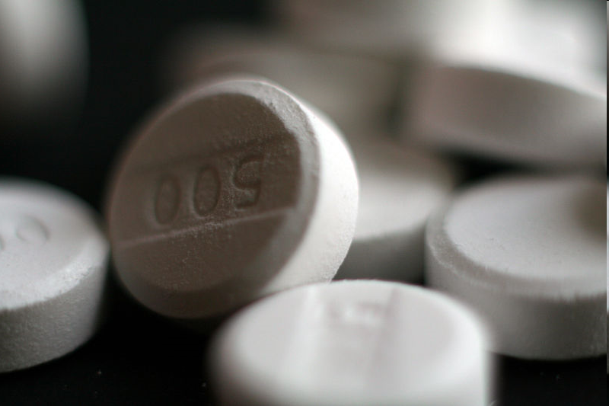
Is this a significant overdose?
12g paracetamol
weight 60kg
dose = 200mg/kg
Threshold for risk of significant toxicity is >150mg/kg (>75mg/kg if high risk) or >12g total paracetamol.

Slide 6
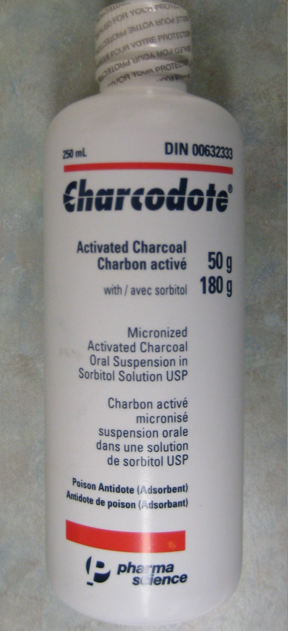
True or false?
Activated charcoal should be
administered without delay
FALSE
Gut decontamination with activated charcoal may reduce absorption of paracetamol minimising the need for NAC but is only effective if given within 1h of overdose. Gastric lavage is not recommended and may actually enhance early absorption.

Slide 7
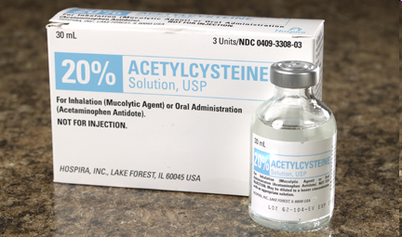
True or false?
An infusion of N-Acetylcysteine (Parvolex®) should be commenced immediately rather than waiting for serum paracetamol levels
TRUE
Efficacy of NAC is maximal when started within 8h of OD. Patients presenting >8h after a potentially significant OD should be commenced on NAC immediately pending the results of blood tests/paracetamol levels.

Slide 8
True or false?
Paracetamol levels are irrelevant as the overdose occurred 12h ago
FALSE
Paracetamol levels are prognostically accurate and should guide treatment decisions up to 15h post-OD. Levels are irrelevant in cases of staggered overdose.

Slide 9
True or false?
The fact that she drank a significant quantity of alcohol just prior to the overdose means that she is higher risk of hepatotoxicity from the paracetamol overdose
FALSE
Higher risk is associated with chronic alcoholism (glutathione deficiency, enzyme induction). Acute ethanol ingestion is paradoxically hepatoprotective as it may inhibit conversion of paracetamol to its toxic metabolite (NAPBQI) by the CYP450 enzyme system. NB - the paracetamol nomogram has been updated and now has only one treatment line.

Slide 10
True or false?
If IV access proves difficult then oral methionine can be given instead of NAC
FALSE
There is no evidence that oral methionine is effective in later presentations of paracetamol OD and its use is not generally recommended by the National Poisons Information Service. Oral NAC is an effective alternative but is not generally available in the UK.

Slide 11
True or false?
If the patient was found to be pregnant then the dose of NAC administered should be halved to avoid foetal toxicity
FALSE
The risks of foetal toxicity with NAC treatment is minimal, whereas witholding treatment may pose significant risks both to the mother and developing child. There is no evidence to support reduced doses of NAC in pregnancy.

Slide 12
Scenario 1 continued
30 minutes in to the NAC infusion the patient became distressed and felt ‘dreadful’. She was flushed, with a high respiratory rate and wheezy. She vomited.
On examination her blood pressure was 134/78 mmHg and heart rate 90/min.

Slide 13
True or false?
NAC should be stopped immediately and anaphylaxis treated with IM adrenaline, IV antihistamines, nebulised beta-agonists and IV hydrocortisone
FALSE
This is not anaphylaxis (BP is normal). This is a pseudoallergic (anaphylactoid) reaction which occurs in up to 20% of people given intravenous NAC. Treatment is with antihistamines only ± bronchodilators if wheezy (NAC may precipitate acute asthma). The infusion can usually be restarted after a short interval e.g. 30 mins or at half the rate (the reaction tends to occur during the first bag as it is concentration dependent).

Slide 14
Scenario 1 continued
The patient completed the remainder of the course of NAC without complication and received treatment for alcohol withdrawal symptoms
Post-NAC blood results:
Result | Post-NAC | Pre-NAC
Na | 138 | 140
K | 3.3 | 4.1
Urea | 3.2 | 4.0
Creatinine | 77 | 80
INR | 1.3 | 1.0
ALT | 45 | 46

Slide 15
True or false?
Repeat paracetamol levels should have been taken along with the other post-NAC bloods
FALSE
If the initial paracetamol level was taken at ≥4h post-OD then repeat levels are NOT required as absorption is maximal by 4h (unlike poisoning with other drugs e.g. salicylate, lithium, iron etc. when repeated levels are indicated).

Slide 16
True or false?
The NAC infusion should be continued as the INR has risen from 1.0 to 1.3 indicating early hepatotoxicity
FALSE
NAC treatment itself may cause mild increases in PT (destabilises proteins including clotting factors) and an INR of ≤1.3 post-infusion is acceptable (especially as the ALT has not risen from baseline).

Slide 17
Scenario 1 continued
6h later the patient was awaiting a mental health review when she suddenly became unresponsive and had no pulse.
A cardiac monitor was attached and showed ventricular tachycardia. CPR was commenced and a single shock successfully restored spontaneous circulation.
Post-arrest bloods showed a K⁺ of 2.0 mmol/L.

Slide 18
Post-arrest 12-lead ECG
Prolonged QTc (560ms)
460ms (upper limit of normal) on admission ECG

Slide 19
What is the cause of her hypokalaemia?
Vomiting
Stress hormones (catecholamines, cortisol)
IV dextrose used to administer NAC (dilutional ± insulin release)
Alcoholism/withdrawal
Direct toxic effect of paracetamol (decreased prostaglandins reduce renal perfusion resulting in release of renin/aldosterone)
Notes:
Paracetamol od reduces K levels by an average of 1.3 mmol/L

Slide 20
What caused her cardiac arrest?
Ventricular tachycardia caused caused by prolonged QTc due to:
hypokalaemia
hypomagnesaemia
drugs (olanzepine and citalopram)
IV antihistamines

Slide 21
Summary: paracetamol poisoning
Calculate dose/kg to estimate toxicity
Take levels once at ≥4h
Treat if above or around the line on the nomogram
Start treatment immediately if ≥8h since OD and review with levels
Levels are useful up to 15h but irrelevant in staggered OD
Anaphylactoid reactions to NAC are common and are not an ‘allergy’
NAC may cause a slight increase in INR. Continue NAC if INR >1.3 or significant elevation in transaminases
Beware of hypokalaemia (consider IV replacement if other risk factors for hypokalaemia and/or arrhythmia)

Slide 22
Scenario 2: tricyclics
60-year-old female found unconscious at home by daughter
suicide note and empty packet of amitriptyline (28 x 50mg)
daughter had spoken to her 4h prior
history of bipolar disorder
other prescribed medications included lithium and temazepam
O/E sinus tachycardia (130), BP 96/44
GCS 4, dilated pupils, increased tone and hyperreflexia bilaterally with extensor plantars
estimated weight 60kg

Slide 23
True or false?
An urgent CT head is mandatory given her GCS and neurological examination
FALSE
her presentation is entirely consistent with severe tricyclic poisoning and in the absence of other features (head injury, meningism, lateralising neurology) a head CT is not required

Slide 24
True or false?
This is a potentially life-threatening overdose
TRUE
possible total ingestion of 1400mg
weight = 60kg
maximal possible ingested dose = 23mg/kg
risk of fatality with TCA OD at >15mg/kg

Slide 25
Pharmacology Q…
Which of the following receptors do TCAs act upon and what clinical effects does each action cause in overdose?
acetylcholine
histamine
GABA
cardiac sodium channels
cardiac delayed rectifier potassium channels (I_{kr})
noradrenaline
serotonin
α-adrenergic

Slide 26
Answer
All of these receptors:
anticholinergic: tachycardia, confusion, pyrexia, dry skin, dilated pupils, urinary retention and ileus
α₁-adrenergic blockade: vasodilatation and hypotension
histamine: confusion, hallucinations and drowsiness
GABA: drowsiness, ataxia, divergent squint, nystagmus (potentiated by benzodiazepines, alcohol etc.)
cardiac sodium and I_{kr} channel blockade : sinus tachycardia, PR/QRS/QTc prolongation, RBBB, AVB
serotonin: features of serotonin syndrome especially if coningestion of other serotonergic drugs
other effects: increased tone, hyperreflexia, seizures, metabolic acidosis, hypothermia, rhabdomyolysis, ARDS

Slide 27
True or False?
In view of her low GCS and airway risk the patient should be given IV flumazenil to reverse the CNS sedative effects of temazepam which she may have co-ingested
FALSE
flumazenil is rarely indicated in benzodiazepine overdose and in the case of mixed overdose (especially with TCAs) it is contraindicated due to risk of precipitating seizures

Slide 28
Another question…
Which of the following would be an indication for IV sodium bicarbonate administration in the context of TCA OD?
metabolic acidosis
hypotension despite fluid resuscitation
cardiac arrhythmia
QRS prolongation >120ms

Slide 29
Answer
all of these are indications for administration of IV sodium bicarbonate as 50ml boluses of 8.4% aiming for arterial pH of 7.5-7.55
increased pH favours neutral form of tricyclic drug reducing receptor binding
sodium load increases extracellular [Na⁺] attenuating blockade of rapid sodium channels

Slide 30
True or false?
Arrhythmias that do not correct with sodium bicarbonate may be treated with IV magnesium
and/or lignocaine
TRUE
Initial treatment should aim to correct hypoxaemia and acidosis. Class Ia (quinidine, disopyramide, procainamide) and Ic (flecainide, propafenone) antiarrhythmics are contraindicated as these exacerbate cardiac sodium channel blockade

Slide 31
True or false?
IV phenytoin is the drug of choice for refractory seizures in TCA OD
FALSE
Phenytoin acts by blocking sodium channels and therefore increases the risk of arrhythmias. Seizures should be managed by correcting hypoxaemia/acidosis and giving IV lorazepam

Slide 32
True or false?
Despite aggressive fluid resuscitaion and IV bicarbonate the patient became progressively hypotensive. Her BP was now 67/35 and she was oliguric. The Medical SpR thought she should be transferred to HDU for IV noradrenaline to restore her BP and renal perfusion.
TRUE
Noradrenaline is the vasopressor of choice in severe TCA OD with refractory hypotension due to its α₁-agonist properties. IV glucagon 10mg may also be given if significant myocardial depression.

Slide 33
True or false?
24h later the patient was haemodynamically stable and off inotropes. Her electrolytes and acid base balance were normal. She had not had a seizure or arrhythmia since admission and was stepped down to AMU. Her GCS was 13-14 and she was intermittently agitated, confused and appeared to be hallucinating. The ward sister recommended a CT head and referral to the psychiatrists. Is this correct?
FALSE
Following severe TCA OD a prolonged phase of delirium (lasting several days) is common after all the other signs of toxicity have subsided. The patient should be treated supportively ± benzodiazepines (large doses may be required)

Slide 34
Summary: TCA OD
>300 deaths per year in UK (22% of all drug-related suicides) with case fatality rate of up to 3% (12x greater than paracetamol)
calculate dose/kg to estimate toxicity
profound confusion and depression of GCS/respiration may occur after period of relative lucidity
management is largely supportive (correct hypoxaemia, hypovolaemia, electrolyte abnormalities and acidosis)
close attention to ABC with support from ITU
IV sodium bicarbonate 50mmol 8.4% for acidosis, QRS prolongation, arrhythmias and refractory hypotension
IV lorazepam for delirium/seizures (avoid PHT)
IV Mg²⁺/lidocaine for refractory arrhythmias (avoid class Ia and Ic)
IV noradrenaline ± glucagon for refractory hypotension
prolonged delirium is common during recovery

Slide 35
Opiate Toxicity
Classic Opiate overdose features : “Overdose triad”. Pinpoint pupils, unconsciousness, respiratory depression.
For morphine, diamorphine, codeine, and pethidine, risk of toxicity is significantly increased if kidney function is impaired
Opoids can also precipitate pulmonary oedema and rhabdomyolysis.
Cardiotoxicity e.g. Methadone – prolonged QT and Dextropropoxyphene, causing sodium channel blockade and prolonged QT
Brief note on the effects of opiate’s on the respiratory system : Respiratory depression is mediated by Mu-μ receptors. These receptors cause a decreased medullary response to hypercapnia and hypoxia resulting in a reduction in stimulus to breath and consequently apnoea.
Initial management of toxicity
Start with the ABC’s including: Head tilt / jaw thrust / chin-lift +/- airway adjuncts if signs of airway compromise .Oxygen (if sats
<95%) and IV access. Check pupils and glucose.
Now to the Naloxone!
Deliberate overdose : 400 micrograms as an IV bolus, over 30 seconds, repeated every 1-2 minutes until a adequate clinical
response is achieved, to maximum of 10 milligrams. Achieve an alert conscious level and a RR/BPM >10.
200-400 mcg S/C and IM administration may be used whilst IV access is obtained.
Secondary to Medicinal use of opiates/Iatrogenic: : As above but start with 100 to 200 micrograms (1.5 to 3 micrograms/kg) IV.
and BE AWARE that sudden reversal of opoids in chronic users can precipitate withdrawal symptoms!
Next slide will outline the Nov 2014 NPS ALERT on long-term opiate overdose/intoxication.
Naloxone Infusion guide :
Two-thirds ( 60% ) of the total bolus dose needed to reverse toxicity given hourly as a continuous infusion.
Useful in patients who have been on opiates with a long half-life e.g Methadone and Buprenorphine

Slide 36
Regarding the NPS Alert
Risk of distress and death from inappropriate doses of naloxone in patients on long-term opioid/opiate
treatment : November2014
The BNF highlights that doses used in acute opioid/opiate overdose may NOT be appropriate for the management of
opioid/opiate- induced respiratory depression and sedation in those receiving palliative care and in chronic opioid/
opiate use.
Naloxone must be given with great caution to patients who have received longer-term opioid/opiate treatment for pain
control or who are physically dependent on opioids/opiates
Use of naloxone in patients where it is not indicated, or in larger than recommended doses, can cause a rapid reversal of
The physiological effects for pain control, leading to intense pain and distress, and an increase in sympathetic nervous
stimulation and cytokine release precipitating an acute withdrawal syndrome. Hypertension, cardiac arrhythmias,
pulmonary oedema and cardiac arrest may result from inappropriate doses of naloxone being used for these types of
patients.
The recommended dose for adults in post-operative respiratory depression and for palliative care
and chronic opioid/opiate use by intravenous injection is 100 to 200 micrograms (1.5 to 3 micrograms/kg).
If the response is inadequate, give subsequent dose of 100 micrograms every two minutes. The naloxone doses in the
BNF may differ from those in product literature. Even where doses are given as recommended, there is still a need for
careful monitoring of vital observations and maintaining or restoring pain relief.

Slide 37
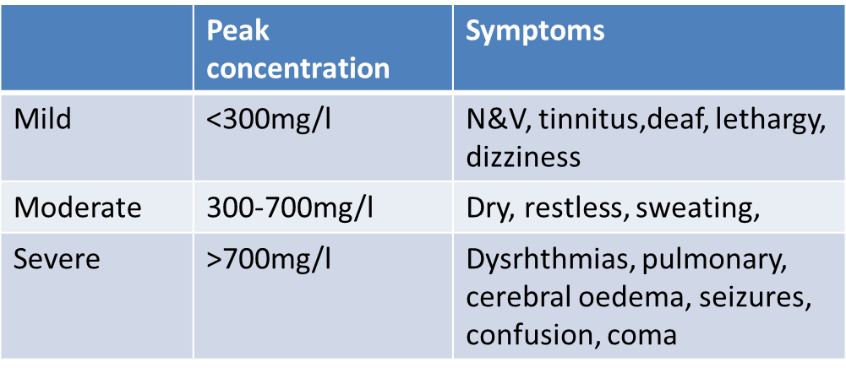
Salicylate poisoning
Symptoms:
Prevents oxidative phosphorylation = widespread symptoms
Direct effects on resp centre + increased fatty acid metabolism = respiratory alkalosis + ketotic acidosis = mixed resp alkalosis/metabolic acidosis

Slide 38
Workup and treatment
Check levels until peak and 2hrly start to drop
(acute peaks 6 hours, chronic up to 20)
FBC, UE, BIC, ABG, PT, BM, ECG (QTc)
Treatments:
Treat low K, when in normal range if acidotic give bicarb: 50-100 mmoL over 30 mins
Urinary alkalisation if levels >500mg/l
Urine Ph 7.5-8.5, use Sodium Bicarb
Consider haemodialysis >700mg/l
Do not compromise respiratory drive!
Asymptomatic – observe for 6 hours if <300mg/l = home

Slide 39
Iron overdose
Children
Sickle cell, thalasaemia, Myelodysplasia
Different preparations contain different amounts elemental iron
20 mg/kg elemental iron is potentially toxic
GI toxicity > 20 mg/kg
Moderate intoxication > 40 mg/kg
Severe/lethal toxicity > 60 mg/kg
200-250 mg/kg elemental iron is potentially fatal
Notes:
Common overdose in children. Other patient demographics to be aware of are those who require multiple blood transfusions.
Different iron preparations (salts) contain different amounts of elemental iron, as follows: Fumarate - 33%, Sulfate - 20%, Gluconate - 12%

Slide 40
Features
Corrosive vs Cellular
Corrosive to GI tract
> 20 mg/kg
nausea, vomiting, abdominal pain, haematemesis, and diarrhoea
may become hypovolemic because of significant fluid and blood loss
Cellular toxicity at higher levels
Primarily liver
Chronic iron overload – heart deposition causing myocardial siderosis
Notes:
2 - 5 weeks after ingestion: Rarely, in severe poisoning, gastric scarring causing stricture or pyloric stenosis (alone or in combination) may lead to partial or complete bowel obstruction. The most common site is at the gastric outlet as this is where the highest iron concentration occurs.

Slide 41
Management
Usual monitoring – ECG, temp, BP etc.
IV fluids
Seizures as per normal algorithm
If metabolic acidosis despite correction of hypoxia and fluids, consider sodium bicarbonate
NB Activated charcoal does not bind iron

Slide 42
Serum iron concentration 4 hours after ingestion is the best measure of severity
Less than 3 mg/L – Mild
Desferrioxamine is not required.
If the level is taken at 4 hours, repeat at 6 hours to ensure peak has occurred
If asymptomatic, discharge
3 - 5 mg/L - Moderate toxicity
Repeat levels after 2 hours. If falling and asymptomatic, intervention is unlikely to be required. If symptomatic, monitor. If rising and asymptomatic continue supportive management until 12 hours post ingestion
If rising and symptomatic or have biochemical abnormalities (eg acidosis, haemolysis), consider the use of desferrioxamine
> 5 mg/L - Severe toxicity
If the patient is symptomatic or has biochemical abnormalities (eg acidosis, haemolysis) consider the use of desferrioxamine.
If asymptomatic continue with supportive management and repeat level after 2 hours. Consider desferrioxamine if deterioration in clinical state occurs during this time or if the iron concentration is rising

Slide 43
6 hrs after ingestion
> 6 hours, peak iron levels will have passed
Interpretation difficult
Repeat iron level within 2 hours to confirm falling
If level > 5 mg/L, consider desferrioxamine
IV desferrioxamine dose is 15 mg/kg body weight/hour
continued until clinical features improve

Slide 44
Severe poisoning
Severe poisoning
Reduced GCS
Shock/hypotension
Metabolic acidosis
PR bleeding, haematemesis
Convulsions
Haemolysis & positive anion gap
Haemolysed blood samples are a potential for concern in this context
ALL indications for urgent treatment with desferrioxamine
Features of hepatocellular necrosis and renal failure may appear after 12 hours.
Polymorph leukocytosis and hyperglycaemia may appear within 6 hours

Slide 45
Any questions at this point?

