Slide 1
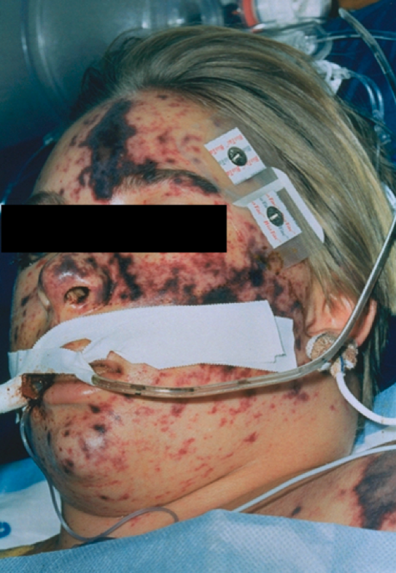
Sepsis 2020 update
Dr Nicola Cooper
Consultant Physician & Clinical Associate Professor
Medical Assessment Unit
Notes:
If you are using these slides to teach, please acknowledge the author: Dr Nicola Cooper, consultant in Acute Medicine, Royal Derby Hospital.

Slide 2
The problem of sepsis
A life-threatening medical emergency
A global health priority (WHO)
A clinical syndrome that can arise from virtually any infection
Resulting in a wide variety of presentations
Can sometimes be difficult to recognise
250,000 cases each year in the UK and 44,000 deaths
Over half of survivors experience long term reductions in quality of life

Slide 3
Barcelona Declaration 2002
Notes:
Here is the story of sepsis
Barcelona Declaration: aim to reduce sepsis deaths by 25% over next 5 years

Slide 4
Notes:
We also have a NICE guideline
While NICE acknowledges definition of sepsis (dysregulated host response) it focuses on ”think sepsis” and “risk of sepsis” , early assessment and treatment of “high risk” pts but does not focus on actual sepsis
GPs now have this sepsis risk stratification tool in their PCs and have received “think sepsis” training and we are starting to see more patients walk in (ore well) to MAU ?sepsis or fever ?cause as a result …
Lots of publicity about sepsis, overdiagnosis – and yet at same time we still often don’t recognise actual sepsis and treat it as an emergency.

Slide 5
What is ‘sepsis’?
What differentiates sepsis from ‘infection’ is an abnormal or dysregulated host response and the presence of organ dysfunction
Specific infections may result in local organ dysfunction without generating a dysregulated host response
Notes:
Note new definitions
e.g. biliary infection + abn LFTs and a bit of a low BP is not sepsis
Likewise, UTI and AKI in elderly pt on diuretics not E+D, BP a bit low is not sepsis
Chest inf needing oxygen is not sepsis

Slide 6
Prevalence and hospital mortality associated with sepsis
Proportion (%) of admissions to ICU with severe sepsis in the first 24 hours
Hospital mortality (%)
70
60
50
40
%
30
20
10
0
0–4
5–9
10–14
15–19
20–24
25–29
30–34
35–39
40–44
45–49
50–54
55–59
80–84
85–89
90+
60–64
65–69
70–74
75–79
Age group (years)
Notes:
Severe sepsis affects all ages.⁸
Of those adults admitted to the ICU, a similar proportion in each age group will present with severe sepsis.⁸
Hospital mortality associated with severe sepsis increases with age.⁸
Severe sepsis in adults is associated with hospital mortality ranging from 28% to 50%.¹⁹
The hospital mortality associated with admissions to ICU with severe sepsis in the first 24 hours in ICU in 92 adult general ICUs, included in the ICNARC Case Mix Programme Database for England, Wales and Northern Ireland, is 44.7%.⁸
In adults, the proportion of admissions in ICU with severe sepsis in the first 24 hours in ICU remains fairly constant across age groups. However, hospital mortality increase steadily with age.⁸
Recent analyses of data collected on 61,874 admissions to 92 adult general ICUs in England, Wales and Northern Ireland (between 1996 and 2000) have shown that hospital mortality for admissions to the ICU with severe sepsis in the first 24 hours in ICU is 44.7%. Hospital mortality increases with age from 5.4% for admissions aged 5–9 years to 64.1% for admissions aged 90–94 years.⁸

Slide 7
The prognostic effect of organ dysfunction in sepsis
Proportion (%) of admissions to ICU with severe sepsis in the first 24 hours in ICU with (N) organ dysfunctions
Hospital mortality (%)
100
80
60
%
40
20
0
1
2
3
4
5
Number of organ dysfunctions
Notes:
Hospital mortality for admissions to ICU with severe sepsis in the first 24 hours in ICU increases with the number of organ dysfunctions.⁸
Multiple organ dysfunction syndrome (MODS) is a progressive clinical syndrome characterised by the presence of altered organ function such that homeostasis cannot be maintained without intervention.¹¹ Primary MODS develops because of the initial insult or infection. Secondary MODS develops in organs distant from the primary infection and as a consequence of an abnormal host response.¹¹
Organ dysfunction is usually sequential, with lung dysfunction being the most common.¹⁰⁰
Prognosis is directly related to the number of organs affected.^{8,100} The more organ systems affected, the greater the need for additional supportive therapies and the worse the prognosis. The particular organs involved have differing prognostic significance: dysfunctions of the kidney significantly raise the hospital mortality associated with severe sepsis.^{8,100}

Slide 8
Hospital mortality associated with sepsis by APACHE II score
Proportion (%) of admissions to ICU with severe sepsis in the first 24 hours in ICU by APACHE II score
Hospital mortality (%)
100
80
%
60
40
20
0
0–4
5–9
10–14
15–19
20–24
25–29
30–34
35–39
40–44
45+
APACHE II score groups
Notes:
The Acute Physiology and Chronic Health Evaluation II (APACHE II) score combines physiological measurements, age and comorbidity to assess severity of illness for individual ICU admissions.
Hospital mortality increases with APACHE II score.^{8,40}
The APACHE II scoring system is used in ICUs to assess the severity of illness for individual admissions and to allow stratification by patient groups. APACHE II assesses the patient according to physiological variables and their deviation from the normal range, neurological function (according to the Glasgow Coma Scale) and assessment of chronic health and age. APACHE II can be used to estimate group outcome among ICU admissions.^{40,100}
This slide shows the trends in hospital mortality with APACHE II score for admissions to the ICU with severe sepsis in the first 24 hours in the ICU. An increase in hospital mortality is associated with an increase in APACHE II score.^{8,40}

Slide 9
Pathogens involved in sepsis
Gram negative
Gram positive
Fungal infection
20%
Mixed bacterial
45%
19%
Other mixed
3%
10%
3%
Unconfirmed
Only 60% of sepsis/septic shock cases are associated with confirmed infection
Disease progression is similar regardless of causative organism
Notes:
The most common microbial causes of sepsis are pure Gram-negative or Gram- positive pathogens (36% and 35% of cases, respectively).¹⁵
Mixed bacterial infections account for 19% of cases, pure fungal 5%, with mixed bacterial/ fungal/viral infections comprising the remaining 5%.¹⁵
Almost every type of micro-organism has the potential to initiate an episode of sepsis. However, only 60% of cases may be associated with a microbiologically confirmed infectious pathogen.¹⁵
The clinical progression of sepsis is similar, regardless of the infectious agent.^{6,15,23}
Although Gram-negative bacteria have traditionally been the most common bacteria associated with septic shock,^{25,26} the relative proportion of cases associated with Gram-positive infection has escalated.^{6,23,24}

Slide 10
Sepsis (formerly ‘severe sepsis’) The result of the body’s over-response to infection
Pathogen
Infection
Host response ++
Coagulation / fibrinolysis
Inflammation
Other factors
Endothelial dysfunction
Loss of homeostasis
Organ dysfunction
Death
Notes:
Bacterial infection evokes a host response by triggering the immune system.
Normally, the endothelium plays a key role in maintaining homeostasis.^{41,42}
Systemic microvascular endothelial damage compromises the active, moderating role of the endothelium.⁴¹
In the sepsis patient, endothelial dysfunction is central to the imbalance between inflammation, coagulation and fibrinolysis.⁴¹
Other pathophysiological mechanisms, including nitric oxide and mitochondrial dysfunction, may also be involved in disease progression.⁴³
Loss of homeostasis in sepsis patients may result in organ dysfunction.^{41,44}

Slide 11
Inflammatory response to infection
Pathogen
Infection
Anti-inflammatory
mediators
IL-4, IL-10, IL-11, IL-13,
IL-1r
Monocyte/ macrophage
Pro-inflammatory
cytokines
Tumor necrosis factor, IL-1, IL-6, IL-8
Neutrophil activation,
aggregation,
degranulation;
release of oxygen free radicals and proteases
Platelet
activation –
aggregation
T-cell
IL-2,
Interferon-γ,
GM-CSF
Endothelial damage
Notes:
Stimulation of the host immune response by toxins causes an inflammatory response that can lead to endothelial damage.⁴¹
Pro-inflammatory cytokines, such as tumour necrosis factor (TNF), interleukin-1 (IL-1) and IL-6, are released in response to infection with the aim of destroying damaged tissue and promoting wound repair. Normally, anti-inflammatory mediators (e.g. IL-10, IL-13) are subsequently released to regulate the inflammatory response and restore homeostasis.⁴⁸
Although inflammation is an essential host response, excessive levels of pro-inflammatory cytokines can lead to systemic endothelial damage, and high levels of anti-inflammatory mediators can result in immune suppression.⁴⁸
In sepsis, the imbalance between pro-inflammatory cytokines and anti-inflammatory mediators results in:
• stimulated coagulation response⁵²
• inhibited anticoagulant response^{44,47}
• inhibited fibrinolytic response.^{44,47,53,54}
These processes lead to endothelial damage and loss of equilibrium between the coagulation and fibrinolytic mechanisms.⁴⁴ As a procoagulant state develops, thromboses may form in the microvasculature, and in severe sepsis, the condition may progress to acute organ dysfunction and eventually death.^{44,47,55}

Slide 12
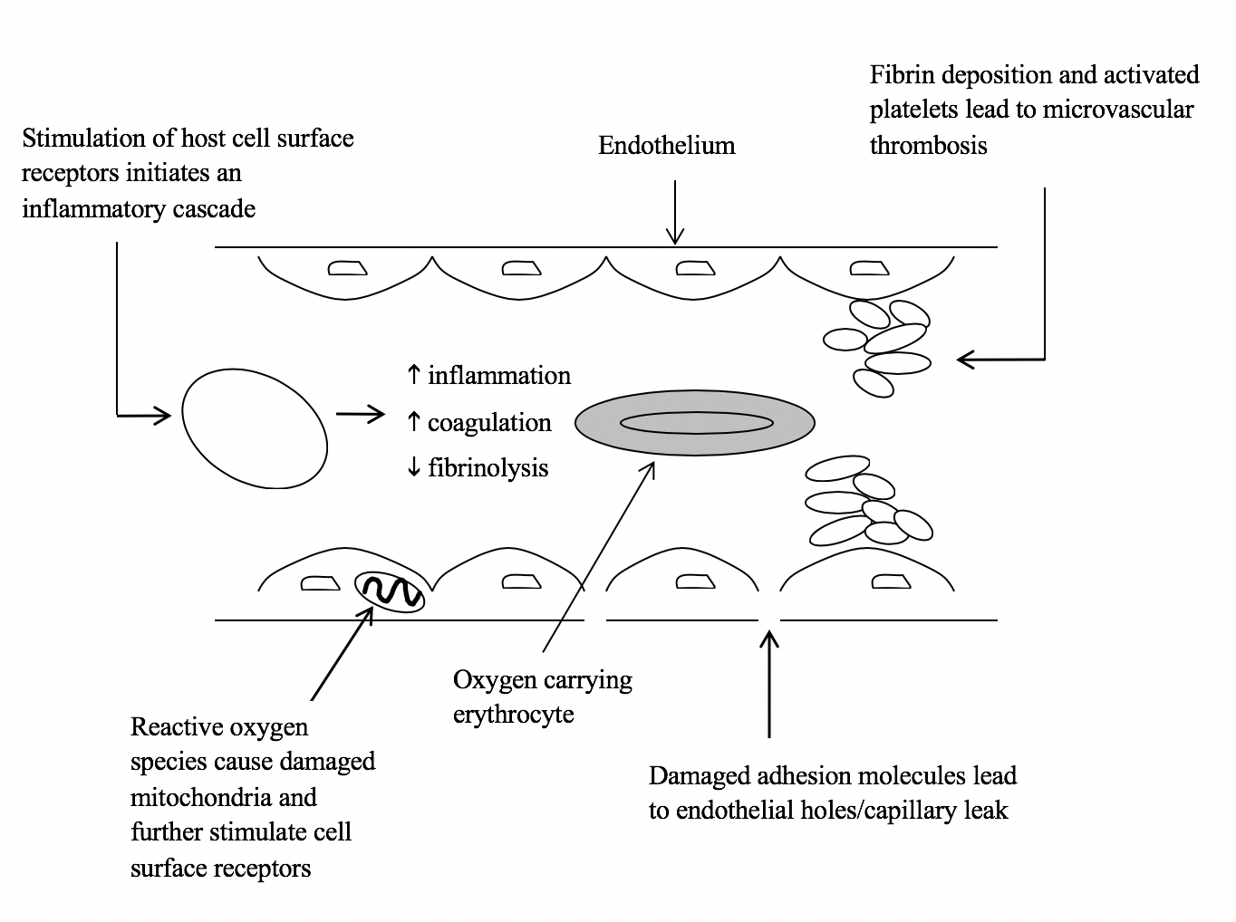

Slide 13
We no longer talk about ‘SIRS’ – SIRS is normal
Severe sepsis
Infection
SIRS
Sepsis
Old!
Death
A non-specific clinical response including >2 of the following:
As well as infection, SIRS can also be caused by trauma, burns, pancreatitis and other insults
Temperature >38ºC or <36ºC
Heart rate >90 beats/min
Respiratory rate >20/min
White blood cell count >12,000/mm³ or <4,000/mm³ or >10% immature neutrophils

Slide 14
NEW: infection-inflammation vs sepsis
Infection
Sepsis
Death
Infection with signs of at least one acute organ dysfunction as represented by a SOFA* score of 2 or more:
Hypotension
Altered GCS
Respiratory failure (PaO₂/FiO₂)
AKI
DIC
etc.
Septic shock Sepsis with hypotension refractory to adequate volume resuscitation
*Sepsis-related organ failure assessment

Slide 15
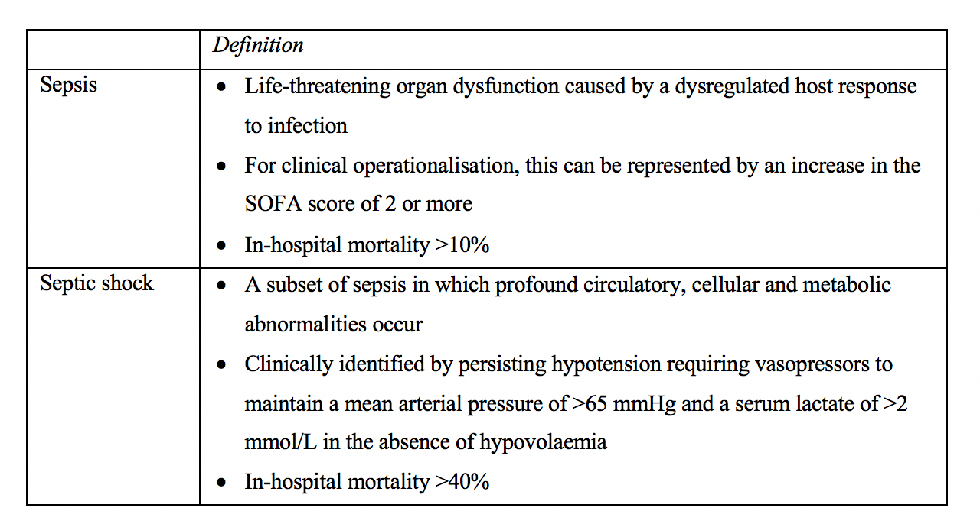

Slide 16
All hospitals are required to screen for sepsis
UK Sepsis Trust and NICE recommendations -
If one of more of these present, the patient is ‘high risk’ (of having sepsis):
New altered mental state
BP < 90 systolic
HR >130 /min
RR > 25 /min
Needs oxygen
Poor urine output
Lactate > 2 mmol/L
Recent chemotherapy
Mottled or ashen appearance

Slide 17
Is this sepsis?
A frail elderly patient admitted with a chest infection, delirium and fast atrial fibrillation.
New altered mental state
Needs oxygen
HR >130 /min

Slide 18
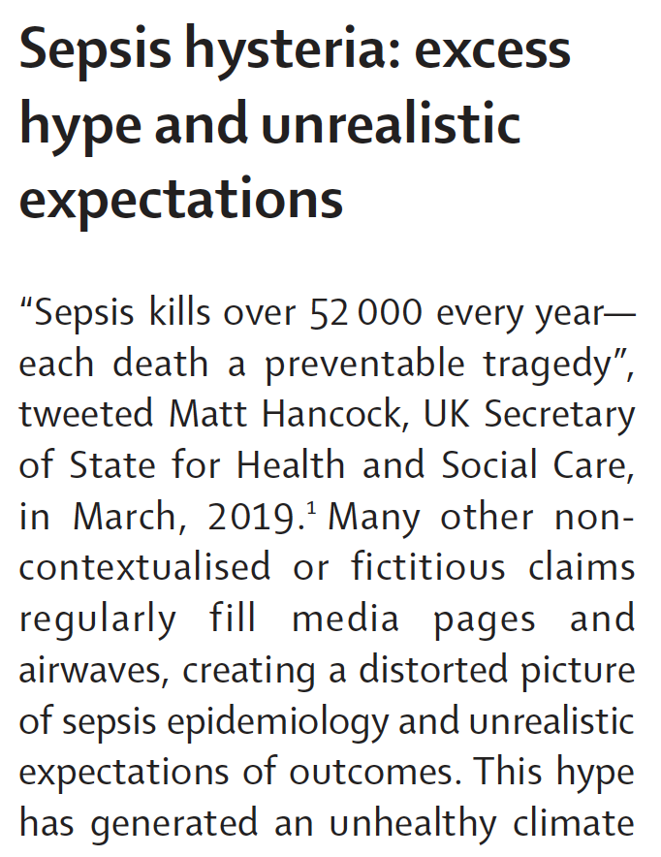
Lancet 2019; 394(10208):1513-14

Slide 19
In response to concerns about labelling people with infection as having sepsis and concerns about antibiotic stewardship, the updated 2019 UK Sepsis Trust care bundle and the NICE guideline has ‘immediate review by a senior clinical decision maker to assess the person and think about alternative diagnoses to sepsis’ as the first step.
This is not yet in the Trust’s sepsis screening tool.

Slide 20
Screening for sepsis
NEWS2 has been found to be a good predictor of mortality
‘Is this person scoring because of an infection?’
qSOFA rapidly identifies patients likely to have poor outcomes from sepsis, and should prompt clinicians to look for organ dysfunction and escalate care
Respiratory rate of >22/min
Altered mentation (Glasgow Coma Score of less than 15)
Systolic blood pressure of <100 mmHg

Slide 21
Screening for sepsis
There is no diagnostic test for sepsis
So ‘think sepsis’ if:
The patient looks ill
Is triggering on NEWS2
And has symptoms or signs of an infection (including on blood tests)

Slide 22
Biochemical markers of severe illness
Infection + NEW:
Metabolic (lactic) acidosis
High or low white cell count
Low platelet count
High creatinine
High C-reactive protein (CRP)

Slide 23
When do I ‘think sepsis’?

Slide 24
Summary: what is sepsis?
Pneumonia requiring oxygen?
Hypotension and AKI in an elderly nursing home resident, not eating and drinking because of an infection?
An infection with normal BP + organ failure(s) + severe metabolic acidosis?

Slide 25
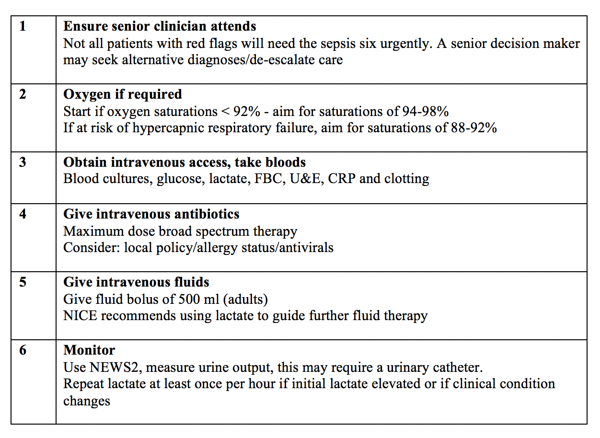
The updated ‘Sepsis Six'

Slide 26
Sepsis Six: a word of caution …
Hyperoxaemia can be harmful
Lactate levels correlate with mortality but lactate might be an adaptive response in sepsis
Never write ‘blood cultures if spikes fever’!
What’s the evidence for antibiotics within 1 hour?
Sepsis-induced hypotension is the result of different pathological processes – too much fluid is harmful

Slide 27
Don’t stop after the ‘Sepsis Six’
Culture everything!
Source control – the 4 D’s:
Drainage
Debridement
Device removal
Definitive repair of anatomical abnormality (e.g. perforated viscus)
Monitor for signs of improvement
If no improvement in 1 hour – escalate!

Slide 28
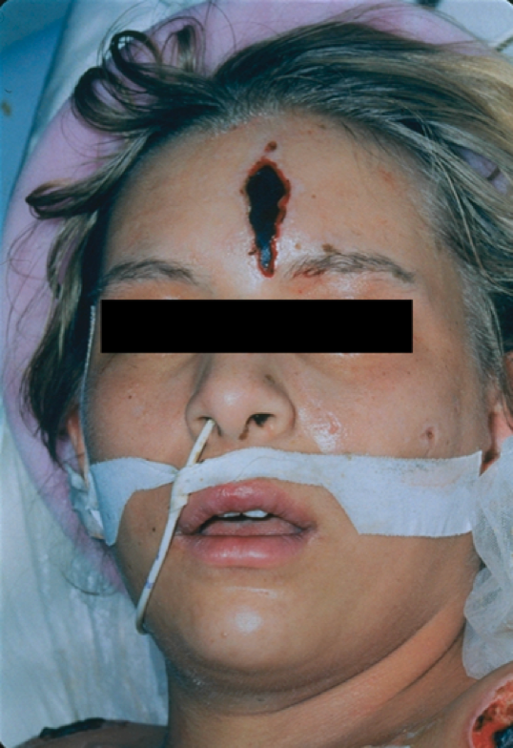
Summary
Sepsis continues to have a high mortality
Rapid recognition and treatment outside the ICU can improve mortality
New definitions
NICE emphasises ‘think sepsis’ – but NICE criteria is not (necessarily) sepsis
Notes:
For diagnosis and treatment to be most effective, it is vital that there is continuing education and raised awareness.
Greater understanding of the pathophysiology and clinical features will allow quicker recognition of sepsis, enabling fast, specialist intervention and improved outcome. It is therefore vital that there is continuing education within the medical profession on the issues surrounding sepsis, and that a concerted focus is kept upon this condition.

Slide 29
Questions?

Slide 30
Is this sepsis? 1
A 60-year-old man was admitted from the heart failure clinic with increased SOB. His most recent LVEF was 35%.
Vital signs: alert, BP 88/60, temp 38.1ºC, RR 24, SpO₂ 93% on air, HR 90. NEWS2 = 8
VBG shows a lactate of 1.2 mmol/L
Chest X-ray: left basal consolidation, CURB-65 = 1

Slide 31
Is this sepsis? 2
A 52-year-old woman with no PMH attended ED feeling unwell. Her daughter said she had a fever, was confused at times, felt nauseated and “ill”.
Vital signs: alert, BP 120/70, temp 38.0ºC, RR 18, SpO₂ 96% on air, HR 90. NEWS2 = 0.
While she was being examined, the doctor noticed rapidly appearing purpuric spots on her abdomen and limbs which the daughter and patient had not noticed before.

Slide 32
Is this sepsis? 3
A 95-year-old woman was admitted from a nursing home with drowsiness, not eating and drinking. She had been started on antibiotics two days before for a chest infection. PMH: CCF, AF, CKD, dementia. On a diuretic, ACEi and DOAC.
Vital signs: drowsy, BP 90/60, temp 36.7ºC, RR 22, SpO₂ 93% on air, HR 135. NEWS2 = 13.
Chest X-ray: right lower zone consolidation

Slide 33
Is this sepsis? 4
A 30-year-old woman was admitted to hospital via her GP because she triggered on the community sepsis screening tool. She had been to see her GP because of a fever, sore throat and feeling ”awful”.
She walked in to the department with her GP letter.
Vital signs: alert, BP 140/65, temp 38.9ºC, RR 20, SpO₂ 98% on air, HR 115. NEWS2 = 3.
On examination, she had enlarged tonsils covered in white exudate, and tender anterior cervical lymph nodes. She was able to swallow.
Centor Score = 4

