Slide 1
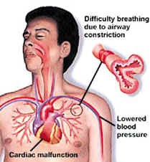
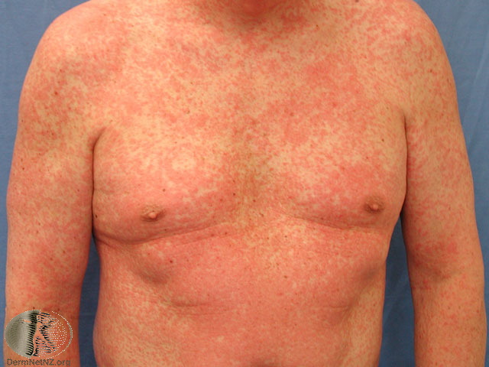
Rash and Anaphylaxis
By
Habib Haider
SpR AIM / GIM

Slide 2
Objectives
Unwell Patient with a Rash
Recognise Dermatological emergencies
Cutaneous Manifestation of Systemic Diseases
Vasculitis
Hypersensitivity Reactions
Anaphylaxis
Resus Council & NICE Guidelines of Anaphylaxis

Slide 3
Approach and Management
Recognise dermatological emergencies
Danger signs
Drug rashes
Initial and long term management
Involving a dermatologist

Slide 4
Introduction
Dermatological emergencies are rare but important
As they are infrequently encountered clinicians are often unfamiliar with them
Can be divided into primary skin diseases and severe systemic disease with cutaneous manifestations
Can lead to “acute skin failure” – loss of:
Fluid and electrolyte homeostasis
Temperature homeostasis
Immunological function

Slide 5
The Danger Signs
Fever with rash
Sick patient/SIRS
Blistering disorders
Mucosal involvement

Slide 6
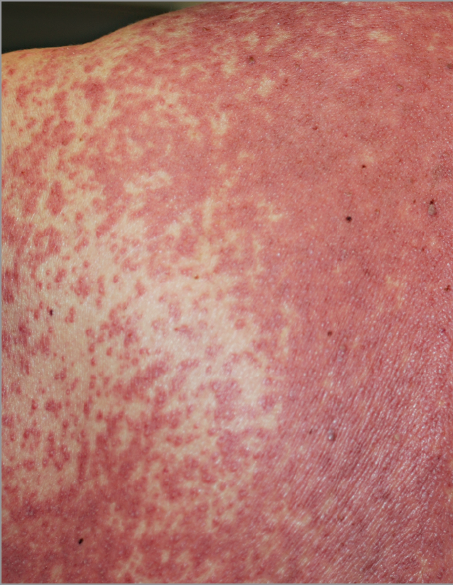
Drug hypersensitivity syndrome (DRESS)
2-8 weeks after starting drug
Unwell patient
Fever, lymphadenopathy and systemic features
Eosinophilia common
Commonly due to anticonvulsants
8% mortality
Treatment systemic steroids
Occ. IVIG, plasmapheresis

Slide 7
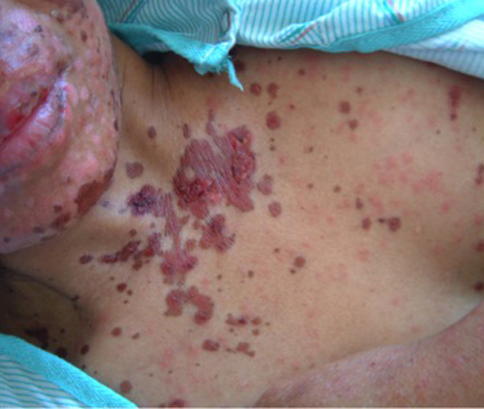
Stevens-Johnson syndrome

Slide 8
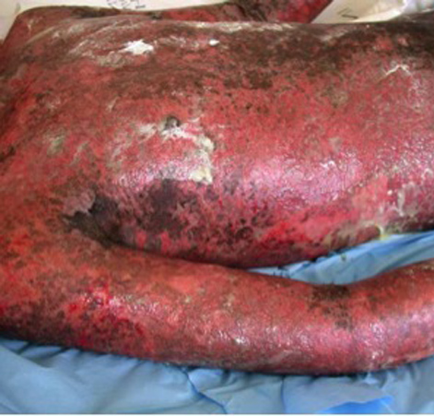
TEN

Slide 9
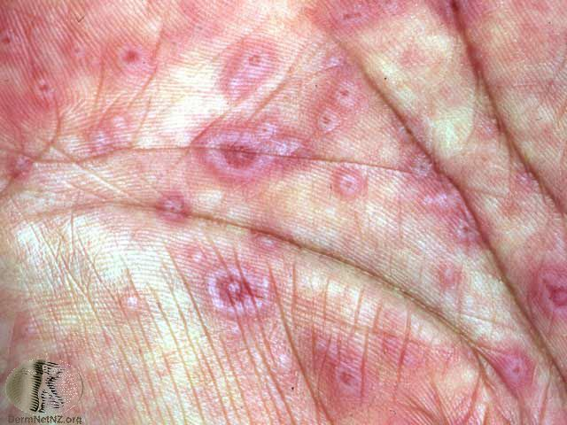
Erythema multiforme
Mycoplasma pneumoniae
Herpes simplex virus
Drugs

Slide 10
SJS/TEN vs. erythema multiforme
SJS/TEN | EM
Commonly drug induced | Commonly associated with infection
Atypical target lesions | Typical or atypical target lesions
Starts on face and trunk | Starts distally
Mucosal involvement common | Mucosal involvement rare (bullous EM)
Sick patient | Well patient
Systemic features | Lack of systemic features

Slide 11
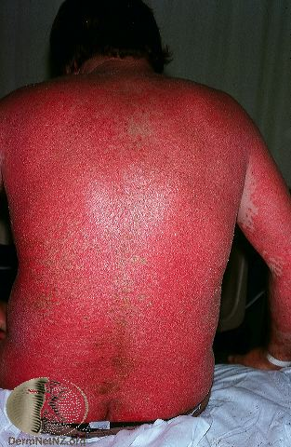
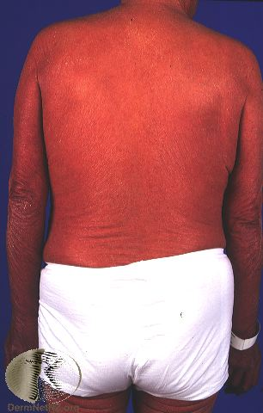
Erythroderma

Slide 12
Erythroderma
Inflammation of greater than 80-90% of the skin
May be systemically unwell with fluid and electrolyte imbalance and loss of thermoregulation
Various causes, can sometimes be differentiated from history and examination

Slide 13
Management of erythroderma
Most need admission for
Bed rest
Observations
Fluid resuscitation
Temperature regulation
Intensive emollient therapy
Systemic therapy
Directed at underlying cause if possible

Slide 14
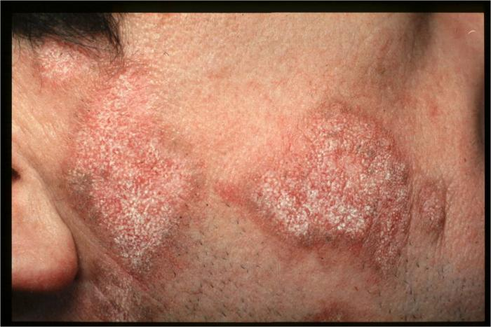
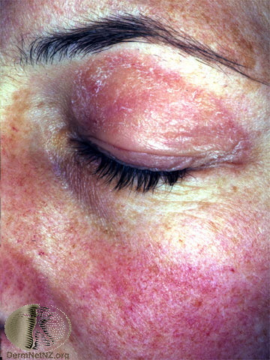
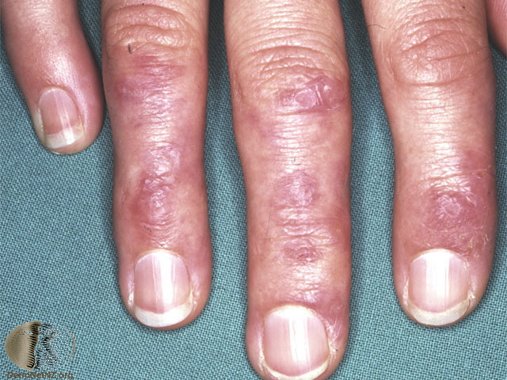
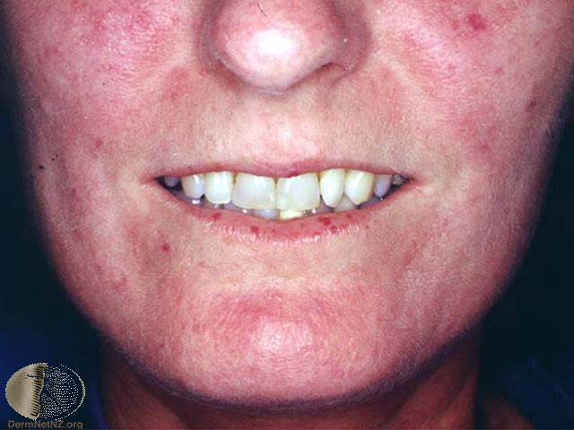
Rashes - Vasculitis
Discoid lupus erythematosus
Scleroderma Localised, limited cutaneous (CREST) or systemic/diffuse
Dermatomyositis

Slide 15
Work up
Bloods – ESR & CRP
Autoimmune profile
ANA, ANCA, Complement Factors
Specific Antibodies
Urine Dipstick

Slide 16
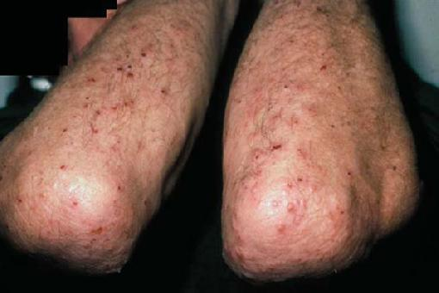
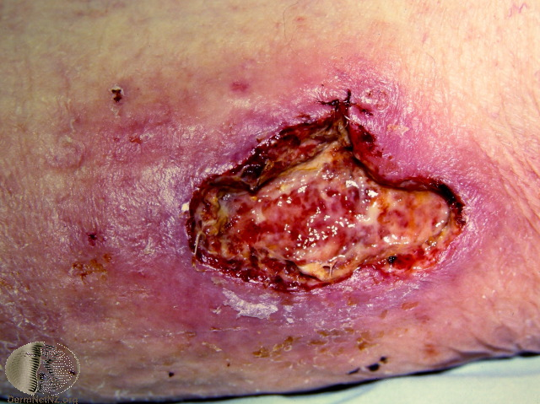
Skin manifestations in GI Diseases
Dermatitis Herpetiformis Coeliac disease
Erythema Nodosum Inflammatory bowel disease, sarcoidosis, Strep A, TB, COCP
Pyoderma gangrenosum Inflammatory bowel disease, rheumatoid arthritis

Slide 17
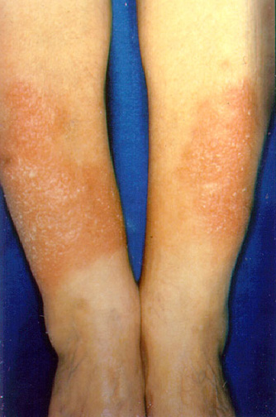
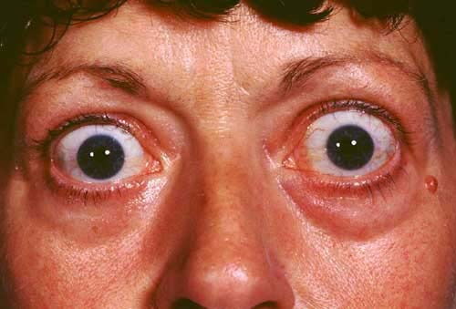
Skin manifestations in Endo
Thyroid eye disease
Pretibial Myxoedema

Slide 18
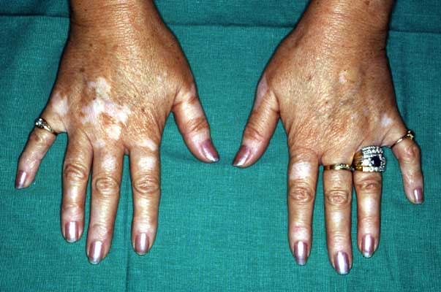
Skin manifestations in Endo
Necrobiosis lipoidica Diabetes mellitus
Vitiligo Other autoimmune disease e.g. diabetes, Addison’s

Slide 19
Skin Manifestations in Pulm
Lupus Perino
Mycoplasma pneumoniae
Herpes simplex virus
Drugs

Slide 20
Hypersensitivity reactions

Slide 21
Anaphylaxis
Serious Type I reactions
• Laryngeal oedema & Bronchospasm
• Hypotension/collapse – Anaphylactic Shock
• Onset usually within minutes/seconds
• Almost invariably
symptoms begin within 60 mins
• Generally the later the onset the less severe the symptoms
• 30% have a biphasic reaction 1-4 hours

Slide 22
Anaphylaxis – Initial management (A – E Approach) – Resus Council

Slide 23
Anaphylaxis – NICE guidelines
Document clinical features, time reaction,circumstances immediately before
Mast cell tryptase ASAP, 1-2 hours, (+ at Fup)
Observe 6-12 hours
Referral pathway Specialist Allergy service
Offer adrenaline autoinjector (AAI)
Inform anaphylaxis, biphasic reactions, AAI,
avoidance, referral, patient support groups

