Slide 1
Palliative Care in Acute Medicine
September 2021
Dr Ruth England
Consultant Palliative Medicine UHDB
ruth.england@nhs.net
@DrRuthEngland

Slide 2
Aim of afternoon

Slide 4
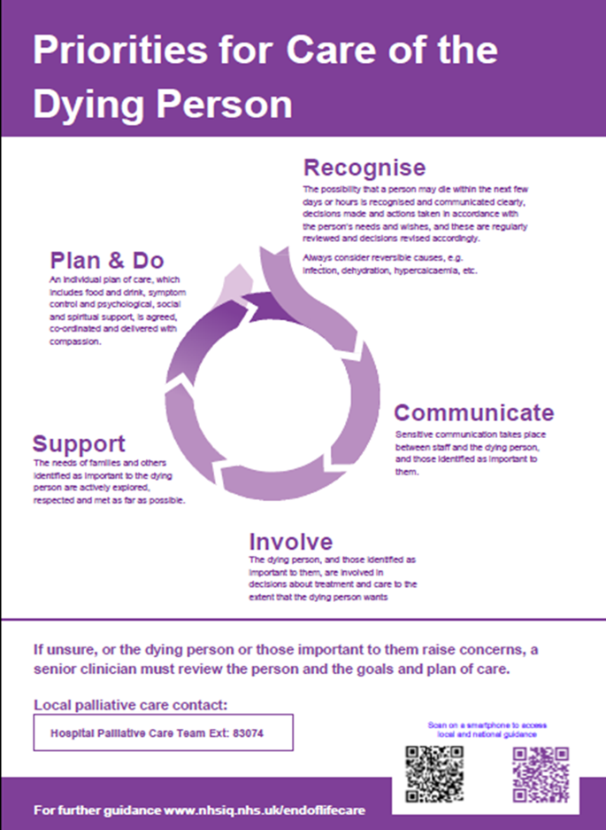
Recognise – senior doctor
Discuss with patient and family
Communicate with wider team
Involve patient & family
Support for families
Deliver good care
xx

Slide 5
Factors that may indicate that dying is imminent in a patient with a progressive underlying condition with limited/no reversibility
Bedbound
Drowsiness, impaired cognition
Difficulty taking oral medications
Reduced food and fluid intake
Increasing symptom burden

Slide 6
Crisis management in patients with end stage dementia

Slide 7
Gwen
Current medication: warfarin (INR in range), mirtazapine 15mg od, omeprazole 40mg od, lactulose 10ml qds, fortisip, atorvastatin 40mg od, AdCal D3 od
What is the prognosis here?
What is an appropriate management of her likely aspiration pneumonia in these circumstances? Consider her current medication

Slide 8
Indicators of advanced dementia GSF 2006
Unable to walk without assistance, and
Urinary and faecal incontinence, and
No consistently meaningful verbal communication, and
Unable to dress without assistance
Barthel score < 3
Reduced ability to perform activities of daily living
Plus any one of the following:
10% weight loss in previous six months without other causes, Pyelonephritis or UTI, Serum albumin 25 g/l, Severe pressure scores eg stage III / IV, Recurrent fevers, Reduced oral intake / weight loss, Aspiration pneumonia

Slide 9
Deprescribing in palliative care
Deprescribing in palliative care | RCP Journals
DOI: https://doi.org/10.7861/clinmedicine.19-4-311
Notes:
Classes of medications highlighted as being appropriate to consider deprescribing are those prescribed for primary and secondary prevention, or those with no short term benefit eg statins, antihypertensives, gastric protection and, in some cases, oral hypoglycaemics. Kutner et al conducted a multicentre, randomised controlled trial on the safety of discontinuing statins in patients with a life expectancy of less than 1 year. 14 They showed no difference in the number of patients who died within 60 days of study enrolment and no difference between the two groups of occurrence of cardiovascular-related events. They conclude that stopping statins in this cohort of patients was safe and may have benefits including enhanced quality of life. 14 Antihypertensive medications are also an option for deprescription in the palliative population, particularly when geared towards primary prevention, and when the time to therapeutic benefit is greater than estimated life expectancy. 15 Pasierski highlights the importance of reviewing and considering stopping antihypertensives for patients with a limited life expectancy. 16 Often towards the end of life there is a natural lowering of blood pressure putting those continuing to take these drugs at risk of hypotension (and dizziness and falls). 16 Gastric protection where there is no history of gastrointestinal bleeding, peptic ulcer, gastritis, or when taken to prevent side effects of other medications that have been ceased (eg steroids or nonsteroidal anti-inflammatory drugs) is likely to be unnecessary. 17 Oral hypoglycaemics may no longer be indicated if the sole use was secondary prevention of diabetic associated events or to treat mild hyperglycaemia. 18 Certainly in the final weeks of life there should be more relaxed blood glucose control for patients previously on strict regimens. 1

Slide 10
Feeding difficulties
Assessment by a specialist team, including dietician, speech therapist and specialist nurses and doctors, is needed before starting clinically assisted feeding.
There are several ways of doing this:
Nasogastric tube (NGT)
Percutaneous endoscopic gastrostomy (PEG)
Radiologically inserted gastrostomy (RIG)
Intravenous feeding

Slide 11
Feeding difficulties
In advanced dementia, the risks associated with clinically assisted feeding increase significantly. As many as a third of patients may die in the first month after gastrostomy insertion, especially if they also have an infection and pressure sores.
There is now strong evidence that suggests that clinically assisted feeding does not lengthen life in people with far advanced dementia, nor does it improve quality of life, nutritional status, function or reduce pressure sores.

Slide 12
Feeding difficulties: references
Harwood RH. Feeding decisions in advanced dementia. J R Coll Physicians Edinb 2014; 44:232-7
RCP. Oral feeding difficulties and dilemmas: a guide to practical care, particularly at the end of life. Report of a working party. Jan 2010. RCP London
DiBartolo MC. Careful hand feeding: a reasonable alternative to PEG tube placement in individuals with dementia. J Gerontol Nurs. 2006 May;32(5):25-33
Murphy LM, Lipman TO. Percutaneous endoscopic gastrostomy does not prolong survival in patients with dementia. Arch Intern Med. 2003 Jun 9;163(11):1351-3.
Luk J, Chan F, Hui E et al. The feeding paradox in advanced dementia: a local perspective Hong Kong Med J 2017 Jun;23(3):306–10
Mitchell SL, Teno JM, Keily DK, et al. The clinical course of advanced dementia. N Engl J Med 2009;361:1529-38
Hoffer LJ. Tube feeding in advanced dementia: the metabolic perspective. BMJ 2006;333:1214-5
Finucane TE, Christmas C, Travis K. Tube feeding in patients with advanced dementia: a review of the evidence. JAMA 1999;282:1365-70.

Slide 13
What makes a good discharge summary for a patient with palliative care needs?
Statement that the patient is at risk of dying within the next year/months/weeks/days
Outcome of any ACP discussions including patient preferences for place of care and death
Details of conversations with those close to the patient
Information on whether any DNACPR order is to remain in place, or be subject to further review
A request that patient is placed on GP palliative care register
Notes:
For those patients who recover and are well enough to be discharged to primary care, it is essential to document the following points in the discharge communication: > the patient has been recognised as being at risk of dying in the next year > outcomes from discussions about ACP, including patient preferences on place of care and death; and information on whether any do not attempt CPR (DNACPR) order is to remain in place, or be subject to further review > a request that the patient is placed on the GP palliative care / end-of-life register > information about SPC referral, if made > information given to those close to the patient. The NHS is promoting an electronic palliative care coordination system (EPaCCS)16 to act as a register for key patient information, such as their treatment preferences and care plans, including any ADRT documents and DNACPR forms. It is anticipated that better access to key information will improve communication and coordination between professionals, and avoid unwanted or unnecessary treatments or interventions. Currently, there is wide variation across England and Wales in how far this system is embedded. Universal adoption and use of electronic registers is an important step towards effective coordination of care, and is essential to support patient choice at the end of life.

Slide 14
An unexpected death

Slide 15
Mei
Current medication: no prescribed medication has been administered this lunchtime. Normally takes amlodipine, metformin, Humulin, paracetamol, senna, AdCal D3, lansoprazole
What is the prognosis here?
What is the immediate medical management? Consider the management of her diabetes and prescription of anticipatory medication.
Mei is currently unconscious and as such lacks capacity. There is no record of a previous ReSPECT form being in place. What should you do?
Notes:
Humulin insulin, metformin 1g bd, amlodipine 10mg od, paracetamol, senna, Adcal D3, lansoprazole,

Slide 16
Diabetes at the end of life
The care of a dying person with diabetes is challenging, depending on prognosis and encompassing changes to:
Glycaemic targets
Individual and carer expectation
Reducing risk of hyper and hypo glycaemia
Managing the effects of other medications such as glucocorticoids
Tailoring diabetes medications

Slide 17
EoL_Guidance_2018_Final.pdf (diabetes.org.uk)

Slide 19
Notes:
How often to do BMs?

Slide 21
Principles of DNACPR Decision Making

Slide 22
What is CPR?
An emergency treatment that can sometimes restart breathing +/- circulation of blood following a respiratory +/- cardiac arrest
Mouth to mouth breathing
Chest compressions
Electric shocks

Slide 23
Risks of CPR:
Rib or sternal fractures
Hepatic or splenic rupture
Renal dialysis
Brain damage
Undignified and uncomfortable death and traumatic for people close to the patient to witness

Slide 24
Survival to discharge rates in hospital after CPR?
15 - 20%
25 – 40%
50 – 70%
75 – 100%

Slide 25
Most recent statistics show worse at weekends and nights (Resuscitation Council UK, 2016 )
B. 25-40%........but only just – 26% within Mon-Fri working hours in acute hospitals
Reduces to 19% at weekends
Reduces further 14% at night
Arrests out of hospital 5 – 10% discharge rates
Notes:
Doctors, nurses and patients significantly overestimate the chance of survival from CPR

Slide 26
Age influences survival
77 CPR attempts on patients over 70 years
31% immediate survival
92% of these alive after 24 hours
NONE SURVIVE TO DISCHARGE
Reviews in Clinical Gerontology Feb 2010
Lannon & O’Keefe
Notes:
Cardiopulmonary resuscitation in older people
Survival to discharge about 20% in those aged 65-69 yrs
10% to those 90 yrs or more

Slide 27
Cancer influences survival
CPR in cancer patients
Survival to discharge
9.5% localised disease
~ 6% metastatic disease
Many other factors important
type & extent of tumour, functional status, clinical deterioration
Reisfield GM et al Resuscitation(2006)
Notes:
Review of 42 studies 1966-2005
Analysis of data from 1990
Survival rates: localised disease 9.1%
metastatic 7.8%

Slide 28
What influences survival after CPR attempt?
274 patients resuscitated, none survived to discharge when:
Metastatic cancer
Pneumonia
Creatinine > 150µmol/l
Shock
pO2 < 6Kpa
S O’Keeffe et al 1991 Quarterly Journal of Medicine

Slide 29
Patients likely to benefit from CPR:
Good functional status
Early disease stage
Normal renal function
Absence of hypotension
Absence of pneumonia
Remediable cause eg. MI

Slide 30
Our duty is to offer treatments which we believe are likely to yield more benefit than harm or risk
- No difference in principle to providing any other treatment
Notes:
Ethical principles

Slide 31
When and how to discuss DNACPR decisions with patients - Tracey v Cambridge university hospitals NHS FT 2014
“There must be a convincing justification not to consult the patient – patient distress is no longer sufficient justification, must be considered to cause the patient “physical or psychological harm” not to discuss or patient indicates they do not wish to discuss”
Futility is not a valid argument for not discussing

Slide 32
In Summary
Core principal to consult and inform patient (and or family) of DNACPR decision, in cases both of capacity, or absence of capacity
Remains a clinical decision
In absence of capacity, clinicians MUST take into account the views of carers, and make every effort to contact them, even if it means a phone call at 3am

Slide 33
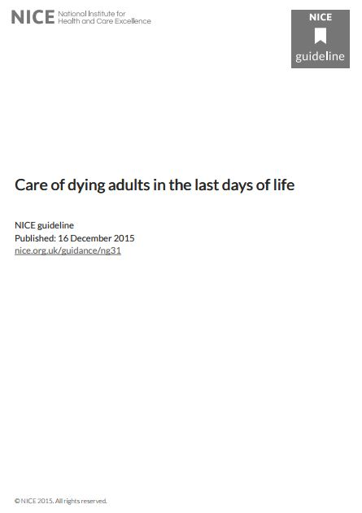
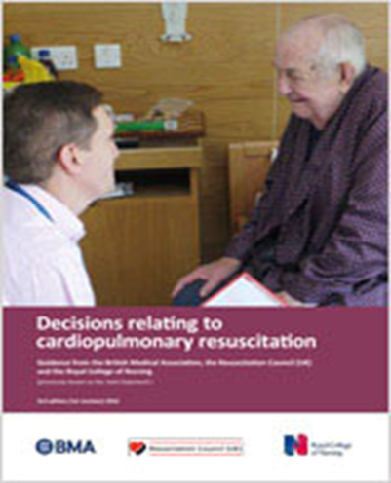
Guidance from: General Medical Council (2010), NICE (2015), Resuscitation Council (2017)
Treatment and care towards the end of life - GMC (gmc-uk.org)
Overview | Care of dying adults in the last days of life | Guidance | NICE
Publication: Decisions relating to cardiopulmonary resuscitation (3rd edition - 1st revision) | Resuscitation Council UK
Notes:
You are able to get the son on the phone. He is very shocked. He says he has power of attorney for mum. While he understands medical options for treatment are limited he is concerned that she should be hydrated. What are the issues here?

Slide 34
True/False
An LPA for health and welfare
Has to be registered with the Office of the Public Guardian
Costs money to register
allows the attorney to make any decision about health and personal welfare. This includes where a person lives and how they’re cared for, diet and clothes as well as decisions about medical treatment

Slide 35
Once an individual has lost capacity to make an advance decision no one else can make an advance decision on their behalf
If they have appointed a Lasting Power of Attorney (LPA) for health and welfare then that individual has the right to consent or refuse treatment on their behalf (including life saving/prolonging if specifically recorded) but not to demand specific treatments.
Otherwise decisions are based on any existing valid and applicable advance decision or in the best interests of the incapacitated individual. The best interests decision is a decision of the responsible professional.
The Mental Capacity Act requires the professional team to consider a number of areas in their decision making on behalf of an incapacitated adult. This can be summarised in a checklist.

Slide 36
Which of the following factors must be taken into account when making a best interests decision for an adult who lacks capacity?
The patient’s wishes
The risks and benefits of the proposed treatment and any alternatives
The religious beliefs of the individual
The views of the person’s family
The views of the nursing staff caring for the patient
The content of their advance decision

Slide 37
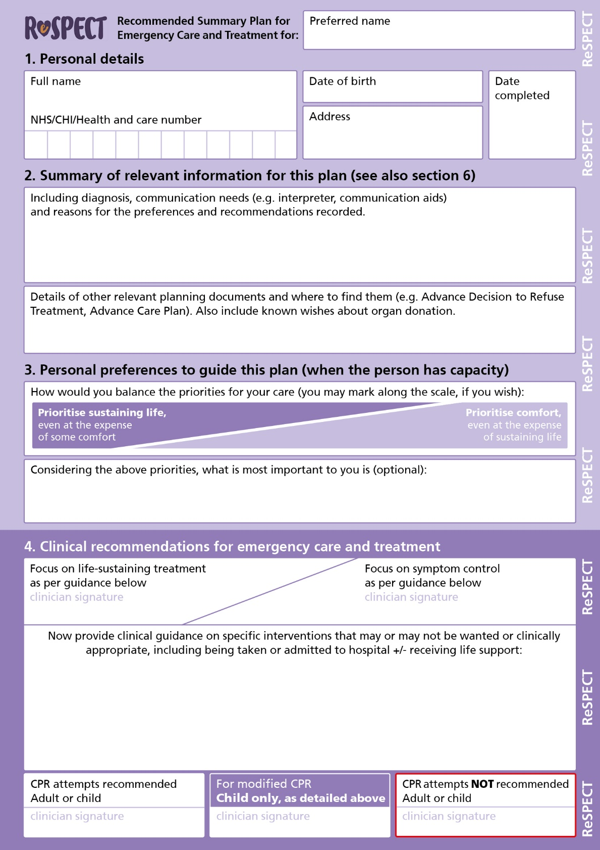

Slide 38
Approaching the end of life with cancer

Slide 39
David
Current medication: fentanyl patch 50mcg/h oramorph 5mg as required paracetamol 1mg qds simvastatin 40mg metoclopramide 10mg tds levothyroxine 50mcg od ramipril 5mg od, docusate 200mg bd
What is the prognosis here?
In terms of pain management, what else are you curious about?
What is your suggestion to manage his pain?
How would you manage AF in this case?
Should you prescribe anticipatory medication now?
Would you make any other medication changes?
How would you ask about the future?

Slide 40
Fentanyl patches
Scottish Palliative Care Guidelines - Fentanyl Patches

Slide 41
Management of bone pain
For symptomatic relief:
Apply hot or cold packs.
Use standard analgesia in a stepwise approach, including NSAID
If incident pain occurs on movement, encourage the person to take a dose of their breakthrough analgesia 20–30 minutes before anticipated movement
Consider radiotherapy and/or bisphosphonates – d/w oncology
Seek urgent advice from an orthopaedic surgeon if there is evidence or suspicion of an actual or imminent fracture.
If pain is difficult to manage, refer to palliative care

Slide 42
Suggestions for starting a conversation about future care
What do you understand about what is happening to you / your health?
Do you want to talk about / have you thought about what will happen to your health in the future?
Do you have any strong feelings about treatments that you would or would not want to receive?
Notes:
Evidence suggests that healthcare professionals are poor at initiating discussions with patients about EOL care, despite most patients wishing to be informed and involved in this.11 A willingness to initiate these discussions should be demonstrated at a senior level and advanced communication skills training has been shown to help.12 Conversations should not centre on withholding specific treatments, such as cardiopulmonary resuscitation (CPR), but rather discussion about these treatments should be placed in the context of a conversation about the patient’s illness and what will or will not be helpful (Box 1). It is important to check what conversations have already taken place, which might be recorded in an electronic palliative care coordination system or in an advance decision document. Bear in mind that the language healthcare professionals commonly use may, in itself, be distressing for patients and relatives. A senior medical review should aim to include: > an explanation to the patient that they may be in the last year of life, with limited reversibility of their underlying condition > a review of current treatment and care, based on patient goals > agreement with the patient on goals for further treatment, focusing on what can be done to support the patient to live well, but also on those interventions that are no longer helpful for that person; this may also include discussions about discharge to another care setting, and a plan for future deteriorations and whether these should result in readmission to hospital > some people will choose the most active treatment on offer to them, including readmission to hospital, whereas others may prefer to avoid this.1 All discussions and treatment plans should be documented clearly in the medical notes with a treatment escalation plan (TEP), as part of personalised care and support planning, and communicated with colleagues as part of routine handover.13 Discussions should also be offered to those identified as important to the patient, especially if there are concerns regarding the patient’s current or future mental capacity. A patient with capacity has the right to refuse any treatment, even if this seems unwise to the people looking after them. They do not have the right to demand treatment that is not felt to be clinically appropriate

Slide 43
Suggestions for starting a conversation about future care
What are your thoughts about the future? How do you see things going?
In thinking about the future, have you thought about where you would prefer to be cared for if things get worse?
What do you see happening with your illness over the next few months?
It would be good to discuss what kind of medical care you would want if you should get sick again. How do you feel about talking about this?

Slide 45
Trainee safeguards – using Real Talk video clips in online, streamed training
The trainee must ensure that video clips are only visible and audible to the individual(s) undertaking the training.
You must not record clips in any way, including photographic, audio, video or screen capture.
Both during and after the training session, the trainees and facilitator(s) must not talk about any individual shown in the video clips in personal or negative terms.
It is possible that, in your personal or professional life, you may come across people who you have seen in the video clips. Please be aware that these individuals are unlikely to know that you have seen video footage of them.
If you recognise any of the people in the video clips, you must not refer to them by name.
The video materials include content that may be distressing. You are encouraged to share any feelings of distress with your training facilitator during or after the streamed session.
Be aware that none of the professionals who appear in the recordings would claim that their clinical practice is perfect. However, the clips do include many examples of skills and actions that can contribute to good practice.
All of the people involved in the recordings gave their permission for clips from their recordings to be used in training, provided that the above safeguards are upheld.
March 2021
Copyright © Loughborough University. All rights reserved.

Slide 46
Specialist Palliative Care – who are we and what can we do for you?
We are a multi-disciplinary team of professionals trained and experienced in specialist palliative care. We have the knowledge, skills and experience to manage challenging problems that people with advanced, progressive and life-shortening illness may face. Our aim is to maximise quality of life and relieve suffering for patients as well as supporting their companions.
UHDB Specialist Palliative Care Service Referral Criteria:
Adults (usually aged 18 and over)
With a diagnosis of an advanced, progressive and life-shortening illness
Whose problems cannot be addressed by the skills of their usual health care provider
Can be made by any health care professional providing
Patient agrees
Responsible consultant/GP agrees

Slide 47
“Clinical staff need to ensure that treatments provided are both appropriate and proportionate, and they should be supported to identify and accept when patients are coming to the end of their lives without viewing this as a failure”

Slide 48
Review
Two learning points you will take from this afternoon?

Slide 49
Recommendations for professional development in EOL care include the following
Integrate palliative care into your daily practice – ask a member of your palliative care team to attend clinics, ward rounds and multidisciplinary team meetings, especially in areas with a high proportion of patients who require palliative care
Actively incorporate feedback from patients and carers to guide your professional development; for example, use patient or carer surveys or personal reflection
Refer to your local palliative care guidelines for quick reference and a stepwise management guide to common palliative care problems.
Include at least one learning event on ‘end-of-life care’ within a 5-year continuing professional development (CPD) cycle
The e-learning programme End of Life Care for All (e-ELCA) aims to enhance the training and education of the health and social care workforce

