Slide 1
Dealing with Challenging Situations in Mental Health
Dr Nicola Cooper
Consultant Physician
Regional AIM Training Day
January 2021

Slide 2
Things you really must know
Legal and professional frameworks within which medicine is practiced in the UK
Methods of ethical reasoning that inform decisions in medical practice
The influence of values, assumptions, attitudes and emotions on your communication, decision-making and practice

Slide 3
Learning outcomes
Understand the basic principles of the Law as applied to medicine (England and Wales)
Know the relevant sections of the Mental Capacity Act and Mental Health Act applicable to Acute Medicine
Be able to apply these legal frameworks appropriately in a clinical setting

Slide 4
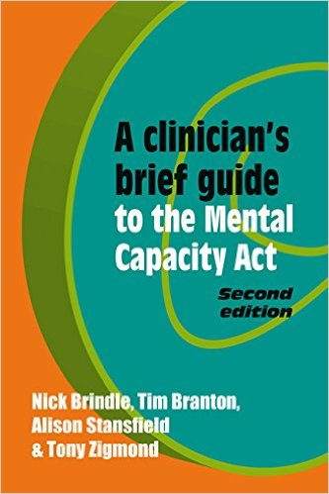
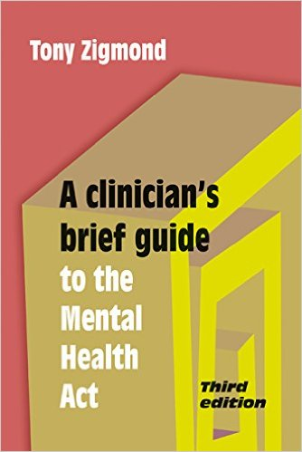
Notes:
Recommended reading
(Law applies to England and Wales only)
These are updated 2015 to incorporate latest judicial interpretations of statutory laws.

Slide 5
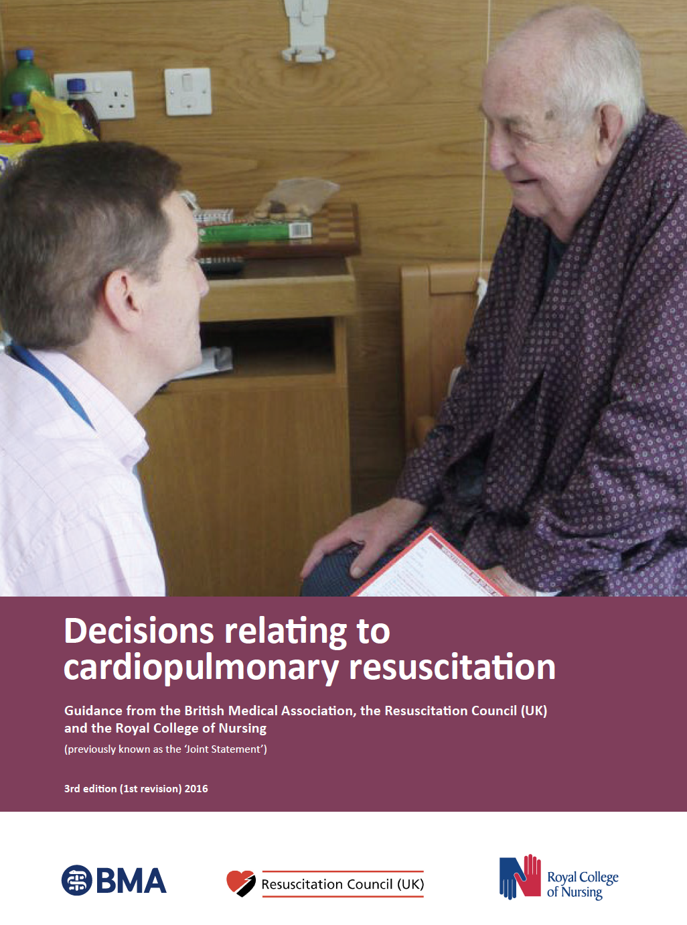
Confidentiality
Covert medication
End-of-life decisions
Fitness to drive
Duty to public safety

Slide 6
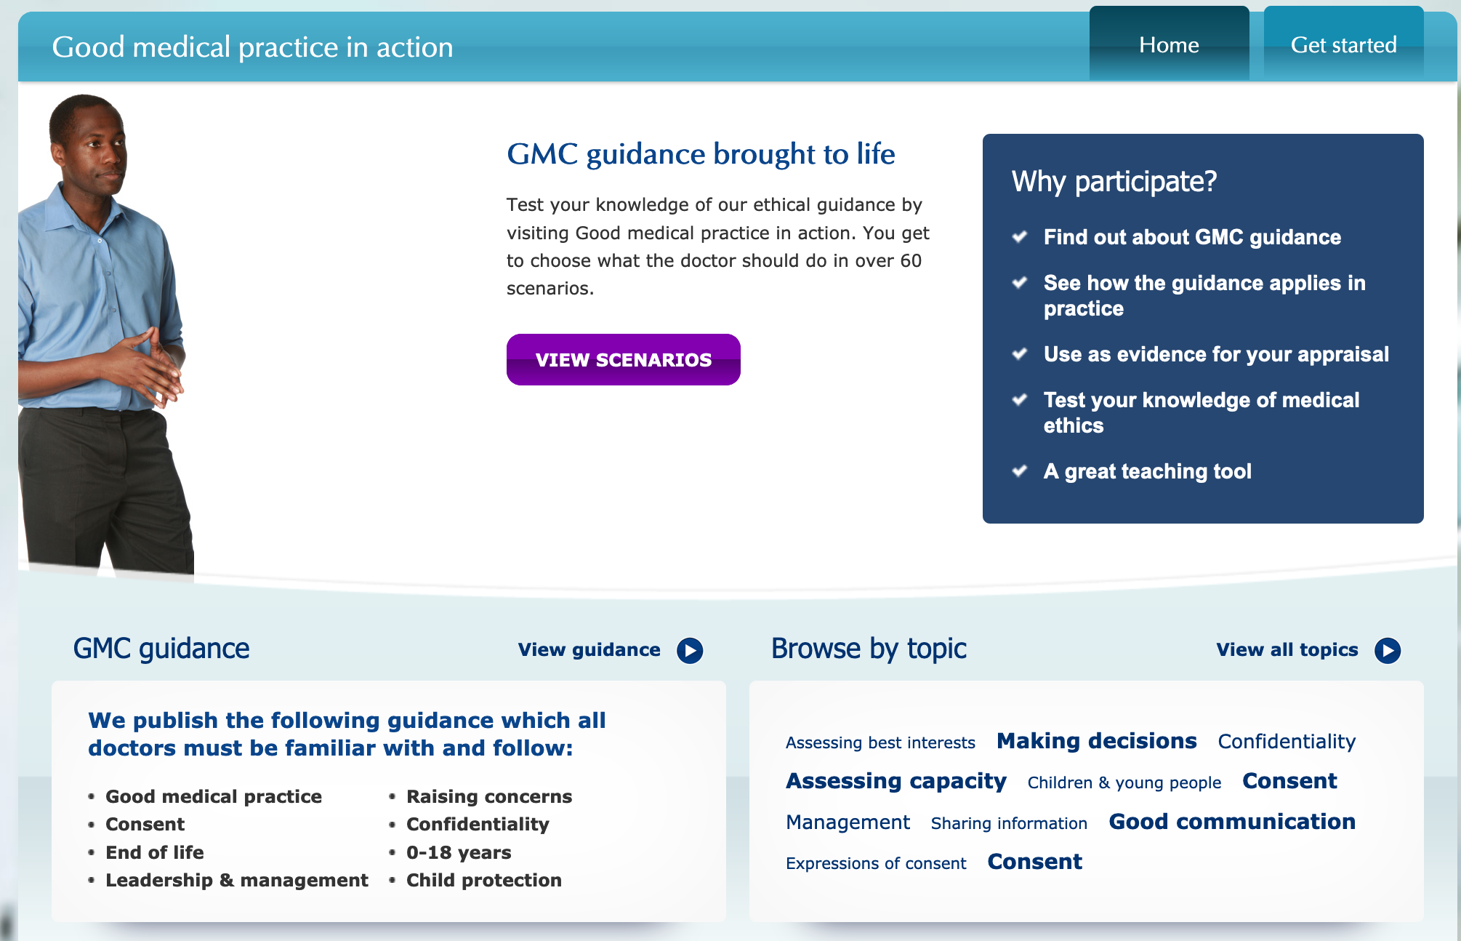

Slide 7
GMC: Decision making and consent. Nov 2020
‘Doctors are expected to keep up to date with the Law and follow our guidance and other regulations that are relevant to their work.’

Slide 8

Notes:
Does anyone have any stories about a really challenging situation when you did not know what to do?

Slide 9

Legal framework in England and Wales
European Law*
European Convention on Human Rights
Statute Law
Acts of Parliament –
Mental Capacity Act 2005
Mental Health Act 1983
Human Rights Act 1998
Judicial
interpretation of Statute Law
Common Law
‘Common sense under a wig’
Notes:
[Two kinds of European Law: ones agreed by the EU e.g. the European Working Time Directive, binding on member states, and the European Convention on Human Rights which makes some specific requirements of UK laws, and it incorporated in to UK Law by the Human Rights Act 1998. Clinicians, when treating an NHS patient, act as ‘public authorities’ and therefore must keep the ECHR in mind when conducting clinical practice (although it is more complicated in practice – clashing rights, best interests, proportionality etc.):
Article 2: the right to life
Article 3: the prohibition of torture and inhuman and degrading treatment
Article 5: the right to liberty and security (‘no-one shall be deprived of his liberty save the lawful detention of e.g. persons of unsound mind..’)
Article 6: the right to a fair trial
Article 8: the right to respect for private and family life
(The UCHR followed the atrocities of the 2nd World War).
State compliance with the European Convention of HR is determined by the European Court of Human Rights.]
In terms of consent to medical treatment – unless a patient is subject to the Mental Health Act, the Common Law and statutory criminal law determine the rules for clinicians whose patients HAVE decision making capacity.
For patients who LACK capacity, the Mental Capacity Act provides the statutory framework for decision making and has also introduced substitute decision making powers in the form of:
Advance refusals of medical treatment
Lasting Powers of Attorney and Deputies appointed by the Court of Protection
It also provides safeguards like the Court of Protection, Independent Mental Capacity Advocates and a new criminal offence of ill-treating or neglecting a person lacking capacity.

Slide 10
Common Law

Slide 11
Consent to medical treatment in patients who HAVE capacity
Consent is:
‘The voluntary and continuing permission of a patient to be given a particular treatment, based on a sufficient knowledge of the purpose, nature, likely effects and risks, including the likelihood of its success and any alternatives to it. Permission given under any unfair or undue pressure is not consent.’
Notes:
From the Mental Health Act code of practice.
Every adult of sound mind as a right to determine what shall be done with their own body. Any clinician who performs an op/procedure without consent is guilty of trespass(civil wrong) and assault (criminal act). This does not apply in an emergency if the pt is unable to consent and it it necessary to perform the procedure before consent can be obtained.
Several judgments have upheld the right of people with capacity to refuse consent ‘even if the reasons appear to be irrational and regardless of the wisdom of consequences of the decision. The decision does not have to be justified to anyone. The fact that the intervention is well meaning or therapeutic makes no difference.’ These judgements assert the principle of autonomy.
However, things are not so black and white in reality – an irrational refusal could be a sign of difficulty with decision-making capacity. Assessment of capacity can sometimes be difficult.
Patients have the right to refuse all or part of a treatment, it is not an ‘all or nothing’ issue.

Slide 12
The 7 principles of decision making and consent
All patients have the right to be involved in decisions about their treatment and care and be supported to make informed decisions if they are able
Decision making is an ongoing process focused on meaningful dialogue: the exchange of relevant information specific to the individual patient
All patients have the right to be listened to, and to be given the information they need to make a decision and the time and support they need to understand it
Notes:
This is GMC GUIDANCE (not Law – but in response to recent Legal rulings in Courts).

Slide 13
The 7 principles of decision making and consent
Doctors must try to find out what matters to patients so they can share relevant information about the benefits and harms of proposed options and reasonable alternatives, including the option to take no action
4. Doctors must start from the presumption that all adult patients have capacity to make decisions about their treatment and care. A patient can only be judged to lack capacity to make a specific decision at a specific time, and only after assessment in line with legal requirements

Slide 14
The 7 principles of decision making and consent
The choice of treatment or care for patients who lack capacity must be of overall benefit to them, and decisions should be made in consultation with those who are close to them or advocating for them
Patients whose right to consent is affected by Law should be supported to be involved in the decision-making process, and to exercise choice if possible.

Slide 15
GMC: Decision making and consent. Nov 2020
‘You should not withhold information a patient needs to make a decision for any other reason, including if someone close to the patient asks you to. In very exceptional circumstances you may feel that sharing information with a patient would cause them serious harm and, if so, it may be appropriate to withhold it. In this context ‘serious harm’ means more than that the patient might become upset, decide to refuse treatment, or choose an alternative. This is a limited exception and you should seek legal advice if you are considering withholding information from a patient.’

Slide 16
What Common Law covers: consent
The age of consent in the UK is 16+
People aged 16+ are deemed to have the mental capacity to consent for medical treatment
However, 16 and 17 year olds are not adults (adults = 18+)
Unlike adults, refusal of treatment can sometimes be over-ridden by a parent, person with parental responsibility or a Court
Common Law no longer covers ‘the doctrine of necessity’ in the person’s ‘best interests’ for people who lack capacity to consent
Notes:
This is what Common Law now covers –
The Mental Capacity Act applies to people aged 16+
In Law therefore anyone aged 16+ is presumed to have capacity and can consent or refuse medical treatment
Previously a competent 16 or 17 year old could not refuse treatment (in practice, life-saving treatment) – this could be over-ridden by those with parental responsibility.
But it is recognised that a 16 or 17 year old may lack the maturity to understand a weighty decision, or may be overwhelmed by it, or find the decision too difficult to make – but this does not really mean they lack capacity within the meaning of the MCA.
If lack of capacity is suspected, then consent must be sought from someone with parental responsibility – but only if it is a decision that would normally fall within the scope of parental responsibility, and is in the young person’s best interests. The young person should be involved as much as possible.
If two people with parental responsibility disagree – legal advice should be sought.
A person with parental responsibility cannot over-rule the refusal of a 16 or 17 year old who HAS capacity. The Court of Protection can.

Slide 17
Who has parental responsibility?

Slide 18
Parental responsibility
(if a patient under 18 lacks capacity)
Defined in the Children Act 1989 as:
Mother
Father if married to mother at the time of birth; or (from Dec 2003) if not, the birth was jointly registered with both names on the birth certificate; or there is a parental responsibility agreement made by a Court
A legally appointed guardian
A designated local authority in a care order for the child (except if the child is ‘accommodated’ or in ‘voluntary care’)
A person to whom the Court has made a residence order concerning the child
Notes:
Parental responsibility is the right of a parent or legal guardian to consent to treatment if the child does not have capacity and the treatment is in their best interests.

Slide 19
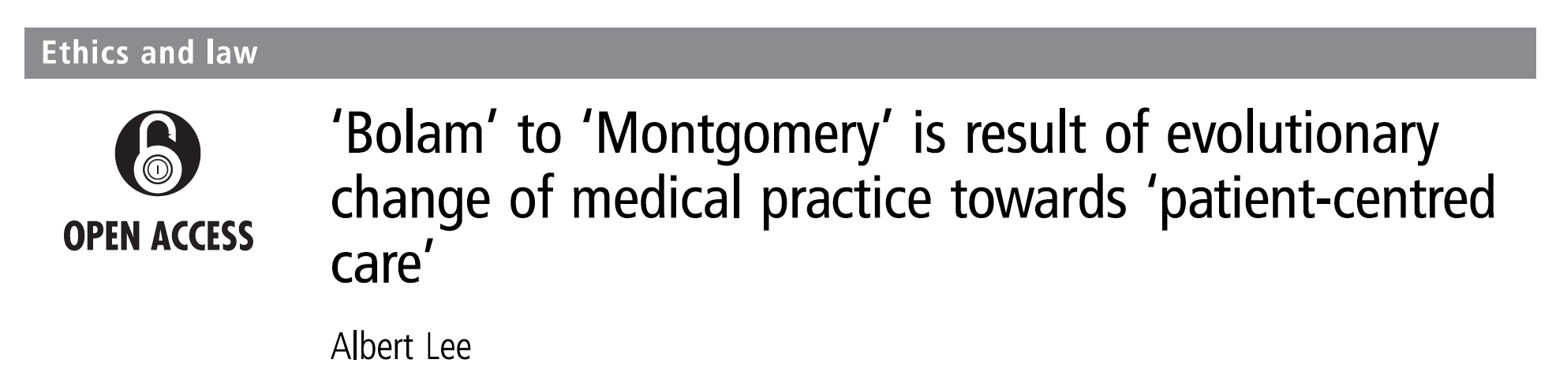
Consent and medical treatment
Bolam refers to a case that laid down the typical rule for assessing the appropriate standard of reasonable care in negligence cases.
It states that if a doctor meets the standard of care of ‘a responsible body of medical opinion’ they are not negligent.
Bolam was rejected in the 2015 Supreme Court decision of Montomery v Lanarkshire Health Board, which is why we now have new guidance on consent from the GMC.

Slide 20
Any questions at this point?

Slide 21
Mental Capacity Act
Notes:
Covers people aged 16+ (England and Wales).

Slide 22
Section 5 of the Mental Capacity Act
Authorises the clinician to act (or treat) so long as:
The principles of the Mental Capacity Act have been observed
‘Reasonable steps’ have been made to ascertain decision-making capacity and the assessment has led to a ‘reasonable belief’ that the person lacks capacity in relation to the matter in question
The action taken is in the best interests of the person
Notes:
Because the Mental Capacity Act provides the legal authority to carry out acts in connection with the care and treatment of people who lack capacity to consent, it also gives legal protection from liability for carrying out those acts.
The authority to ‘act’ covers:
Personal care
Healthcare and treatment
The MCA code of practice states that consideration should be given to –
Past and present wishes, feelings, values and beliefs of the person
Views of anyone previously named by the person as someone to be consulted
Views of carers/any Attorney or Deputy appointed for the person
If there is no-one to consult, and the issue relates to a serious medical treatment of change of accommodation (care home for more than 8 weeks) then an Independent Mental Capacity Advocate should be appointed.
Section 5 of the MCA does NOT cover:
Withholding/withdrawal of artificial nutrition /hydration in persistent vegetative state
Organ donation
Non-therapeutic sterilisation
Where there is a dispute about what is in the person’s best interests
These should be referred to the Court of Protection.
Section 5 of the MCA has limits. The following cannot be done under the ‘general authority’ of Section 5 of the MCA:
Anything that conflicts with the decision of a valid /applicable Power of Attorney or Deputy (assuming they are acting in the person’s best interests)
Depriving a person of their liberty**
Restraining a person – unless it is to prevent harm to the person, is proportionate, and not a deprivation of liberty. Everything done within the authority of the MCA is about the person’s best interests. So, for example – sedating a person to prevent aggression rather than to prevent distressing restlessness – is not authorised under the MCA.
Restricting a person’s freedom of movement, whether the are resisting or not

Slide 23
Mental Capacity Act 2005
Is underpinned by 5 key principles:
Presumption of capacity
Support in decision-making
Acceptance of unwise decisions
Acting in best interests
Taking the least restrictive option
Notes:
OUTSIDE the scope of the MCA is:
Marriage/civil partnerships
Divorce
Sexual relationships
Taking over parental responsibility for a child
Consent to fertility treatment
Voting
Detention/treatment under the Mental Health Act
The MCA applies to people aged 16 and over EXCEPT people under the age of 18 cannot:
Make a Lasting Power of Attorney
Make an advance decision to refuse medical treatment
Apply to the Court of Protection
When dealing with people aged 16-17 who lacks capacity to consent, the clinician should follow the principles of the Act but MUST consult others involved in the person’s care (if practical and appropriate) including those with parental responsibility – without unlawfully breaching the person’s right to confidentiality. If there is disagreement, then in some circumstances the case may be heard in the Family Court/Court of Protection.

Slide 24
A few words about capacity …
Studies estimate 40% of acutely ill medical in-patients lack capacity
Capacity is NOT ‘all or nothing’ – it is decision specific
Capacity and capability are different things
All doctors should to be able to assess capacity (psychiatrists may be required in borderline or high stakes cases)
Assessment of capacity requires the ‘two-stage test’
Notes:
Two-stage test of capacity:
Does the person have an impairment of mind or brain, or is there some sort of disturbance affecting the way their mind or brain works?
Second, does that impairment or disturbance mean the person is unable to make the decision in question at the time it needs to be made?
Incapacity may be temporary or permanent.
A person is regarded as unable to make a particular decision if they are unable to:
Understand the information relevant to the decision
Retain that information in their mind
Use or weigh up that information as part of the decision-making process
Communicate their decision in any form
The burden of proof that someone lacks capacity is “on the balance of probabilities”.
All doctors should be able to assess capacity BUT for interventions such as a medical treatment, the assessment should be undertaken by someone with sufficient knowledge to explain clearly to the patient what they need to know – e.g. risks/benefits.
MMSE/MOCA/AMT etc. are NOT capacity assessments, though they may be used to inform an assessment.
Assessment of capacity should not be a one-off event in situations where care and treatment is on-going.

Slide 25
Exercise
Describe the ‘two-stage test’ of mental capacity
Complete the following paragraph: ‘A person is regarded as being unable to make a particular decision if they are unable to …’

Slide 26
Useful questions when assessing capacity
Understanding
What is your understanding of your diagnosis?
What treatments have been recommended?
What are the risks/benefits of treatment?
Weighing
Do you believe you need treatment?
What will happen to you if you don’t get treatment?
Why have you chosen this rather than that?
Notes:
Think of ways to maximise capacity …
MMSE/MOCA can be helpful
But important to note that cognitive impairment per se or a mental health diagnosis does not of itself mean lack of capacity
Medical professionals have been criticised for assuming incapacity in the case of physically disabled adults
Social care professionals have been criticised for assuming capacity to avoid making difficult decisions!
The professional who knows the person best is most suited to assess capacity

Slide 27
Best interests
Is not only medical
The IMCA service must be involved to support people who are incapacitous who have no friends or family to advocate for them when certain serious decisions need to be made e.g.
  Cancer treatment/major surgery
  ECT
  Termination of pregnancy
They are recommended in other situations e.g.
  Person is to be placed in alternative accommodation
They are advocates, not decision-makers
Notes:
Clinicians are expected to use common sense in emergencies!
Can you think of other aspects of “best interests” that are NOT medical?
Social
Psychological
Spiritual
For example, 80-year-old woman, type 2 DM on insulin, advanced dementia. Refusing insulin every day. Insulin converted to a once-daily regimen and allowances made for suboptimal control. Each morning the pt refused her insulin, the nurses held her arms and gave it to her. The patient did not put up a fight. This was discussed with her son and agreed as the way to manage her diabetes and dementia in her best interests.
NB – The Court of Protection is required for certain decisions: Withdrawal of artificial hydration/nutrition in persistent vegetative state, sterilisation, organ/bone marrow donation.

Slide 28
What is deprivation of liberty?
‘Continuous supervision and control and not free to leave’
Within the meaning of Article 5 of the ECHR
Complex DoLS covers those aged 18+, suffering from mental disorder or learning disability, lacking capacity in relation to where they should live, who are deprived of their liberty*
A person is deprived of their liberty whether they are objecting or not
(Old) DoLS code of practice: ‘Urgent DoLS not required where there is no expectation a standard DoLS will be required i.e. treatment of a physical illness which is expected to lead to the rapid resolution of the mental disorder.’
Notes:
Restricting a person’s liberty is not the same as depriving them of their liberty in the MCA (as per the meaning in the ECHR).
However, there is no statutory definition so this is an area of confusion!
Case law defined deprivation of liberty as: continuous supervision and control and not free to leave’. A person’s compliance, lack of objection, the normality of the placement, and the reason or purpose behind it has been deemed irrelevant. Massive implications!!
DoLS (deprivation of liberty safeguards) criticised for being overly complex and misunderstood by everyone – House of Lords Select Committee said ‘not fit for purpose’ and requested a review.
Only applies to people aged 18+
*Deprived of liberty in a care home or hospital, provided various requirements are met:
No advance refusals/Attorneys/Deputies
Best interests
Detention under Mental Health Act does not apply
DoLS forms must be submitted and authorisation complete within 21 days

Slide 29
Mental Capacity Amendment Act (2019)
The purpose of the Act is to abolish the Deprivation of Liberty Safeguards and to replace them with a completely new system, the Liberty Protection Safeguards (LPS) - because the old safeguards were so confusing! (England & Wales)
Will apply in all settings
Age 16+
The ‘Responsible Body’ will authorise deprivations of liberty (e.g. CCG, Local Authority, NHS Trusts)
There will be 3 assessments: capacity, medical and ‘necessary and proportionate’ assessment
An Approved Mental Capacity Professional (usually a social worker) will help deal with complex cases
Expected to be implemented in April 2022

Slide 30
Any questions at this point?

Slide 31
Interface between the MCA and MHA
The criteria for the MHA include that it is necessary for the patient’s health or safety or for the protection of others.
If the treatment can be given with the authority of the MCA then the MHA is not necessary and should not be used.
(See flowchart)
Notes:
See hand out.
The Mental Capacity Act cannot be used to protect others – it only applies to the best interests of the patient.
Common Law and the MHA can be used to protect others.
There is no power under the MCA for the Police to remove people from a private residence to a hospital or other place of safety for assessment/treatment of a mental disorder if the patient objects – Sec 135 must be used. But they can use different legislation to ‘save life and limb’ or ‘prevent serious damage to property’.
The MHA is used in treatment for a “mental disorder” – this is defined as ‘a disorder or disability of mind’ – the cause is not relevant. The MHA states that ‘Any reference in this Act to medical treatment, in relation to a mental disorder, shall be construed as a reference to medical treatment the purpose of which is to alleviate, or prevent a worsening of, the disorder or one of more of its symptoms or manifestations.’
So this could include force-feeding in life-threatening anorexia nervosa, or treating life-threatening wounds after self-harm, or treating the consequences of an overdose.
HOWEVER – Section 5(2) of the MHA is purely a detention, NOT a treatment, order.

Slide 32
Mental Health Act

Slide 33
When do we need the MHA?
For patients WITH capacity
At risk to themselves or others (‘it is necessary for their health’ - not just ‘dangerousness’)
Due to a mental disorder (dependency on alcohol or drugs is excluded, but intoxication or withdrawal are not)
The risk cannot be assessed or managed any other way than hospital admission
The person is not agreeing to the admission

Slide 34
Relevant sections of the MHA
Section 5(2)
  A doctor’s holding power for general hospital in-patients
  When not possible (due to time) to use other Sections
  Up to 72 hours, not renewable
  Cannot be used in the Emergency Department
  Treatment cannot be given without consent UNLESS a) the patient lacks capacity and it is in best interests or b) it is an emergency to prevent serious harm to the patient or others

Slide 35
Section 5(2) procedure (‘form H1’)
Emergency holding order is required
Organise a formal MHA assessment: AMHP and two doctors
Responsible clinician or nominated deputy makes decision, completes part 1
Document (and keep Form H1) in medical notes
Nurse in charge completes part 2 to receive form on behalf of hospital managers
Inform patient and nearest relative, provide written information
Notes:
Photocopy Form H1 and send this to the relevant managers. Keep original in notes.

Slide 36
Relevant sections of the MHA
Section 2
  Allows detention and most treatments against the patient’s will for 28 days, not renewable
  3 people must agree*
Section 3
  Allows detention and treatment against the patient’s will for 3 months, and free aftercare under Section 117
  3 people must agree*
Section 4
  For emergency assessment in a mental health hospital for up to 72 hours, only two people must agree (one dr)
Section 136
  Allows Police to remove people from a public place (including ED) to a place of safety, ideally a ‘136 Suite’ in a mental health service
Notes:
*3 people are:
An approved mental health professional or relative
An approved doctor
Another registered medical practitioner
A place of safety should not be ED unless the person also has a physical condition.
Police cells may be used if the person is too violent. Lasts up to 72 hours, not renewable.
Section 135 allows an approved mental health professional to obtain a warrant to allow Police to enter premises (e.g. their home where a person is vulnerable/at risk, or take a patient who is already detained under the MHA

Slide 37

Scenarios!
Tip: use the ‘How to manage a patient with challenging behaviour’ flowchart …

Slide 38
Scenario 1
A 30-year-old woman was admitted to the Acute Medical Unit following a mixed overdose of codeine and trazodone.
On examination she scored V on the AVPU scale. The ED notes recorded a past medical history of chronic pain and that she had left a suicide note.
How should her suicide risk be assessed by the clerking-in doctor?
Notes:
VISA assessment tool [see hand out]
Note that demographic risk factors are are not applicable to individuals. There is no reliable suicide risk assessment tool – it requires listening to the individual patient’s story and making a judgement based on that.

Slide 39
VISA assessment tool
V
I
S
A
Violent or pre-planned method
Irrational thoughts or psychosis
Suicidal intent or ideation at the time of assessment
Alone in department or at home
Notes:
V – violent or pre-planned method
I – irrational thoughts or evidence of psychosis
S – suicidal thoughts
A – alone (in department or at home)
If YES to ANY of these Qs, the patient is POTENTIALLY high risk and an assessment is required by the doctor.
Decisions should be made about observations, and what to do if the patient decides to leave.
If no to all of these Qs, patient can be considered low risk and be routinely observed and reviewed by the mental health team

Slide 40
Scenario 2
A 42-year-old woman was admitted following an overdose of long-acting insulin with alcohol. The next morning she began packing her things and stating her intention to leave and “finish the job” i.e. kill herself.
Although she will not fully engage in conversation with you, she appears not to be confused, and has the capacity to make the decision to discharge herself from hospital.

Slide 41
Scenario 3
A 50-year-old man has been admitted following an NSTEMI. His second troponin was 800 ng/L (<14). He has been started on treatment and is awaiting an in-patient angiogram.
However, that evening he has decided to discharge himself against medical advice. The reason appears to be that he hates hospitals following a previous traumatic experience with a relative. He appears to have full understanding and the mental capacity to make this decision.

Slide 42
Scenario 4
An 18-year-old man was admitted because of psychotic symptoms that required an organic cause to be ruled out. After assessment, it was felt that drug-induced psychosis was the most likely cause.
The patient had become increasingly agitated, pacing up and down, and expressing the desire to go home. He was disorientated and incoherent. The nurses were concerned as he kept trying to leave and Security stated they could not help as he ‘was not under a Section’.

Slide 43
Scenario 5
An 80-year-old woman with delirium has been constantly wandering up and down the Acute Medical Unit. Every so often, she attempts to leave, and repeatedly states she wants to go home.
She appears not to have the capacity to make this decision.
Notes:
Confusion due to DTs is a similar example.

Slide 44
Scenario 6
A 25-year-old intravenous drug user was suspected of taking illegal drugs on the ward and dealing with other patients. When security were called to search him, there was an altercation and he punched a member of staff.
The patient was being treated for cellulitis with IV antibiotics, and was well (awaiting blood cultures). There was no evidence of a mental disorder or drug/alcohol withdrawal. He appeared to have the mental capacity to have made his decisions.

Slide 45
Extra scenarios!
Tip: use the ‘How to manage a patient with challenging behaviour’ flowchart …

Slide 46
Scenario 7
A 50-year-old man with COPD was being cared for on a respiratory ward. He was also a below knee amputee and unable to mobilise independently. His electric wheelchair was at home.
After a few days of treatment, he stated he wanted to discharge himself against medical advice. The staff knew full well that he was physically incapable of taking his own discharge, so they ignored him. The patient appeared to have the capacity to make this decision.

Slide 47
Scenario 8
A 50-year old man was being treated for severe delirium tremens and Wernicke’s encephalopathy when he decided he wanted to go home. He phoned his girlfriend and asked her to come and collect him from hospital, then started to get his things together.
He stated he would sign himself out. He appeared to be confused and not have the mental capacity to make decisions about his care.
Notes:
Discuss the legal meaning of the signature on the ‘self-discharge form’ used in many UK hospitals.

Slide 48
Scenario 9
A 65-year old man with early onset Alzheimer’s dementia was admitted to hospital because he was found wandering outside. His wife reported that he was aggressive towards her and she felt vulnerable if he were to return home.
On the Acute Medical Unit, the patient was insistent on returning home and starting to become agitated. There was no evidence of acute illness or delirium.
You have been asked to review him to decide what to do. Outline your thoughts about this case.

Slide 49
Scenario 10
A 40-year-old woman was admitted following a paracetamol overdose. Her level at 4h was above the treatment line and she was started on n-acetylcysteine. After the first bag she left the hospital and refused to return.
She had been seen by a psychiatrist 24 hours earlier and deemed not to have a mental illness and to have capacity to make decisions about her treatment.
The nurse in charge asks you what should be done about the situation.

Slide 50
Scenario 11
A 17-year-old girl was admitted following her second paracetamol overdose of the week. Her level at 4h was again above the treatment line but she refused treatment.
On examination she refused to engage in conversation, focusing on her mobile phone. She shrugged when told refusing treatment could mean liver failure and death. She was able to understand, retain and communicate her decision. There was no evidence of a mental disorder.
What do you think about her capacity and how would you proceed in this case?

Slide 51
Any questions at this point?

Slide 52
Summary
The Mental Capacity Act, not Common Law, covers decision-making in patients who lack capacity
Mental capacity is decision-specific and can be assessed by any doctor
The Mental Health Act can be used for mental disorders, including physical disorders that are causes or symptoms, but is best used when a patient is likely to need Section 2 or 3

