Slide 1
Managing Patient Flow in Hospitals
(Interactive Session)
Dr Nicola Cooper
Consultant Physician & Hon Clinical Associate Professor
Notes:
Welcome to an introduction for managers and clinicians on ‘managing patient flow’.

Slide 2
St Elsewhere’s Hospital
Congratulations!
You are one of 3 new consultants in Acute Medicine at St Elsewhere’s, a 600-bed DGH
St Elsewhere’s is in Mixville, a large town with a thriving retirement population around Oldhay and a large council estate in Ciderhay
You are called to see the Chief Executive and Medical Director because there are serious problems they need your assessment and recommendations on…

Slide 3
Overcrowding and delays
The hospital ‘never has any beds’
ED delays
4 hr target
GP patients to AMU transport delays
Acute Medical Unit
40 beds
CCU, ICU/HDU
Base wards
Discharged
or die
Patients wait for hours in ED

Slide 4
The consequences of inefficient patient flow
‘Boarding’ of patients (holding areas)
Patients on the wrong ward
Wrong skills
Delays in getting right treatment
Poorer communication
Increased harm
Increased length of stay
Reduced throughput and revenue
Stressed /dissatisfied staff and patients
Notes:
In view of the safety concerns associated with crowded EDs, some hospitals have determined that boarding patients in the hallways of in-patient units is preferable to boarding patients in the ED. The rationale for this decision is that sending patients to an in-patient unit is preferred because caring for a few patients in a less-than-ideal setting (a hallway) is less risky than caring for numerous patients in an overcrowded and busy ED. The pros and cons of boarding patients in hallways have been much debated – yet boarding (whether in the ED or hallways) are still a considerable source of frustration for care-givers (drs and nurses), and they generate concerns regarding patient safety.
The need to optimise LoS in most hospitals is crucial in the current economic situation. Turning over beds more frequently without compromising patient care maximises revenue. Reducing LoS by 0.25 days in a typical 300-bed hospital can result in a functional increased of 12 beds.
Inefficiencies in patient flow are frequently a manifestation of hospitals functioning at full or nearly full capacity. Often administrators strive for high bed occupancy in the belief that this is best for business – in fact, as utilisation increases to above a functional capacity that is safe, manageable, appropriate, efficient and conducive to optimal throughput, system inefficiencies occur and become apparent in a detrimental manner – reduced throughput and revenue – just the opposite of what one might expect (eg cancelled elective surgical procedures).
If the consequences of inefficient patient flow are so significant, there are compelling reasons to work towards optimising patient flow as soon as possible. This requires everyone to understand the issues, to be clear about and execute their roles and responsibilities, and a whole-system approach.

Slide 5
Impact of patient flow issues on nurses
Poorly controlled patient flow is an important cause of stress among nurses (and drs!)
Studies report an inverse relationship between nurse staffing and patient complications:
Hospital acquired infections
Bacteraemias
Falls
Medication errors
Shock and cardiac arrest
Longer than expected LoS
Missed nursing assessments /care
Notes:
The arrival of new patients on a nursing unit changes the workload of nurses. The change depends on the number of new patients and the clinical needs of the patients. But how is the quality of care affected when workload changes? More precisely – are patients at increased risk for lower quality and unsafe care when staff contend with surges in demand?
Mixed results in studies looking at nurse levels and mortality.
Patient assessments, nursing interventions and basic care were missed in studies looking at the impact of nurse staffing on quality of care. The 6 most frequently missed nursing activities were:
Ambulating patients
Assessing effectiveness of medications
Turning patients
Providing oral care
Teaching
Administering ‘prn’ medications
The most cited reason for missed care was lack of staff – not necessarily due to the numbers of staff per se, but the unplanned increases in demand for patient care in both volume and activity.
Hospital decision makers need to understand the numerous negative effects of poorly controlled patient flow on hospital systems of care and the individuals affected by them.
Surges in patient demand require managers and clinical staff to gather, filter, and process large amounts of information and co-ordinate the actions of many individuals in an effort to prevent systems from faltering. When systems break down, patients are at risk of experiencing complications or adverse outcomes during their hospital stay. The response of hospital staff who contend with repeated cycles of surges in patient demand come at the cost of staff burnout, stress and fatigue. These costs are shared with the hospital, that pays for hours of unnecessary overtime, excessive use of temporary staff, and needless and costly replacement of staff who leave to work elsewhere.

Slide 6
At your disposal…
Data guy (Steve)
Personnel:
Business manager
x Consultants
x Registrars
x SHOs
No additional resource (unless you can demonstrate it will result in efficiency savings)
Any changes must improve quality and safety
College and specialist society documents
National Directory of Ambulatory Care
NHS Institute of Innovation and Improvement website
List of hospital quality indicators
St Elsewhere’s Service Re-design Team
Knowledge of ‘operations management’

Slide 7
What is ‘operations management’?
‘Operations Management’ – the use of quantitative methods to assist analysts and decision makers in designing, analysing and improving performance or operation of systems’
System-wide, not silo
Science-based and data-driven (being aware of potential data quality problems)
The right structure as well as processes
A compliance review and enforcement process
Notes:
OM is a science that uses mathematical and analytical tools to provide information and insight in to systems and processes, but it is the human decision makers who utilise and implement what is learned through the analysis process to achieve a better performance of the system.
We have our own resident experts in the guise of the ‘Service Re-Design Team’.
Healthcare delivery tends to be departmentally orientated. This is because of clinical sub-specialisation. Other than the flow of patients from and to other departments, each department functions as an independent microcosm. Each has its own manager, budget, and performance indicators. This can result in behaviours that are counterproductive to maximising system-wide patient flow.
The next most important principle of patient flow management is that it is based on Operations Management science and rigorous data analysis. Management decisions are often based on instinct (eg building a larger ED when the real problem is elsewhere) or as a compromise between demands from competing departments (often the loudest wins) and resource constraints. Data analysis helps us to optimise patient flow issues, while understanding our own hospital or department’s idiosyncrasies.
Addressing structure is significantly more critical to patient flow strategy than merely improving individual processes because the major source of patient flow problems is variability in patient demand – ignoring structure while addressing micro-processes could turn out to be a wasted effort.
Old practices die hard, and because of the day-to-day fluidity of flow in healthcare, it is imperative that any patient flow strategy has compliance review as an essential component. Compliance review helps manage and resolve conflicting priorities and tensions between system goals and those of individual departments or services. Without periodic review and enforcement of policies, one can always find a reason to violate rules, depending on the circumstances. If repeat violations go unchecked, their volume increases over time. Quickly, the entire system is threatened. The role of compliance review is to maintain the integrity and fairness of the system and to identify gaps that need to be addressed. Compliance review can occur after the event or in real time (someone needs to have the authority to arbitrate a situation in real time eg about whether a patient can be admitted to a particular unit).

Slide 8
Getting started
There are innumerable patient flow pathways in a hospital! – an assessment cannot realistically include all of them
The goal is to identify the major patient flow problems affecting the hospital system
Major patient demand flows
Flow streams that cross service areas
Notes:
Analysis must make the use of existing IT systems (eg ADT) and databases (eg CARPS) but ‘on the ground’ analysis is also important because IT systems cannot necessarily tell you whether there was a delay in the patient moving to the next step. Hospital policies and actual practice can help to identify bottlenecks (eg the fall in activity during weekends and Bank Holidays).
Basic things to identify are:
Admissions by standard time parameters
Transfers (“)
Discharges (“)
Census (eg daily midnight census across the hospital)
Boarding data (patients waiting for a bed)
Outliers
No of non-short stay patients admitted to SSW (due to lack of beds)
Requests for bank shifts
etc
(In article ‘understanding the current state of patient flow in a hospital’ – ‘The weekly cycle currently relies on empty beds at
midnight on Sundays to allow for the net admissions on the first two days of each week. In this trust, Tuesdays are likely to be the worst crisis days, when expected occupancy peaks at midday’.)

Slide 9
Key concept 1: peaks and valleys
Peaks in activity can have an adverse impact on patient care
While some peaks are natural, many are artificial – created by us
Emergency Department attendances by hour in the period March 08-Feb 09
Notes:
In high demand in-patient areas (eg AMU), nurses bear the brunt of peaks in activity that occur on a daily /weekly /seasonal basis. In addition, more than one patient is likely to occupy a bed on any given day, adding to hour by hour variability to activity and nursing workload.
Unnecessary patient turnover, that occurs when a patient is placed in a bed just because it was available and not because it was the optimal ward for that patient’s care, reflects system inefficiencies. In turn, it creates the potential for added work and increased handovers for nurses, because the patient is later transferred to the right place. This is not unusual.
When staff cannot predict what their activity might be at a given point in time throughout the workday or work week, then the opportunity to efficiently prioritise workload is compromised.

Slide 10
Key concept 2: reducing variability
If all patients arrived uniformly over time, had the same disease, and experienced the same recovery, and if all clinicians had the same ability to provide care, it would be possible to design a 100% efficient patient flow process
Clinical variability
Flow variability
Professional variability
However, artificial variability arises from scheduling practices and inappropriate management of patient flow – this has to be investigated and eliminated
Separating patients in to homogenous sub-groups is a starting point in reducing artificial variability / improving efficiency
Natural variability

Slide 11
The effects of artificial variability
Problems coping with peaks
Compromised quality of care
Reduced patient satisfaction
Waiting
Reduced job satisfaction and staff retention
Operational inefficiency
Artificial variation reduces the number of patients a hospital can care for within existing resources

Slide 12
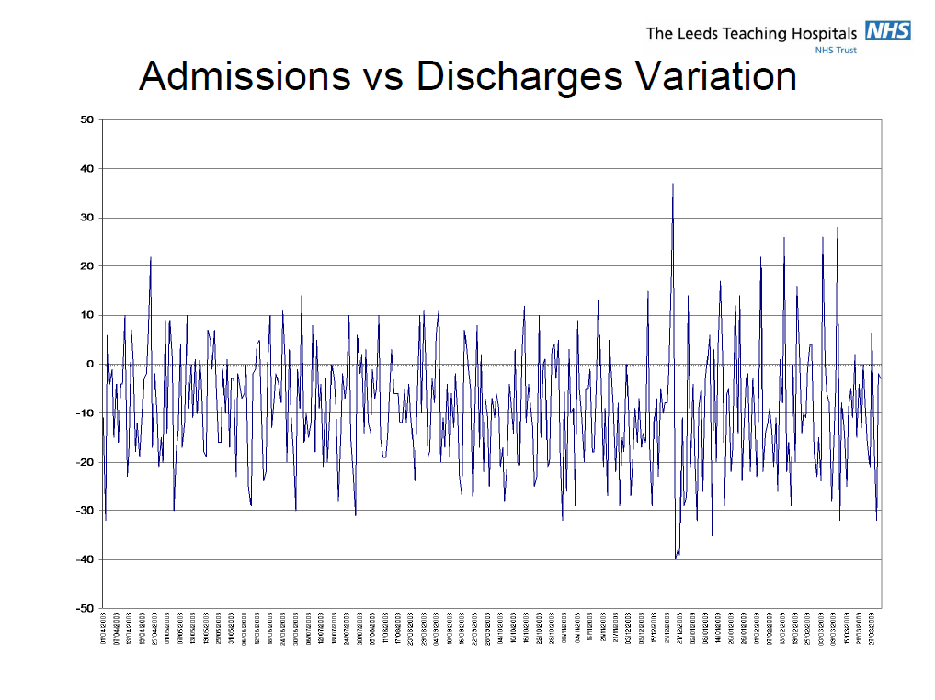
Admissions vs discharges
Christmas
Shows the variation in difference between admission and discharge rates in the period Apr-Mar 08

Slide 13
Eliminating artificial variability – general concepts
Separate homogenous sub-groups on the basis of clinical and/or operational characteristics to maximise efficiency and throughput
eg: elective (urgent and routine), day-case, and acute work
Estimate resource needs
Compliance review
Dynamic bed management systems
Phase 1
Separate elective vs non-elective work
Phase 2
Smooth elective flows
Phase 3
Estimate resources (beds, theatres, scanners, staff)
Notes:
Elective surgical admissions are frequently the biggest source of artificial variation in patient flow across a hospital. Hospitals with cardiac cath labs also experience significant artificial flow variability from their elective cases. Some hospitals may have significant levels of elective medical admissions, eg for cancer treatment.
Any patient flow improvement strategy has to have at its foundation the separation of elective and unscheduled flows and the elimination of artificial variability in elective patient flow.
What are the benefits of this approach? Reduced waits for urgent cases, thereby improving clinical outcomes, increased effective capacity for things like daycase surgery and cardiac cath labs, (with associated increased revenue), reductions in cancelled elective surgery, improved patient and staff satisfaction, targets met.
Smoothing elective flows includes things like scheduling (which includes consultant surgeon job plans, might include all day theatre lists to improve efficiency and so on), and establishing discharge criteria (eg from ICU, or to home).
Political realities often play a significant role in the day-to-day execution of service re-design. Changing a consultant’s practice is likely to require re-scheduling of their other work, and has to involve the anaesthetists. An important consideration is leadership commitment and investment in project management and data analysis expertise (not necessarily from ‘outside consultants’).
Real time bed management systems play an important role in providing visible bed needs and bed availability. They can be powerful in improving timely discharges, thereby reducing LoS, reducing artificial variability and improving patient flow. They can also provide ‘early warning systems’ to identify emerging bottlenecks that may affect new admissions – so people can work quickly to expedite turnaround and identify free beds.
We need an IT system that serves the process.
Why is eliminating artificial variability important? Because working hard to improve patient flow without addressing artificial variability (eg late Consultant ward rounds in medicine) will produce some improvement in flow, but the results are likely to be diminished or even negated by unaddressed inherent variability. Even the best communication processes will fail in the face of excessive fluctuations in nurse-to-patient staffing levels caused by artificial variation. At worst, process improvement before process re-design could result in further entrenchment of bad practices, making the re-design work even more difficult.
Process design without structural re-design ignores key Operations Management principles, such as the distinction between elective and random arrivals. Resources for elective patients can be programmed for nearly 100% efficiency, while random arrivals require a lower utilisation to ensure timely access. The relationship between resource needs for random arrivals and waiting times can be explored only with the help of queuing models. If waste reduction through Lean management eliminates all or most of the flexibility in a system, the result would be unacceptable delays for urgent patients and compromised quality of care. So process improvement methods should follow structural re-design improvements to maximise hospital-wide patient flow.

Slide 14
Key concept 3: bottlenecks
Inappropriate admissions (including defaulting)
Late Consultant ward rounds
Delayed investigations
Portering delays
Waiting for therapy assessment
Waiting for social services
Delayed TTO’s
Delays in patient transport
Cleaning after patient transfer/discharge
Notes:
Key bottlenecks have been identified – but on further analysis some of these bottlenecks are exacerbated by our own behaviour. For example, when key stakeholders met to discuss transport problems, it emerged that staff on the base wards frequently booked ‘same day’ transport rather than pre-booking under a different system. This in turn meant that the acute medical /elderly units could not access ‘same day’ transport for their patients.
Similarly, although there are delays in getting OT assessments, up to one-third of referrals are not necessary, and OT time is wasted going to see patients that could have already been assessed by nursing staff.

Slide 15
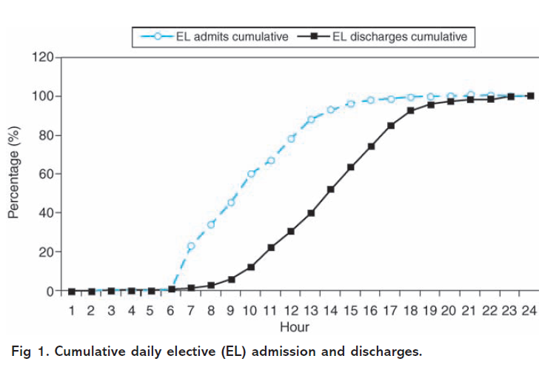
Key concept 4: the lag between admissions and discharges by time of day is responsible for the daily problem of bed availability
desired
admissions
discharges
6am
noon
6pm
midnight

Slide 16
A system model of input, throughput and output eg Acute Medical Unit (AMU)
Death
Hospital admission
OUTPUT
Base ward capacity
Porters
Real-time information
Placement authority
INPUT
Demographics
Health status
Available alternatives
Triage
‘Challenge’
THROUGHPUT
Care processes
Staffing
Access to information
Specialist availability
Diagnostic services availability
Community discharge
OUTPUT
Transport
Community services
Community beds

Slide 17
Now write down how you think the Medical Director and CEO should approach the problem …

Slide 18
Eliminating artificial variability in Acute Medicine - examples
Don’t let GP admissions wait at home
Reduce unnecessary admissions to hospital
Staff according to the predictable workload
Senior doctor WRs every morning on every ward
Discharge MDTs on all wards
Get patients to the right ward first time (eg SSW, specialties)
Eliminate artificial delays
Porters
Cleaning bed spaces
Pharmacy
Transport
Therapy
Investigations at weekends
Social services
Discharge patients earlier in the day, including weekends
Introduce a hospital-wide bed management system
Have a robust compliance review and enforcement process
Notes:
We have started to do some of this already, but it is patchy, with limited ‘buy-in’ and understanding.

