Slide 1
Dizziness
Notes:
With experience, the start of diagnosing dizziness is about pattern recognition – just like we recognise a 60 yr old woman 10 days post knee replacement with breathlessness and pleurisy = PE. Then you need to know what are red flags in the history, and how to examine a patient with dizziness properly. (pattern recognition alone in novices can be dangerous!!)

Slide 2
Learning objectives
Gain organised knowledge in the subject area dizziness
Be able to correctly interpret clinical findings in patients with vertigo
Know and apply the relevant evidence and/or guidelines to different clinical presentations of dizziness
Be aware of common cognitive biases in the diagnosis and management of dizziness
Notes:
Learning objectives always the same for each topic …

Slide 3
Outline
Dizziness is very common
Older can have more than one type of dizziness
A common AMU dilemma is distinguishing peripheral from central causes of vertigo
In vertigo, pattern recognition followed by proper examination of eye movements is key
Dizziness is treatable!
Notes:
Outline of this talk

Slide 4
Scenario 1
A 75 year old woman presented following a fall, she sustained a fractured wrist
She said she bent over to put her shoes on when she experienced a few moments of ‘everything moving’ and she keeled over
This has never happened before
Bloods, clinical exam, ECG, L+S BP all normal
Notes:
BPPV
AND osteoporosis!

Slide 5
Scenario 2
A 70 year old man has had three episodes of syncope in the last 12 months, after the last one his GP stopped his doxazosin
Since the last collapse when he bumped his head he feels his ‘balance is wrong’, he tends to veer to one side when walking
Bloods, clinical exam, ECG, L+S BP, CT head all normal
Notes:
BPPV

Slide 6
Scenario 3
A 40 year old man presented after several hours of vertigo, he has had this twice before in the last 12 months
He had no focal neurological symptoms or signs at any time
On examination, eye movements, cranial n’s, general neurological exam, gait and balance were all normal
Notes:
Migrainous vertigo

Slide 7
Scenario 4
A 60 year old man presented with vertigo, vomiting and ataxia, he is now back to normal
The clerk-in noted he experienced left arm numbness for 10 minutes during the attack
On examination he was back to normal and eye movements, cranial n’s, general neurological exam, gait and balance were all normal
A colleague has diagnosed ‘viral labyrinthitis’ (proper term: vestibular neuritis)
Notes:
Pontine infarct
Normal head thrust test

Slide 8
Scenario 5
A 25 year old footballer woke up feeling ‘a bit dizzy’. On his way to work he started to feel disequilibrium while walking and by the time he got to work he had severe vertigo, ataxia and vomiting.
On examination he had spontaneous horizontal nystagmus (with a slight rotational component) to the right. When he walked he veered to the left. The head thrust test was abnormal on the left.
The rest of the neurological examination was normal
Notes:
Vestibular neuritis

Slide 9
Knowledge gaps is the main reason for diagnostic error in dizziness

Slide 10
Simplified dizzy tree
Lightheaded
Vertigo
Disequilibrium
Postural
1 OH
Unrelated to posture
1 Cardiac
2 Anxiety or stress
1 Uncompensated vestibular disorder
2 BPPV
3 MFDE
4 Neurological disorders
Single attack of prolonged vertigo
1 Vestibular neuritis
2 Stroke
Recurrent attacks
1 BPPV
2 Migraine
3 Meniere’s
Notes:
There are 3 basic types of dizziness: lightheaded, vertigo (which refers to a sensation of movement) and “disequilibrium” – a sort of vague chronic dizziness and balance problem.
Your first task is to figure out what type of dizziness the patient is describing.
Once you have done this, you can narrow things down with further history, clinical examination and – sometimes – investigations.
We’re going to go through this in more detail in a minute, but a few things to note about this diagram: 1) there are lots more diagnoses in these categories but we’re only going to cover the common ones; 2) we’re not going to cover general medical causes of dizziness; and 3) vertigo here means vertigo ALONE – with no other neurological symptoms.
I’m not going to say anything about light-headedness, because we are most familiar with this type of dizziness and I want to focus on vertigo.

Slide 11
Notes:
Of all the subjects I teach, I have observed that dizziness is the most difficult for people to put in to practice correctly to start with. SHOs and Registrars that I teach (in clinic or on the AMU) make many confident misdiagnoses, some of them serious, – until they have applied their learning repeatedly with feedback and reflection over many many months.
So, without further ado, let’s start by looking at some fact and figures …

Slide 12
Facts n figures 1
Causes of acute and recurrent vertigo
 | % of all vertigo in primary care | % of all vertigo in specialist clinics
BPPV (common) | 40% | 10-27%
Vestibular neuritis (common) | 40% | 10-44%
Migraine (probably common) | 14% | 7-10%
Meniere’s (uncommon) | Debatable | 3-11%
Stroke (uncommon) | Not available | Not available
Cerebello-pontine tumours (rare) | Not available | <1%
Barraclough K and Bronstein A. Vertigo. BMJ 2009; 339: 749-52
Notes:
This slide is to give you an idea about what is common and what is uncommon. For example, most people don’t appreciate that migrainous vertigo (or “vestibular migraine”) is the most common cause of recurrent spontaneous vertigo, whereas Meniere’s is an uncommon disease but often overdiagnosed. More of that later.

Slide 13
Facts n figures 2
Diagnosis of vertigo in the Emergency Department (by neuro-otologists)
Diagnosis | % of cases
BPPV Vestibular neuritis Migrainous vertigo Anxiety Stroke Pre-syncope | 31 28 12 11 4 4
Cutfield NJ, Seemungal BM, Millington H, Bronstein AM. Diagnosis of acute vertigo in the Emergency Department. Emerg Med J 2011; 28: 538-9
Notes:
In the ED (altho these are patients were assessed by neuro-otologists!) there is a similar pattern, with BPPV the most common, followed by vesibular neuritis then migrainous vertigo then others. Stroke is an uncommon but important-not-to-miss cause of isolated vertigo.

Slide 14
How common is dizziness in older people?
Prevalence per 1000 people
Marsingh et al. Dizziness reported by elderly patients in family practice: prevalence, incidence, and clinical characteristics. BMC Family Practice 2010; 11:2
Notes:
Dizziness is the most common reason for visits to a doctor by patients aged over 65 according to a RCP working party report on hearing and balance disorders! (2007)
Eighty per cent of older people presenting to an Emergency Department with an unexplained fall have symptoms of vestibular impairment (Pothula et al, 2004).
This slide shows the results of a study that identified all pts aged 65+ who visited their GP because of dizziness. In 40% of patients, the final diagnosis was recorded as … “dizziness”.
In other studies, dizziness is said to affect 30% of over 65-year-olds.
Dizzy older patients are under-referred to specialists, despite dizziness having a major impact on quality of life. Yet – for example – unrecognised BPPV, which has a prevalence of almost 10% in the older population, is very treatable (Oghalai et al, 2000).

Slide 15
Mini-tutorial: eye movements in vertigo
Standard neurological and ENT examination is often negative in dizzy patients
Notes:
But before we go through vertigo in more detail, we need to pause for a mini-tutorial on eye movements. Why is this? I cannot emphasise enough how important it is to document a proper examination of the eye movements in a case of a patient presenting to ED or the AMU with vertigo. Y’see, the key question is whether the patient has a peripheral (inner ear) problem, or a central (brain) problem – like a stroke. Control of eye movements belongs to specific sub-systems and examining them gives us vital clues. This can make the difference between going home or being admitted and having expensive tests. A proper clinical examination is MORE ACCURATE than an MRI scan in diagnosing a post circ lesion as I will explain a bit more later.
First: nomenclature … NYSTAGMUS is named by its direction of fast phase … e.g. ‘left horizontal nystagmus’ . But we are also interested in whether this is spontaneous or gaze-evoked … let me explain.

Slide 16
Examination of eye movements: look for
Primary gaze / spontaneous nystagmus
Ask patient to fix gaze on a clearly visible object ahead
Gaze-evoked nystagmus
Take a fixation target (eg your pen) 30 degrees to the right, left, up and down, at an average fixation distance of 30cm*
Pursuit
Repeat the above and look for jerky eye movements. Saccadic (jerky) pursuit indicates a central lesion but is a normal finding in old age
A normal or abnormal head-thrust test
Ask patient to fix gaze on your nose, or an object just behind you, and keep their eyes on the target while you move their head briskly 30 degrees to the right, then left
(Positional nystagmus)
Observe for any and what type of nystagmus during a Hallpike Manoeuvre
Notes:
So this is (no REALLY!) what you need to do for any patient who presents with vertigo:
There are different types of nystagmus so never just write “nystagmus” in the notes. Describe exactly what you see.
Spontaneous nystagmus is nystagmus when the patient looks straight ahead. Both peripheral and central lesions can cause spontaneous nystagmus, but there is only one type of nystagmus you will see in vestibular neuritis: Spontaneous, horizontal nystagmus (with a minor torsional component). And if you see this, in combination with the other key symptoms and signs, you can confidently diagnose vestibular neuritis and the patient does not need further investigations and might not need to stay in hospital.
Gaze-evoked nystagmus is when you see nystagmus only when the patient looks in a certain direction. As a rule of thumb, gaze evoked nystagmus is always central. (Well, it’s a bit more complicated than that as you will discover later on!) Make sure you don’t move your pen too far as many normal people will have nystagmus if you do that.
Pursuit is when you get the patient to follow your pen slowly. Saccadic (jerky) pursuit always indicates a central lesion but can be a normal finding in old age.
Head thrust test. [read slide]. This is a test of the vestibulo-ocular reflex and when it is abnormal indicates a peripheral vestibular lesion on that side.
Positional nystagmus should be tested if no obvious diagnosis so far. Not ONLY because you are testing for BPPV which causes a very characteristic nystagmus and is common in older people - but because it commonly co-exists with other conditions that cause vertigo and because central disorders can cause other types of positional nystagmus.
There are other things that audio-vestibular physicians do but we are keeping things as simple as possible! Don’t worry there are some recommended further resources at the end – and I have some videos!
We’ll talk about the HINTS test later …

Slide 17
Peripheral vs central nystagmus
Horizontal (with a torsional component)
Fast component away from the affected side
Does not change direction with direction of gaze
Inhibited by fixation
Head impulse test abnormal on affected side
Fades after a few days
Vertical, horizontal or torsional
Fast component towards the affected side
May change direction with direction of gaze
Not inhibited by fixation
Head impulse test normal
Lasts weeks or months
Notes:
People SAY that not being able to mobilise points to a central cause of vertigo, but older people can decompensate easier with a peripheral problem, and young people can compensate better with a central problem, so I don’t think this should be a “rule” – take all the features in to account!

Slide 18
Simplified dizzy tree
Lightheaded
Vertigo
Disequilibrium
Postural
1 OH
Unrelated to posture
1 Cardiac
2 Anxiety or stress
1 Uncompensated vestibular disorder
2 BPPV
3 MFDE
4 Neurological disorders
Single attack of prolonged vertigo
1 Vestibular neuritis
2 Stroke
Recurrent attacks
1 BPPV
2 Migraine
3 Meniere’s
Notes:
Back to the dizzy tree.
Vertigo presents to hospital usually in two ways: a single attack of prolonged vertigo, or part of a pattern of recurrent vertigo.
THE PROBLEM is that rarely cerebellar strokes can present with isolated sustained vertigo as the sole feature. In one case series of 240 patients with cerebellar strokes, 25 had vertigo as the sole feature (that’s around 10%). So in elderly pts with vascular risk factors this is a distinct possibility. Therefore, how can we tell the difference between vestibular neuritis and a stroke? Let’s look at this in more detail.

Slide 19
Single attack of prolonged vertigo: red flags
Focal neurological symptoms or signs at any time
Abnormal eye movements not consistent with acute unilateral vestibular failure
Acute hearing loss
Headache
Notes:
If a patient with a single attack of prolonged vertigo has any of these red flags then you must assume their vertigo is central.
[read red flags]
Example: man with vertigo/balance problems but numb left arm 10 mins diagnosed as VN = pontine infarct.
Now the knowledgeable ones among you will know that acute hearing loss and headache are both features of migraine, but NEVER diagnose migraine in an older person presenting for the first time with a single episode of prolonged vertigo.
Reasons are: still need to meet IHS criteria; 10-34% of all stroke pts experience headaches around the time of their stroke – more common in post circ stroke. And some types of post circ strokes eg thalamus also cause “visual spectra” and odd sensory symptoms that may cause non-experts to confidently assume is due to migraine. I have seen registrars confidently diagnose migraine in these situations because they did not know what they did not know.
Yes it is possible that you might come across a first episode of migrainous vertigo – but always investigate (MR scan is the investigation of choice) and consult a specialist.

Slide 20
Watch: https://youtu.be/1q-VTKPweuk
Demonstration of the HINTS exam
Notes:
IMPORTANT!!! You should first screen your dizzy patients for central features that would not be expected in vestibular neuritis and may signify a central cause such as stroke. And they are:
New Significant headache or neck pain
Focal weakness or paraesthesia
Any dangerous D's - diplopia, dysarthria, dysmetria, dysphonia, dysphagia
Vertical nystagmus at rest (not during the Dix-Hallpike test)
Inability to walk unaided
You should carefully consider a central cause if your patient has any of these central features, regardless of their HINTS exam findings.

Slide 21
Vestibular neuritis or ‘neuronitis’ (a.k.a. acute unilateral peripheral vestibulopathy)
History
Acute onset, often on waking
25% experience a gradual onset over several hours and some experience ‘warnings’ a day or two before
Oscillopsia, n&v, veering to one side, head movement makes things worse
No focal neurological symptoms at any time
50% patients have a preceding respiratory tract infection
Examination
Signs of acute unilateral vestibular failure and nothing else:
Veering towards the affected side
Spontaneous horizontal nystagmus (with a torsional component) away from the affected side
Abnormal head thrust test on the affected side
Notes:
The most common cause of a single attack of prolonged vertigo is vestibular neuritis (or “neuronitis”). Btw – please DO NOT use the term “viral labyrinthitis”. Labyrinthitis is a rare condition, usually bacterial, and associated with deafness. The condition we are talking about is NOT labyrinthitis!
VN is the second most common vestibular disorder after BPPV. Patients are often young/middle aged but older people can get it too. These are the features of VN on history and examination.
[read left hand column]. It’s thought to have a viral aetiology (a bit like Bell’s Palsy except it’s the 8th cranial nerve).
On examination, people with VN have signs of an acute unilateral vestibular failure and nothing else (that nothing else is v important). They veer towards the affected side, they have spontaneous horizontal nystagmus away from the affected side. (If you think of the slow beat of the nystagmus: both the patient and the eyes DRIFT towards the lesion). The head thrust test is always abnormal in pts with acute vestib neuritis, yet is normal in almost all pts with isolated vertigo due to stroke.
The problem is that after a couple of days, the signs subside as the brain compensates … if you see the patient a week later it can be difficult to distinguish a peripheral from a central cause of vertigo clinically (so these people might need to be referred to a specialist clinic). Treatment is SHORT TERM vestibular suppressants (eg stemetil) and then getting back to normal activity as soon as possible – even though some things will make the person feel dizzy (eg turning quickly). It takes several weeks to make a complete recovery (up to 12) and for the less than 20% with persistent bothersome symptoms vestibular rehabilitation (all physio depts know about this) is very effective.
Steroid treatment does not change the clinical course, but note that 20-30% of pts with vestibular neuronitis develop BPPV later on the affected side.

Slide 22
Resolution of eye signs in acute vestibular neuritis
Acute stage
Sub-acute stage
Notes:
In the acute stage (first day) of vestib neuritis there is unidirectional nystagmus in all 3 directions of gaze.
In a peripheral vestibular nystagmus, the nystagmus increases when the patient looks in the direction of the fast phase and decreases in the opposite direction (Alexander’s Law).
(The nystagmus is also partly suppressed by fixation).
After a while, the nystagmus intensity decreases over time and may only be visible when the patient looks in the direction of the fast phase. In other words, if you see the patient a week later they will only have gaze-evoked nystagmus. Remember - that is a central nystagmus if seen acutely. But the head thrust test persists for longer (and is permanent in at least 70% of people) and a specialist clinic has fancy methods it can use to distinguish between a peripheral vs central cause of a single attack of prolonged vertigo if the patient presents late. In other words, if a patient presents late it can be impossible to distinguish VN from a stroke on the history and examination.

Slide 23
What would do you do in this situation?
A previously independent 80 year old lady presented to ED with acute onset vertigo and unsteadiness that morning. There were no other symptoms at any time.
Her past medical history included hypertension, type 2 diabetes and a previous myocardial infarction.
She could no longer mobilise independently.
The standard neurological examination was normal. Examination of her eye movements showed horizontal gaze evoked nystagmus that changed direction with direction of gaze and did not improve with visual fixation, saccadic pursuit, a normal head thrust test and a negative Hallpike Manoeuvre on both sides.
Her CT head was normal.
Notes:
So here is a dizzy dilemma to illustrate. [Allow audience to read slide].
Despite what I said about MRI being the investigation of choice, in a clinical acute stroke we are interested only in excluding a bleed and CT is better than MRI at doing that. Many hospitals do not have MRI, or access is limited. Also we need to be aware of the fact that MRI has a significant false negative rate (around 10% in small post circ strokes). In other words, stroke is a clinical diagnosis in this situation. An MRI won’t change management as this lady still needs vascular risk factors addressing, and she will NOT be getting carotid Dopplers! If you want, you could call this a “possible stroke” but the point is there is no other plausible explanation for this lady’s symptoms.
Her clinical examination is consistent with a stroke. She will need a mixture of vestibular /gait and balance rehabilitation.
So – just to recap: in a single episode of prolonged vertigo, vestibular neuritis has distinct features in the history and examination – especially of the eyes. Anyone with any red flags needs imaging and referral to a neurologist/stroke specialist. Simple!
Or is it …??

Slide 24
Abnormal eye movements in different types of stroke
Site of infarct | Nystagmus | Other findings
Partial AICA (labyrinth) | Identical to vestibular neuritis (ie horizontal-torsional towards healthy side) | Abnormal head thrust test but profound hearing loss
Complete AICA | As above plus gaze-evoked nystagmus towards lesion | As above plus Horner’s, facial paralysis, saccadic pursuit, ipsilateral limb ataxia
One vestibular nucleus | Purely torsional towards healthy side | Skew deviation, saccadic pursuit
Brainstem at the root entry of the vestibular nerve | Identical to vestibular neuritis | Hearing symptoms, hemi-ataxia, Horner’s
PICA | Identical to vestibular neuritis plus gaze-evoked nystagmus towards lesion | Wallenberg’s syndrome
Cerebellar | Gaze-evoked nystagmus | Limb and/or truncal ataxia
Notes:
The main purpose of this slide is to show you that some types of stroke produce identical eye signs to vestibular neuritis! – the anterior inferior cerebellar artery (AICA) supplies different parts of the vestibular system. Branch occlusion could lead to partial infarction of the AICA territory eg infarction of the labyrinth and 8th nerve - this produces signs of peripheral vestibular dysfunction (ie identical nystagmus to vestibular neuritis and an abnormal head thrust test) – BUT also deafness.
In stroke there are always other findings to make you suspicious … either in the history or examination. The warning here is to carefully assess the patient and DO NOT rush! Remember in acute vestibular neuritis the nystagmus is in the same direction no matter what direction the patient is looking. In central lesions, the nystagmus acutely is either only gaze-evoked, or there are red flags in the history and examination: focal neurol symp/signs at any time, acute hearing loss, headache, abnormal eye movements not consistent with purely an acute unilateral vestibular failure.
Let me give you an example: A 50 year old lady came to our AMU with 3 episodes of vertigo associated with acute hearing loss and numbness of one side of the face – all the symptoms resolved each time. She did not have obvious vascular risk factors. She also had no history of migraine. RED FLAGS. Although neurologists will tell you that these features can all be part of migraine, remember the IHS criteria – you cannot diagnose migraine in this situation. We started high dose aspirin and requested an urgent MRI scan. We got our liaison neurologist involved. 24 hours later this lady dropped her GCS – she had suspected basilar artery thrombosis following an emergency CT head. She died before she could be treated (the treatment in this case would have been thrombolysis: IV or IA depending on your centre).
[Skew deviation: misaligment of eyes due to a central lesion. Like a squint but stable in all directions of gaze.]

Slide 25
Single episode of prolonged vertigo: summary
The key question is whether the vertigo is peripheral (inner ear) or central (brain) in origin.
A patient with clear brainstem or limb symptoms (at any time), any red flags, or abnormal eye movements apart from a peripheral vestibular nystagmus has a central disorder until proven otherwise.
Notes:
Summary!
Mention HINTS test here. (Discussed a lot in the literature).
1. Head impulse
2. Nystagmus
3. Test of skew = get patient to look straight ahead, cover one eye, then rapidly uncover it and see if it moves to re-align itself. Test other eye as well. Skew + reflects a brainstem lesion.
When HINTS test is negative this rules out a stroke better than MRI+DWI in the first 24-48hrs. The HINTS test has a sensitivity of 100% and specificity of 98% for stroke.
In a study of diagnostic error in neurological emergencies in the ED, common mistakes were doctors not understanding the limitations of imaging especially when performed early. The clinical examination when performed properly is MORE ACCURATE than an MRI scan.

Slide 26
Any questions at this point?

Slide 27
Simplified dizzy tree
Lightheaded
Vertigo
Disequilibrium
Postural
1 OH
Unrelated to posture
1 Cardiac
2 Anxiety or stress
1 Uncompensated vestibular disorder
2 BPPV
3 MFDE
4 Neurological disorders
Single attack of prolonged vertigo
1 Vestibular neuritis
2 Stroke
Recurrent attacks
1 BPPV
2 Migraine
3 Meniere’s
Notes:
Back to the dizzy tree.
The most common cause of recurrent attacks of vertigo is benign paroxysmal positional vertigo, followed by migrainous vertigo, followed by Meniere’s. They all have distinct patterns that I will run through very quickly.

Slide 28
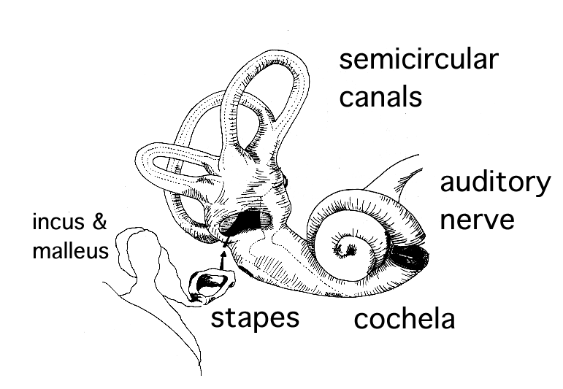
Benign Paroxysmal Positional Vertigo
Affects almost 1:10 older people, women twice as much as men
A range of symptoms:
Brief vertigo with certain head movements
Disequilibrium: ‘My balance is wrong.’
More prolonged dizziness can occur
A range of consequences:
Falls, fractures
Loss of independence
Very treatable!
cochlea
Notes:
[read slide]
Now it’s important to remember that ANY head movement makes most vestibular disorders worse. The most common form of BPPV causes vertigo when the head moves specifically in ONE direction [demonstrate]. So the typical history is brief vertigo when looking up, or stooping, lying flat or turning over in bed. By the way, if you move your head you have to move your neck. Neck problems such as ‘cervical spondylosis’ do not cause vertigo. ‘Vertebrobasilar insufficiency’ – originally a term to describe post circ TIAs – is not caused by neck extension. Please never diagnose these two conditions in people with vertigo. Please never prescribe a soft collar for a patient with vertigo!
This condition is so easy to test for and treat, you should have a low threshold for looking for it.

Slide 29
Migrainous vertigo (a.k.a. vestibular migraine)
…not the same as basilar migraine
Proposed criteria for migrainous vertigo:
Episodic vestibular symptoms
Migraine according to the IHS criteria
At least one of the following migrainous symptoms during at least two vertigo attacks:
Migrainous headache
Photophobia
Phonophobia
Visual or other auras
Other causes ruled out by appropriate investigations
Proposed criteria for probable migrainous vertigo:
Episodic vestibular symptoms of at least moderate severity
At least one of the following:
Migraine according to the HIS criteria
Migrainous symptoms during vertigo
Migraine-specific triggers of vertigo
Response to anti-migraine drugs
Other causes ruled out by appropriate investigations
Notes:
Even in older people, migraine as a cause of recurrent attacks of vertigo is more common than Meniere’s. Migraine changes with age. Migraine aura without headache can occur at any age and in people who never had a migraine headache. However, migraine aura without headache it is most common in older people, especially in those who had auras accompanied by migraine headaches when younger.
There is also an increased incidence of BPPV in migraine!
Migrainous vertigo is quite variable in its clinical presentation. It can present with recurrent attacks of spontaneous vertigo, or more of a disequilibrium-type of dizziness (more of that type of dizziness in a bit). Attacks of vertigo last anywhere from seconds to weeks! In the majority the vertigo lasts between a few hours and a few days. Only a minority of people have a headache accompanying their vertigo. So it’s really important to ask anyone with recurrent attacks of vertigo about a previous history of migraine or migraine-sounding headaches. During an acute attack of migrainous vertigo, any type of nystagmus can occur but in between attacks eye movements are normal.
As you know, migraine can be accompanied by focal neurological symptoms – a common one is word-finding difficulties. But we don’t have time to go in to that in more detail!
The treatment for migrainous vertigo is the same for migraine. I have found that an explanation and discussion around migraine triggers is often enough to reduce the severity and frequency of attacks. But many patients need prophylaxis, and some also need vestibular physiotherapy. These simple treatments can be life-changing.

Slide 30
Meniere’s Disease (a.k.a. idiopathic endolymphatic hydrops)
Clinical features
Prevalence 0.2-2 per 1000 people cf migrainous vertigo 10 per 1000 people
Recurrent attacks of vertigo with cochlear symptoms
Fluctuating then progressive hearing loss
Becomes bilateral in 40% of cases
40% also have BPPV
Investigations and treatment
Vestibular suppressants for acute attacks
Low salt diet, bendroflumethiazide, surgical options, ?regular betahistine
Refer ENT
Driving advice
www.tinnitus.org.uk
Notes:
In contrast, Meniere’s in uncommon and dizzy specialists say it is overdiagnosed in general practice. I am always suspicious of this diagnosis until I have heard the history for myself. Lots of older people have some hearing loss! The hallmarks of Meniere’s are recurrent attacks of vertigo with cochlear symptoms. A typical attack starts with a rushing tinnitus, and moments later the vertigo starts which lasts 20 mins to several hours, aggravated by any head movement. Vomiting is common during an attack, and diarrhoea can also occur. People are often unsteady for a day or two afterwards. In addition, some people with Meniere’s describe sudden falls “as if being pushed to the ground by some external force” but they can get up immediately and carry on. Meniere’s is accompanied by fluctuating then progressive hearing loss, so if you meet someone who has suffered attacks of recurrent vertigo over a few years without progressive hearing loss, it is probably not Meniere’s. Please note the increased incidence of BPPV in people with Meniere’s as well.
Patients should be referred to ENT as surgical treatments are available. And this is the ONLY dizzy disorder when someone might be on a long term vestibular suppressant. Otherwise NEVER prescribe long term vestib suppressants (eg betahistine, stemetil, cyclizine etc) for “dizziness” because a) they don’t work apart from to relieve symptoms in an acute attack, b) they impair central compensation – ie they stop you getting better – and c) they and can have other adverse effects in older people.

Slide 31
Other causes of recurrent attacks of vertigo
Symptom | No of patients
Visual (diplopia, field defects) | 29
Drop attacks | 14
Unsteadiness, inco-ordination | 9
Extremity weakness | 9
Confusion | 7
Headache | 6
Hearing loss | 6
Loss of consciousness* | 4
Extremity numbness | 4
Dysarthria | 4
Tinnitus | 4
Peri-oral numbness | 2
Do not diagnose TIAs in cases of recurrent attacks of vertigo and no other symptoms.
Grad A, Baloh RW. Vertigo of vascular origin: clinical and electronystagmographic features. Arch Neurol 1989; 46: 281-4
Notes:
Are TIAs a cause of recurrent attacks of vertigo alone? NO.
42 pts.
Typical post circ TIA is double vision and numbness of one side of face with vertigo …
(I saw a pt with vertigo, acute deafness and numbness one side of face – recurrent attacks. We started high dose aspirin. She acutely deteriorated with a basilar artery thrombosis).
However, sometimes it can be difficult to distinguish TIAs from migraine in older people (because of accompanying neurol symptoms) but as a rule of thumb, the more attacks you have had, the longer they have been going on, the less likely they are to be TIAs and more likely to be migraine. These people should be referred to a specialist though.

Slide 32
Any questions at this point?

Slide 33
Simplified dizzy tree
Lightheaded
Vertigo
Disequilibrium
Postural
1 OH
Unrelated to posture
1 Cardiac
2 Anxiety or stress
1 Uncompensated vestibular disorder
2 BPPV
3 MFDE
4 Neurological disorders
Single attack of prolonged vertigo
1 Vestibular neuritis
2 Stroke
Recurrent attacks
1 BPPV
2 Migraine
3 Meniere’s
Notes:
Now I cannot finish this talk without telling you about something very important – because you have all probably seen it but not know what it was: an uncompensated vestibular disorder. When a person gets an attack of vertigo of whatever cause it takes a few days – in some cases weeks – to get back to normal again. Once they emerge from their bed, people feel their balance is wrong at first, they get vertigo if they turn their head quickly in any direction, they get symptoms of “visual vertigo” – that means visually rich environments like traffic, supermarkets and checkerboard patterns, make them feel ill. They feel “as if they are walking on a ship”. But the majority get back to normal again. However, some people (because they have problems in other areas affecting central compensation or because they are unlucky) get “stuck” in this in-between phase.
The patient then goes to see their doctor and says something like this: I feel like my balance is wrong. I feel like I’m walking on a ship all the time, my head spins if I turn quickly, I can’t go to the supermarket, I can’t visit my sister in law because she has a vivid red and black striped carpet in her living room..” – and most doctors have no clue what to do. Patients have often suffered without help for years, and some of my patients have been referred to psychiatrists. Top tip – ask, 1) have you ever had a bad attack of vertigo? An uncompensated vestibular disorder can be dramatically improved by vestibular physiotherapy. Tailored physio-led programmes are more effective than home exercises. Nearly all hospital physio depts have someone who can do this.
I don’t have time to go in to the other causes, but briefly: migraine can cause symptoms of disequilibrium, and BPPV can present with just balance problems. Multi-factorial dizziness of the elderly is another common cause of a vague chronic dizziness with balance problems – the patient has problems with their vision, posture, proprioception, vestibular system, blood pressure, and often cerebrovascular disease. They are nearly always wearing bifocals. This is multi-factorial and treated with multi-factorial multi-disciplinary interventions.

Slide 34
How to take a history in dizziness
Tell me all about your dizziness …
‘Do you feel lightheaded, or are things moving as if you have just stepped off a roundabout?’
Symptoms associated with the dizziness?
Neurological
Migraine
Hearing/ears
Past medical history
Medication list
In recurrent dizziness: any triggers and whether completely back to normal between attacks
Notes:
So…by way of summary: try to figure out the PATTERN of dizziness. Just let the patient talk to start with. Being listened to is important in dizziness.
2. Is a validated question

Slide 35
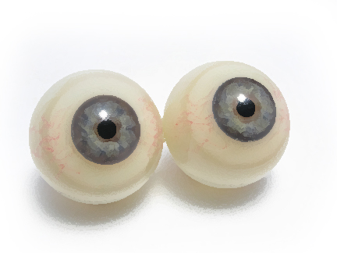
How to examine a patient with dizziness
Lying and standing BP, pulse
Watch the patient walk
Neurological examination including cranial nerves
Document eye movements!!
Spontaneous nystagmus
Gaze-evoked nystagmus
Pursuit
Head-thrust test
Positional nystagmus
Depending on the history, an audiological examination may be required
Notes:
Please note that I have said very little about tests – and that’s because (apart from brain imaging) specialist tests are rarely required.
Having a systematic method for examining these pts can be important – esp when you are not sure what is going on. A 55 year old man came to our AMU with a sudden inability to walk – his balance had gone that morning. It took two people to escort him along the corridor to the assessment room – he was all over the place. There was nothing else in the story, he had no PMH and did not suffer from migraine. His neurological examination was completely normal, including eye movements and a head thrust test. I was stumped. Until I remembered that you should always test for positional nystagmus in a case like this. [I don’t routinely test for positional nystagmus when I see a pt with a single prolonged episode of vertigo who has abnormal eye movements already that tell me what is going on – but otherwise you should always do it]. So I did a Hallpike Manoeuvre and it was strongly positive on the right side: classic delayed rotational nystagmus. I did an Epley Manoeuvre. When we finished, the patient sat up, looked around and said, “that feels better!”, hopped off the couch and walked normally back to his waiting relatives, whose jaws dropped at his transformation back to normal! So have a systematic approach to your history and examination.

Slide 36
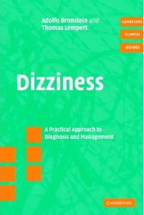
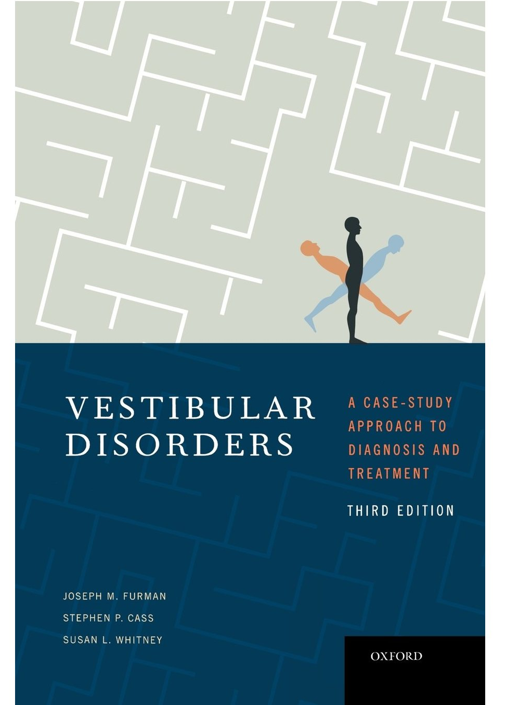
Further reading
Dizziness. A practical approach to diagnosis and management. Bronstein and Lempert (comes with videos on CD!)
Cambridge University Press, 2007
Vestibular Disorders. A case-study approach to diagnosis and treatment 3rd Ed. Furman, Cass and Whitney.
Oxford University Press, 2010
Notes:
Highly recommended books!

Slide 37
Any questions at this point?

Slide 38
Summary of Guidelines and MCQs
Notes:
No NICE guideline for dizziness, there is an RCP London publication (2007) setting out standards for services for people with hearing and balance problems, but nothing else.

