Slide 1
Case 1: First tonic-clonic seizure

Slide 2
Seizures and epilepsy
T-C seizure
Due to acute illness
Provoked
Single unprovoked
Part of epilepsy
(?unrecognised)
Generalised epilepsy
Idiopathic
Young people with normal brains
Focal epilepsy
Symptomatic
Structural brain abnormality (not always demonstrable)
Any age; elderly
Notes:
In adults.
Seizures account for 3% ED attendances and 1% hospital admissions.
T-C seizures often start without warning, often there is an initial cry followed by loss of tone and a fall, then a phase of tonic rigidity followed by regular rythmic shaking of all limbs/trunk/face. Lateral tongue biting, cyanosis, eyes open and duration 1-2 mins are typical features. Post-ictal confusion is usually longer than 10 mins (disorientation, poor concentration and short term memory).
T-C seizures can be the result of an acute illness: brain injury/infection, metabolic problems. They can be provoked e.g. by commonly prescribed meds and alcohol. Or they can be unprovoked.
If unprovoked first T-C seizure (with no other prev other seizure types) in neurological normal pts with normal EEG/MRI then only 1:3 will have another seizure, recurrent seizures are more likely in the first 3-6 months. These people are usually not offered treatment unless there are individual extenuating factors (e.g. need to return to driving asap).
If unprovoked first T-C seizure (with no other prev seizure types) but neurologically abnormal (e.g. learning disabil/prev brain injury) or abormal EEG/MRI then 3:4 will have another seizure and these people are usually offered treatment.
In pts with low risk of recurrence, early treatment reduces risk of further seizures but not long term prognosis or mortality.
However – in half of people with a “first fit” it is not their first fit at all, they have had previous episodes not recognised to be seizures, and non-specialists tend not to ask about these.
So let’s talk about the two main types of epilepsy, and seizure types within these.
Idiopathic generalised epilepsy: T-C seizures, absences, myoclonic jerks (juvenile myoclonic epilepsy – the most common form of idiopathic gen epilepsy).
‘Symptomatic’ focal epilepsy: T-C seizures and partial seizures (‘simple’ or ‘complex’). Most common.
Discuss clinical presentation of these different seizure types …
(For the purposes of this discussion we will exclude those people with severe epilepsy/learning disability and not discuss atonic/tonic seizures).

Slide 3
4 key questions to ask
Was this a seizure?
Were there any obvious provoking factors?
Is there evidence of unrecognised epilepsy?
What is the patient’s job and driving status?

Slide 4
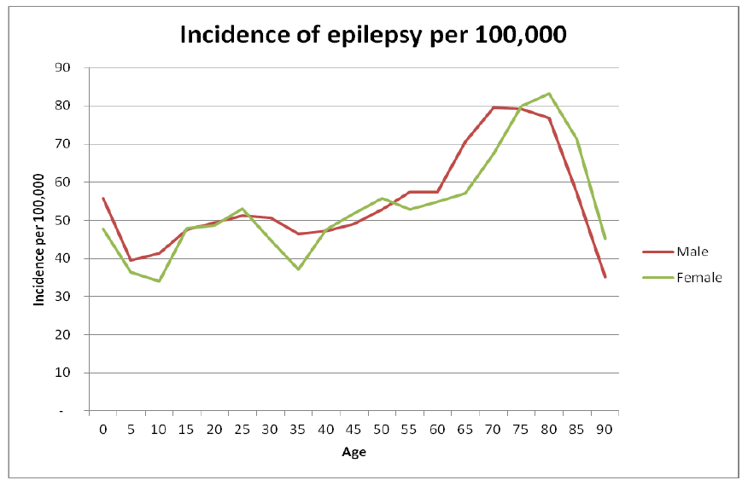
Notes:
UK figures.
Most important to note: the most common time of life to start having epilepsy is in old age (most people are not aware of this).
Mainly due to cerebrovascular disease and dementias.

Slide 5
Summary of NICE guideline: general
All adults with a new suspected seizure should be screened first by a physician then referred to a specialist and seen within 2 weeks
Good communication, including written communication, is vital
A specialist is ‘a doctor with expertise and training in epilepsy’
The diagnosis of epilepsy in adults should be established by a specialist
When NEAD is suspected, patients should be referred to psychology/psychiatry services
AED treatment needs to be tailored to type of seizures and type of patient
Women must be given information about contraception, pregnancy, breast-feeding etc.
All patients with epilepsy should have a regular structured review
If seizures are not controlled, or there is diagnostic uncertainty, patients should be referred to a specialist centre ‘soon’ for further assessment
Notes:
Regular structured review should be at least annually

Slide 6
Summary of NICE guideline: investigations
An EEG should be performed only in patients where the history suggests an epileptic seizure – EEG is not diagnostic and should not be used to ‘rule out’ epilepsy
An EEG should be performed ‘soon’ (within 4 weeks)
MRI is the imaging of choice in epilepsy and should be performed ‘soon’
Imaging is not routinely required when a diagnosis of idiopathic generalised epilepsy has been made
CT can be used acutely to determine whether a seizure has been caused by an acute neurological problem
A 12-lead ECG should be performed in all patients with suspected epilepsy
Serum prolactin measurement is not recommended
Epileptic seizures should be classified using a) a description of the seizure, b) seizure type, and c) aetiology or syndrome.

Slide 7
Summary of NICE guideline: treatment (brief summary for non-specialists)
Focal seizures
Carbemazepine or Lamotrigine as first-line
Leveteracitam is not considered cost-effective (2011 analysis)
Leveteracitam, oxcarbazepine, sodium valproate second-line
Be aware of the teratogenic risks of sodium valproate
(Other drugs in refractory seizures should be prescribed by a tertiary epilepsy specialist)
T-C seizures
Sodium valproate first-line
Be aware of the teratogenic risks of sodium valproate
Offer Lamotrigine if sodium valproate not suitable, but be aware this can exacerbate myoclonic seizures in JME
(Leveteracitam may be used for myoclonic seizures)
Lamotrigine, Leveteracitam, Topiramate second-line
Notes:
The actual NICE guideline on treatment is extremely long and detailed and goes in to lots of different seizure types and syndromes! This is a brief summary for non-specialists …
*AED therapy should be considered and discussed with children, young people and adults and their family and/or carers as appropriate after a first unprovoked seizure if:
- the child, young person or adult has a neurological deficit
- the EEG shows unequivocal epileptic activity
- the child, young person or adult and/or their family and/or carers consider the risk of having a further seizure unacceptable
brain imaging shows a structural abnormality. [2004]
It should be recognised that some children, young people and adults (through their families and/or carers, in some instances) may choose not to take AED therapy following a full discussion of the risks and benefits.

Slide 8
Summary of NICE guideline: treatment (brief summary for non-specialists)
When would you treat after a first tonic-clonic seizure?
The person has a neurological deficit
Brain imaging shows a structural abnormality
The EEG shows unequivocal epileptic activity (?)
The person/carers consider the risk of having a further seizure unacceptable

Slide 9
Case 2: Single episode of prolonged vertigo

Slide 10
Single attack of prolonged vertigo: red flags
Focal neurological symptoms or signs at any time
Headache
Acute hearing loss
Abnormal eye movements not consistent with acute unilateral vestibular failure
Notes:
If a patient with a single attack of prolonged vertigo has any of these red flags then you must assume their vertigo is central.
[read red flags]
Example: man with vertigo/balance problems but numb left arm 10 mins diagnosed as VN = pontine infarct.
Now the knowledgeable ones among you will know that acute hearing loss and headache are both features of migraine, but NEVER diagnose migraine in an older person presenting for the first time with a single episode of prolonged vertigo.
Reasons are: still need to meet IHS criteria; 10-34% of all stroke pts experience headaches around the time of their stroke – more common in post circ stroke. And some types of post circ strokes eg thalamus also cause “visual spectra” and odd sensory symptoms that may cause non-experts to confidently assume is due to migraine. I have seen registrars confidently diagnose migraine in these situations because they did not know what they did not know.
Yes it is possible that you might come across a first episode of migrainous vertigo – but always investigate (MR scan is the investigation of choice) and consult a specialist.

Slide 11
Peripheral vs central nystagmus
Horizontal (with a torsional component)
Fast component away from the affected side
Does not change direction with direction of gaze
Inhibited by fixation
Fades after a few days
Vertical, horizontal or torsional
Fast component towards the affected side
May change direction with direction of gaze
Not inhibited by fixation
Lasts weeks or months
Notes:
People SAY that not being able to mobilise points to a central cause of vertigo, but older people can decompensate easier with a peripheral problem, and young people can compensate better with a central problem, so I don’t think this should be a “rule” – take all the features in to account!

Slide 12
https://youtu.be/1q-VTKPweuk
The HINTS examination

Slide 13
Case 4: Severe headache

Slide 14
Primary
headache
Secondary headache
Painful cranial neuropathies
Migraine
(and its many subtypes!)
TTH
TACS*
e.g. cluster headache
Other primary headaches
e.g. 1º cough
1º thunderclap
1º exercise
Head trauma
Vascular
e.g. ICH
SAH
Giant cell arteritis
RVCS*
Non-vascular
e.g. intracranial hypertension
intracranial hypotension
Infection
5 other categories (not listed)
e.g. TGN
Notes:
*TACS=Trigeminal autonomic cephalalgias (NOT the same as TGN), e.g.
Cluster headache
Paroxysmal hemicrania
Short-lasting unliateral neuralgiform headache attacks (SUNCT)
*RVCS=Reversible vasoconstriction syndrome
The other categories are: headache due to a substance or its withdrawal (incl medication overuse headache but also many other diagnoses!); headache due to a disorder of homeostasis (e.g. high altitude, OSA, fasting!); headache due to disorders of the eyes, ears, neck etc; headache due to psychiatric disorder; and “other” (not classifiable/unspecified).
*TGN=trigeminal neuralgia
There is also occiptal neuralgia, glossopharyngeal neuralgia, and many others in this category!

Slide 15
Cluster headache
Description:
Attacks of severe, strictly unilateral pain which is orbital, supraorbital, temporal or in any combination of these sites, lasting 15–180 minutes and occurring from once every other day to eight times a day. The pain is associated with ipsilateral conjunctival injection, lacrimation, nasal congestion, rhinorrhoea, forehead and facial sweating, miosis, ptosis and/or eyelid oedema, and/or with restlessness or agitation.
Notes:
Diagnostic criteria is as per this description.
A. At least five attacks fulfilling criteria B–D
B. Severe or very severe unilateral orbital, supraorbital and/or temporal pain lasting 15–180 minutes (when untreated)
C. Either or both of the following:
1. at least one of the following symptoms or signs, ipsilateral to the headache:
a) conjunctival injection and/or lacrimation
b) nasal congestion and/or rhinorrhoea
c) eyelid oedema
d) forehead and facial sweating
e) forehead and facial flushing
f) sensation of fullness in the ear
g) miosis and/or ptosis
2. a sense of restlessness or agitation
D. Attacks have a frequency between one every other day and eight per day for more than half of the time when the disorder is active.

Slide 16
Treatment for cluster headache (NICE)
Acute treatment
Oxygen (>12L RB) and nasal or SC tryptan
+/- metoclopramide or prochlorperazine
Do not use oral tryptans, paracetamol, NSAIDs opioids or ergots in acute cluster headache
Prophylactic treatment
Verapamil

Slide 17
Case 8: Fall due to dizziness

Slide 18
Facts n figures
Diagnosis of vertigo in the Emergency Department (by neuro-otologists)
Diagnosis | % of cases
BPPV Vestibular neuritis Migrainous vertigo Anxiety Stroke Pre-syncope | 31 28 12 11 4 4
Cutfield NJ, Seemungal BM, Millington H, Bronstein AM. Diagnosis of acute vertigo in the Emergency Department. Emerg Med J 2011; 28: 538-9
Notes:
In the ED (altho these are patients were assessed by neuro-otologists!) there is a similar pattern, with BPPV the most common, followed by vesibular neuritis then migrainous vertigo then others. Stroke is an uncommon but important-not-to-miss cause of isolated vertigo.

Slide 19
Simplified dizzy tree
Lightheaded
Vertigo
Disequilibrium
Postural
1 OH
Unrelated to posture
1 Cardiac
2 Anxiety or stress
1 Uncompensated vestibular disorder
2 BPPV
3 MFDE
4 Neurological disorders
Single attack of prolonged vertigo
1 Vestibular neuritis
2 Stroke
Recurrent attacks
1 BPPV
2 Migraine
3 Meniere’s
Notes:
There are 3 basic types of dizziness: lightheaded, vertigo (which refers to a sensation of movement) and “disequilibrium” – a sort of vague chronic dizziness and balance problem.
Your first task is to figure out what type of dizziness the patient is describing.
Once you have done this, you can narrow things down with further history, clinical examination and – sometimes – investigations.
We’re going to go through this in more detail in a minute, but a few things to note about this diagram: 1) there are lots more diagnoses in these categories but we’re only going to cover the common ones; 2) we’re not going to cover general medical causes of dizziness; and 3) vertigo here means vertigo ALONE – with no other neurological symptoms.
I’m not going to say anything about light-headedness, because we are most familiar with this type of dizziness and I want to focus on vertigo.

Slide 20
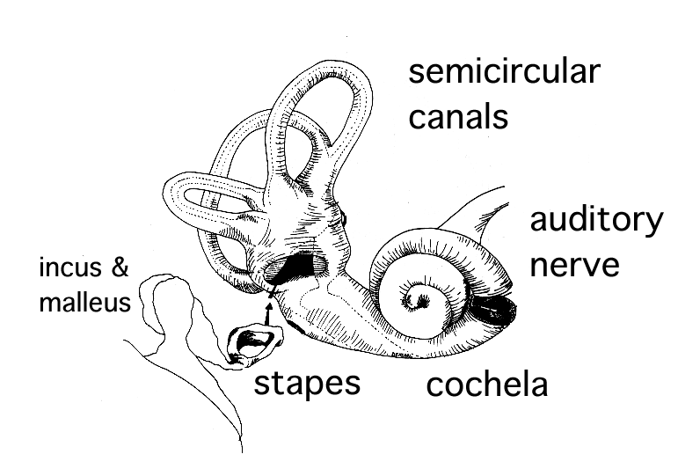
Benign Paroxysmal Positional Vertigo
Affects almost 1:10 older people, women twice as much as men
A range of symptoms:
Brief vertigo with certain head movements
Disequilibrium: ‘My balance is wrong.’
More prolonged dizziness can occur
A range of consequences:
Falls, fractures
Loss of independence
Very treatable!
cochlea
Notes:
[read slide]
Now it’s important to remember that ANY head movement makes most vestibular disorders worse. The most common form of BPPV causes vertigo when the head moves specifically in ONE direction [demonstrate]. So the typical history is brief vertigo when looking up, or stooping, lying flat or turning over in bed. By the way, if you move your head you have to move your neck. Neck problems such as ‘cervical spondylosis’ do not cause vertigo. ‘Vertebrobasilar insufficiency’ – originally a term to describe post circ TIAs – is not caused by neck extension. Please never diagnose these two conditions in people with vertigo. Please never prescribe a soft collar for a patient with vertigo!
This condition is so easy to test for and treat, you should have a low threshold for looking for it.

Slide 21
BPPV: diagnosis and treatment
Patients have a normal neurological exam
They have delayed, rotatory, fatigueable nystagmus during the Dix-Hallpike maneouvre on the affected side
Don’t diagnose BPPV if the above criteria are not met
Treatment is the Epley maneouvre
Cure in 9/10 cases

Slide 22
Case 9: Transient speech disturbance

Slide 23
Diagnosis of TIA
Stroke symptoms and signs that resolve within 24 hours
Sudden, focal, neurological deficit
There are 4 key questions to consider:
Was it sudden? (symptoms usually maximal at onset)
Was it a focal neurological deficit?
Has it resolved … completely?
Was there impaired consciousness?
If the answer to 1-3 is YES then TIA is likely. If the answer to 4 is YES then consider alternative diagnoses
If the patient is not completely back to normal when seen then treat as stroke

Slide 24
TIA/stroke checklist
R or L handed
Driver
BP
Heart sounds
Carotid bruits (if relevant)
12-lead ECG/history of palpitations
Cholesterol
Glucose/HbA1c
CRP/ESR
Other …

Slide 25
Which arterial territory?
Anterior (carotid) circulation | Posterior circulation
Cortical dysfunction (ie aphasia, sensory or visual inattention, hemianopia) Monocular blindness Unilateral weakness Unilateral sensory disturbance Dysarthria* Neuromuscular dysphagia* | Cranial nerve palsy Ataxia/inco-ordination Diplopia Isolated homonymous hemianopia Bilateral visual loss Unilateral/bilateral weakness Unilateral/bilateral sensory disturbance Dysarthria* Neuromuscular dysphagia*
*Less likely to be TIA/stroke if symptoms in isolation.

Slide 26
Case 10: Acute confusion

Slide 27
Transient global amnesia
Formerly thought to be related to migraine, TIA or epilepsy
Most likely caused by transient venous congestion leading to ischaemia in the hippocampus and other mesiotemporal brain structures associated with creating and storing memories
Caused by Valsalva-like maneouvres
Associated with physical exertion, swimming, sexual intercourse, use of marijuana and Viagra
Greatest risk factor is a history of migraines
Good prognosis, and small risk of recurrence

Slide 28
Transient global amnesia
Patients are often wrongly described as ‘confused’
Abrupt onset of severe anterograde amnesia
i.e. inability to form new memories
Hence, often accompanied by repetitive questioning, and disorientated in time and place
Everything else is preserved: memory relating to personal details, higher cortical functions, long term memory
Retrograde amnesia often present (variable duration)
Attacks last 1-8 h
Afterwards, rapid return of anterograde memory, with retrograde memory slower to return, most recent memories returning last
Notes:
Patients will never be able to recall the attack itself – they are left with a “gap” of variable duration.

Slide 29
‘Seeing a healthy person become incapable of remembering what was said only a minute ago is very distressing, and hence it is often the relatives who require reassurance.’
Harrison M & Williams M. The diagnosis and management of transient global amnesia in the Emergency Department. Emerg Med J 2007; 24(6): 444-45.

Slide 30
Diagnostic criteria for TGA
Attack was witnessed and reported
Obvious anterograde amnesia during the attack
No clouding of consciousness
No focal neurological symptoms or signs
No features of epilepsy
Attack resolved within 24 h
No recent head injury or active epilepsy
Hodge & Warlow, 1990

Slide 31
What three things have you learned this morning?

